Slide 1
Noise2Void - Learning Denoising from Single Noisy Images
CVPR 2019

Slide 2
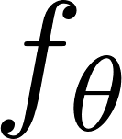
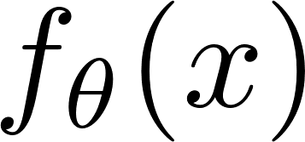
Traditional denoising model
Noisy images
Denoiser
Denoised images
Clean images
loss
By the property of L2 loss, minimizing MSE loss will make be the average of clean images y conditional on x, which results in blurriness problem

Slide 3
Noise2Noise
Noisy images
Denoiser
Denoised images
New noisy images
loss
However, this property of L2 loss also ensures that, adding some zero-mean noise to clean images will not change the optimization goal
Therefore we can train the network to transfer noise to noise, while achieving the same
result as noise2clean
Note that two group noisy images must have the same content and independent noise
what if we don’t have these new independent noisy images?

Slide 4
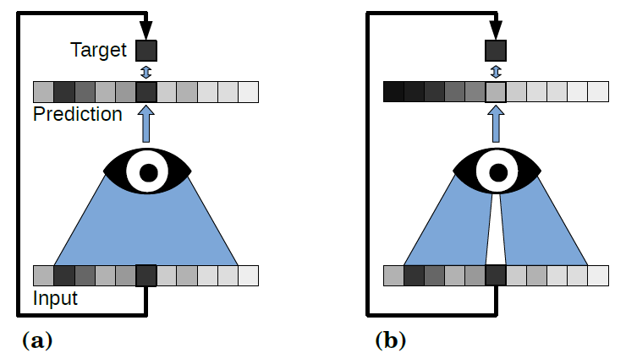
Noise2Void
If we don’t have new noisy images, we can only set the input image as training target. But the network will learn the identity function by simply picking the center pixel from its receptive field
Now we remove the center pixel from the receptive field
Assuming noises in different pixels are independent, then the input-output- independence is satisfied again!

Slide 5
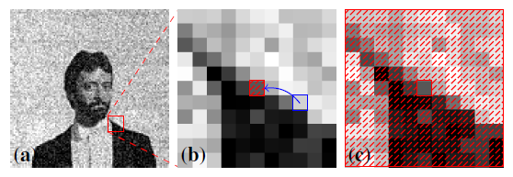
Implementation Details
The noisy image
The receptive field of a pixel. During N2V training, a randomly selected pixel is chosen (blue rectangle) and its intensity copied over to create a blind-spot
The modified patch is used as input and unmodified pixel value is used as target
In practice, we crop patches larger than the receptive field and randomly select several blind-spot to modify and calculate the loss.

Slide 6
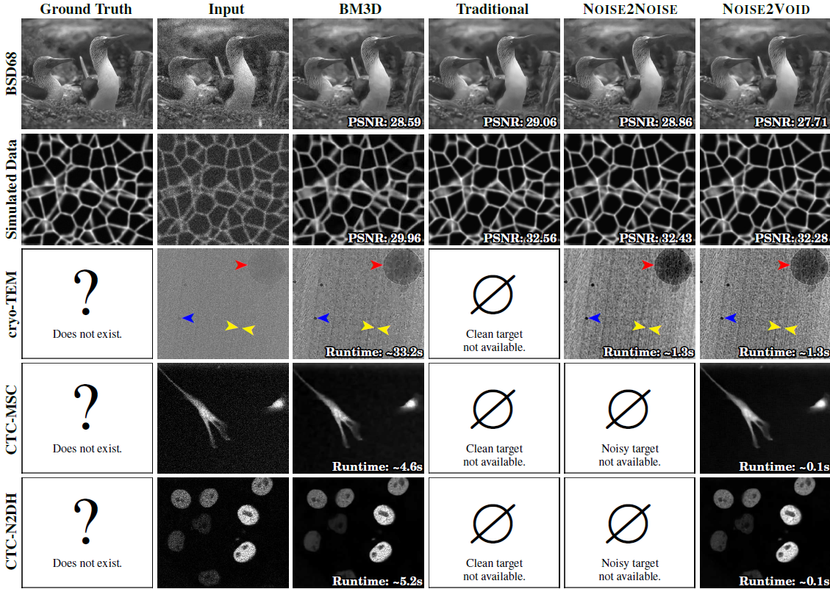
Experiments

Slide 7
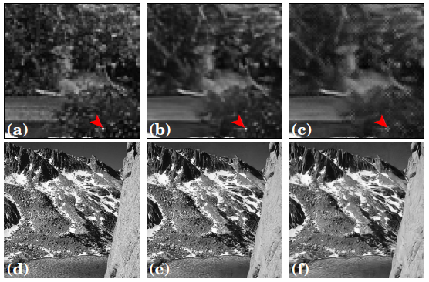
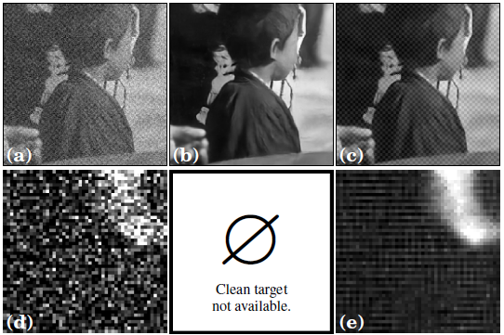
Errors and Limitations

Slide 8
Comments
Pros
interesting and novel idea
can be used when clean images are unavailable
Cons
too strong assumptions
cannot evaluate performance

