Slide 1
Quantifying Visual Image Quality: A Bayesian View
Zhengfang Duanmu, Wentao Liu, ZhonglingWang, ZhouWang
University of Waterloo
Preprint: Article in Annual Review of Vision Science
Notes:
期刊：心理学、神经科学、计算机科学、细胞生物学和遗传学以及临床医学

Slide 2
Overview
Motivation
Bayesian View of Image Quality Assessment
Full-Reference Image Quality Assessment
No-Reference Image Quality Assessment
Conclusion and Open Problems

Slide 3
1 Motivation-Challenges in fundamental of IQA
a well-structured problem formulation is missing to understand the connections between IQA models
many assumptions in algorithms are implicit, making it hard to fairly evaluate hypotheses and recognize their limitations
many methods fail to draw a connection to vision science

Slide 4
2 Bayesian View of Image Quality Assessment
$x$: an image
$y$: subjective quality rating
$p(y|x)$: quality probability distribution -> objective
Method 1: solved by Bayes’ theorem
prior label probabilities $p(y)$
quality level-conditional densities $p(x|y)$
it is possible to generate synthetic data points in the input space
drawback: the lack of training data and effective learning methods
method 1:
generative models

Slide 5
2 Bayesian View of Image Quality Assessment
$x$: an image
$y$: subjective quality rating
$p(y|x)$:probability distribution
Method 1:
Method 2: determine 𝑝(𝑦|𝑥) without modeling image space
training data $D$: input image $X=(x_{1},…x_{n}),$target quality scores $y=(y_{1},…, y_{n})$
posterior quality distribution $p(y|x;D)$
-> a point estimate of 𝑝(𝑦|𝑥)
𝑝(𝑦|𝑥)$=\int{p(y|x;D)p(D)dD}$
the predictive distribution can be parametrized as
parameters of the HVS(Human Vision System) model
point estimate: $p(y|x,D)≈p(y|x,θ^{∗})$, where
Proof: $θ^{∗}=\underset{θ}{argmax}{p\left(θ | D\right)=\underset{θ}{argmax}}p\left(θ | X,y\right)=\underset{θ}{argmax}\frac{p\left(θ,X,y\right)}{p(X,y)}=\underset{θ}{argmax} p\left(θ,X,y\right)= \underset{θ}{argmax} p\left(y | X,θ\right)p\left(θ\right)p\left(X\right) =\underset{θ}{argmax} p\left(y | X,θ\right)p\left(θ\right)$
Notes:
方法二：无需建模图像空间 点估计：sample all possible data $D$ $p\left(θ | D\right)：$参数的后验概率

Slide 6
2 Bayesian View of Image Quality Assessment
$x$: an image
$y$: subjective quality rating
$p(y|x)$:probability distribution
$θ$: parameters of HVS
Keypoint of method 2: estimate $θ^{∗}(=\underset{θ}{argmax}{p\left(y | X,θ\right)p\left(θ\right)})$
$p(y|X,θ)$ is unknown in practice, usually assume
Direct estimation$θ^{∗}$from a set of training data is problematic
sparsity of samples: a few thousands of samples are deemed to be extremely sparsely distributed in image space (i.e. 512*512*256=67,108,864)
mean and variance of the Gaussian distribution
the fundamental problem in the objective IQA: develop a meaningful $p(θ)$
encodes the configuration of the HVS
Notes:
$p(θ)$:prior parameter distribution

Slide 7
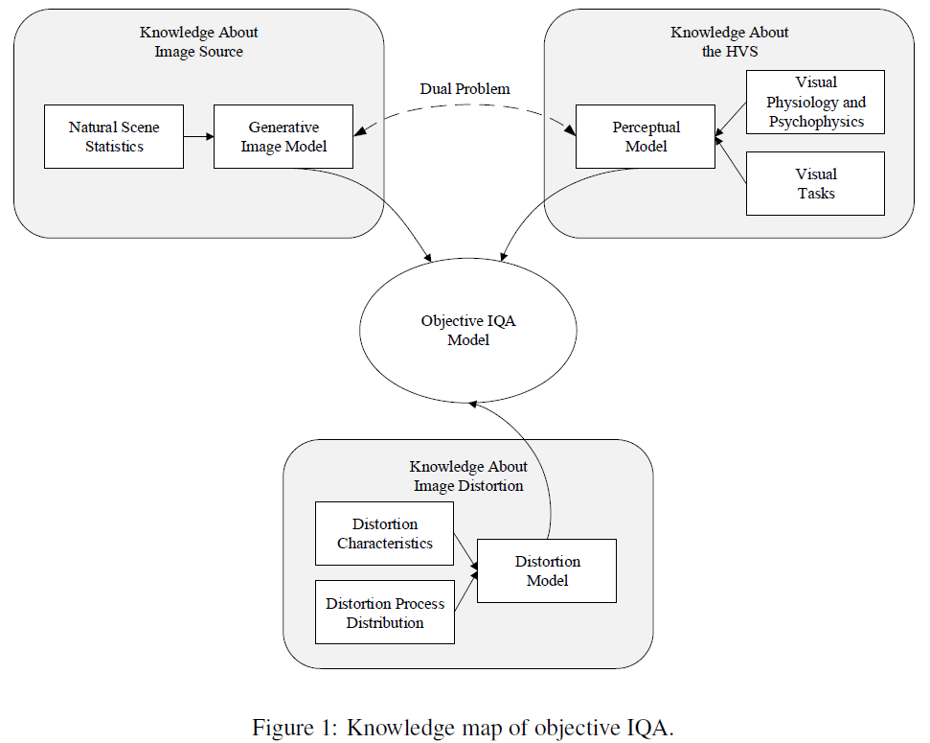
2 Bayesian View of Image Quality Assessment
Notes:
image source: summarizes what natural images should, or should not, look like.

Slide 8
3 Full-Reference Image Quality Assessment
$x_{t}:$a distorted image
$x_{r}:$the pristine image
$y$: subjective quality rating
$θ$: parameters of HVS
objective: $p(y|x_{t},x_{r}, θ)$
assuming the quality label generation process follows a Gaussian distribution:
reduce to finding a deterministic perceptual similarity measure $d(x_{t},x_{r};θ)$
Generalized similarity
for example,
-> neglecting the knowledge about natural images, distortion processes, and the HVS
Notes:
y|d是一个整体

Slide 9
3 Full-Reference Image Quality Assessment
$x_{t}:$a distorted image
$x_{r}:$the reference image
$y$: subjective quality rating
$θ$: parameters of HVS
3.1 Error Visibility Paradigm
compute the numerical errors $e$ between $x_{r}$and $x_{t}$
predict image quality as the visibility of $e$ based on models of the HVS
Limitations
the stimuli used in the psychophysical experiments are much simpler than natural images
not every error signal leads to quality degradation (i.e. Contrast enhancement)
Notes:
Channel Decomposition：localized, band-pass, and oriented linear filters
Error Normalization: takes into account the effects of luminance masking and contrast masking

Slide 10
3 Full-Reference Image Quality Assessment
$x_{t}:$a distorted image
$x_{r}:$the reference image
$y$: subjective quality rating
$θ$: parameters of HVS
3.2 Structural Similarity Paradigm
Assumption
HVS is highly adapted to extract structural information
a measurement of structural similarity approximates to perceptual image quality
structural similarity + nonstructural similarity
SSIM
luminance: use mean intensity $μ_{x_{t}}$ and $μ_{x_{t}}$
contrast: use standard deviation $σ_{x_{t}}$ and $σ_{x_{r}}$
structure: use the normalized signals $\frac{x_{t}−μ_{x_{t}}}{σ_{x_{t}}}$and $\frac{x_{r}−μ_{x_{r}}}{σ_{x_{r}}}$
SSIM and its variations perform somewhat surprisingly well in various IQA tests
the definition of structural/non-structural distortions is not unique
Notes:
这里是越接近1（越大），则越相似

Slide 11
3 Full-Reference Image Quality Assessment
$x_{t}:$a distorted image
$x_{r}:$the reference image
$y$: subjective quality rating
$θ$: parameters of HVS
3.3 Task-oriented Feature Learning Methods
Assumption
the HVS are associated with more well-defined auxiliary tasks (i.e. image recognition and semantic segmentation)
${\overset{ˆ}{x}}_{j1},…,{\overset{ˆ}{x}}_{j\overset{ˆ}{N}}$: samples in task $𝒯_{j}$
$ψ_{j}$: task specific parameters
$$p(\overset{ˆ}{X}|θ)=\prod_{j}{ }\left(\int{ }p\left({\overset{ˆ}{x}}_{j1},…,{\overset{ˆ}{x}}_{j\overset{ˆ}{N}}∣ψ_{j}\right)p\left(ψ_{j}|θ\right)dψ_{j}\right)$$
point estimate: $θ^{∗}=\underset{θ}{argmax}{p(\overset{ˆ}{X}|θ)}$
$d_{\text{Task} }\left(x_{t},x_{r};θ\right)=d_{W}\left(h\left(x_{t};θ\right),h\left(x_{r};θ\right)\right)$
$h\left(x_{t};θ\right)$, $h\left(x_{r};θ\right)$: feature representations of $x_{t}$ and $x_{r}$ computed by the task-oriented function
$d_{W}(⋅,⋅)$: a certain distance measure in the feature domain (Euclidean distance, multi-scale SSIM, learned by CNN, etc.)
-> potential to change the landscape of the field of IQA
Notes:
$p\left(\overset{ˆ}{X} | θ\right):$ the marginal likelihood function 格局

Slide 12
3 Full-Reference Image Quality Assessment
$x_{t}:$a distorted image
$x_{r}:$the reference image
$y$: subjective quality rating
$θ$: parameters of HVS
3.4 Information Theoretic Paradigm
Assumption
each $x_{t}$ comes from a probability distribution $q(x_{t})$
use of information theoretic distances as perceptual similarity
$p\left(x_{r};θ_{1}\right)$: natural image distribution
$q\left(x_{t};θ_{2}\right)$: distorted image distribution
$d_{\text{INFO} }\left(p\left(x_{r};θ_{1}\right),q\left(x_{t};θ_{2}\right);θ_{3}\right)$
use a stack of sub-images within $x_{t}$ and $x_{r}$
Limitation
the independent and identically distributed assumption barely holds
the image quality y is independent of the distortion process
Notes:
neighboring spatial locations are strongly correlated in intensity

Slide 13
3 Full-Reference Image Quality Assessment
$x_{t}:$a distorted image
$x_{r}:$the reference image
$y$: subjective quality rating
$θ$: parameters of HVS
3.5 Fusion-based Methods
“mixture of experts” : use existing methods
each image has an unknown class $z$
$p\left(y|x_{t},x_{r},θ\right)=\sum_{k=1}^{l}{ }p\left(y|x_{t},x_{r},z=k,{\left\{θ_{k}\right\}}_{k=1}^{l}\right)p\left(z=k|x_{t},x_{r},{\left\{θ_{k}\right\}}_{k=1}^{l}\right)$
assume $p\left(z=k|x_{t},x_{r},{\left\{θ_{k}\right\}}_{k=1}^{l}\right)$= $p\left(z=k|{\left\{θ_{k}\right\}}_{k=1}^{l}\right)$
$p\left(z=k|{\left\{θ_{k}\right\}}_{k=1}^{l}\right)$ can be determined empirically or learnt from data
$k$ -th base IQA model
weight of k-th predictions
Notes:
due to the lack of training data, early researches

Slide 14
4 No-Reference Image Quality Assessment
$x_{t}:$a distorted image
$x_{r}:$the reference image
$y$: subjective quality rating
$θ$: parameters of HVS
4.1 Empirical Statistical Modeling Approach
an image appearing more frequently in the natural world would have better visual quality
one needs to state which environment shapes the HVS (consider $p(θ)$)
consider $θ$ by estimating the probability density function of test images $p(x_{t}|θ)$
Dimension Reduction
the cluster of typical natural images may be represented by a low-dimensional manifold
$p_{X}\left(x_{t};θ\right)=\int{p\left(x_{t}|z;θ_{1}\right)p\left(z;θ_{2}\right)dz }$
$z:$a low dimensional latent variable
$θ=\left\{θ_{1},θ_{2}\right\}$
NIQE $:p\left(x_{t}|z;θ_{1}\right)$ is modeled by an Asymmetric Generalized Gaussian distribution , and assume that the latent variable $z$ follows a multi-variate Gaussian distribution.

Slide 15
4 No-Reference Image Quality Assessment
$x_{t}:$a distorted image
$y$: subjective quality rating
$θ$: parameters of HVS
Limitation of
overly simplistic: not enough for descriptions of the probability distribution of natural images
Patch-based Density Estimation
learn the probability density function of low-dimensional sub-images
assume that the image patches are independent and identical samples of $p(x_{t}|θ)$
make over-simplified empirical assumptions about the image density
a significant improvement over the traditional approaches without relying on excessive assumptions
Notes:
过于简单化：对自然图像的概率分布的描述不够充分

Slide 16
4 No-Reference Image Quality Assessment
$x_{t}:$a distorted image
$y$: subjective quality rating
$θ$: parameters of HVS
4.2 Fidelity Model Distillation Approach
directly learn the prior distribution from FR IQA models
Learning from Synthetic Quality Labels
$X_{r}=\left(x_{r,1},…,x_{r,n}\right)$: a dataset of $n$ pristine images
$X_{t}=\left(x_{t,1},…,x_{t,n}\right)$, where $x_{t,i}=g\left(x_{r,i};φ\right)$: synthetically distorted images
$g(⋅;φ)$: a distortion simulator
$d\left(x_{t},x_{r}\right)$: a FR IQA model
${\overset{ˆ}{y}}_{i}=d\left(x_{t,i},x_{r,i}\right)$: synthetic quality score
estimation of $θ$: maximizes the likelihood function $p\left(X_{t},\overset{ˆ}{y}∣θ\right)$
yield high correlation with human opinion scores on the standard distorted images whose distortion process can be faithfully simulated
the robustness heavily relies on the diversity and quality of $g(⋅;φ)$

Slide 17
4 No-Reference Image Quality Assessment
$x_{t}:$a distorted image
$y$: subjective quality rating
$θ$: parameters of HVS
Learning to Rank
learn from the relations among the training images
in a pair of images $\left(x_{t,i},x_{t,j}\right):r_{ij}=1 \text{if} {\overset{ˆ}{y}}_{i}>{\overset{ˆ}{y}}_{j} \text{and} r_{ij}=0 \text{otherwise}$
estimation of 𝜃: maximize the likelihood function $p\left(\left\{x_{t,i},x_{t,j},r_{ij}\right\}|θ\right)=\prod_{⟨i,j⟩}{ }p\left(r_{ij}|x_{t,i},x_{t,j},θ\right)$
Limitation of 4.2
their performance is upper-bounded by that of FR IQA models

Slide 18
4 No-Reference Image Quality Assessment
$x_{t}:$a distorted image
$y$: subjective quality rating
$θ$: parameters of HVS
4.3 Transfer Learning Approach
like 3.3 Task-oriented Feature Learning Methods
Method 1: freeze the convolutional layers optimized for an auxiliary task, and only retrain the fully connected layers at the top
Method 2:the convolutional layers may be initialized with the auxiliary task-optimized parameters, and are fine-tuned by subject-rated images
used auxiliary task: image recognition, image restoration, distortion identification
not easily extended for authentically distorted images
Notes:
because there is no well-defined categorization of real-world image distortions

Slide 19
4 No-Reference Image Quality Assessment
$x_{t}:$a distorted image
$y$: subjective quality rating
$θ$: parameters of HVS
Discussion of NR-IQA
The Knowledge about Distortion
the visual systems are capable of judging image quality independent of the knowledge about distortion
The Data Challenge
sparsity of samples
fatigue effect
representative of images
alignment of dataset
The Fair Comparison Challenge
It remains unclear whether the performance gain comes from a more representative dataset, a more powerful model, an advanced machine learning technique, or the superiority of the proposed hypothesis
Notes:
1 the development of universal distortion model is extremely challenging, because of the constantly evolving distortion process distribution
a naïve subject can consistently assess image quality without access to the underlying distortion process
2 are deemed to be extremely sparsely distributed in the image space
3 the subject-rated images in the existing IQA databases may not be representative of the real-world distorted images
4 the consistency of subjective image quality among IQA databases is only moderate due to drastically different experimental conditions

Slide 20
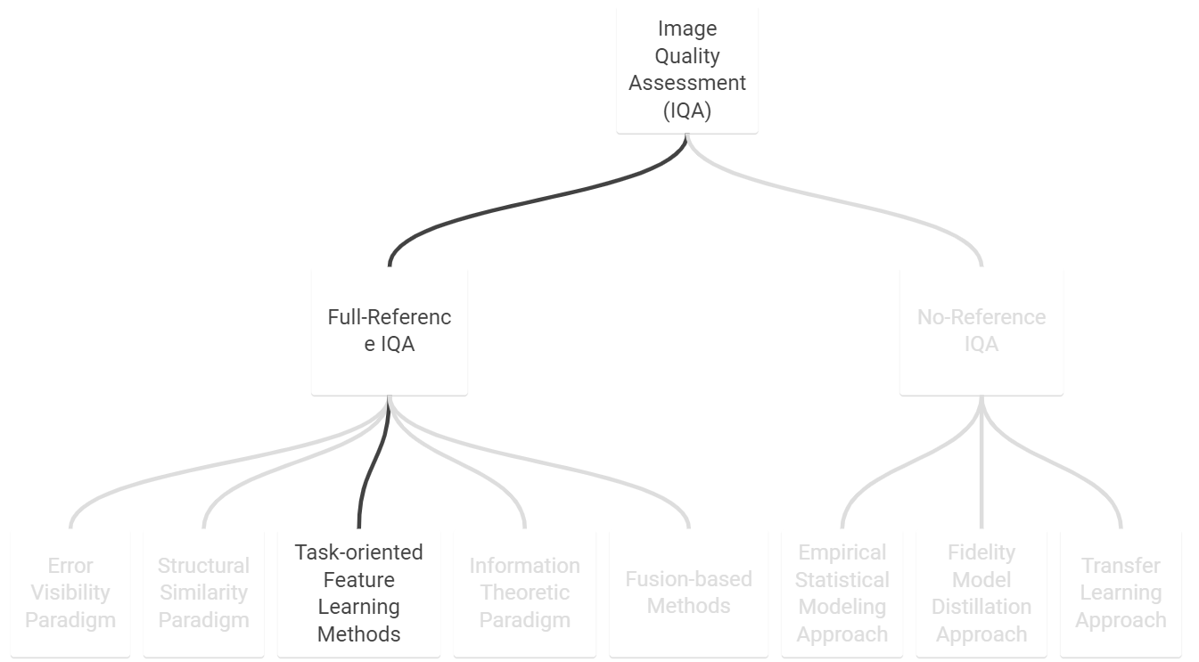
http://ivc.uwaterloo.ca/research/bayesianIQA/ -> 37 IQA methods contained

Slide 21
5 Conclusion and Open Problems
demonstrate that existing IQA methods can be explained by a common Bayesian framework with concrete mathematical formulation
try to discover the configuration of the HVS represented by the prior distribution $p(θ)$
Open Problem
generalization problem
understanding the mathematical properties of IQA measures
the complexity of IQA algorithms
novelty
just present formulation and assume

