Slide 1
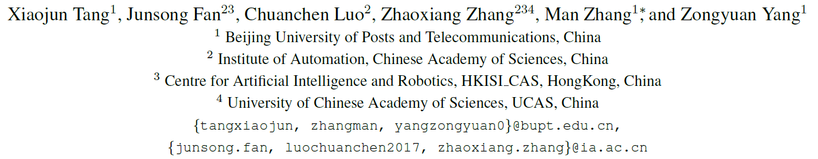
DDG-Net: Discriminability-Driven Graph Network for Weakly-supervised Temporal Action Localization

Slide 2
Background
WTAL: Weakly-supervised temporal action localization
Large-scale datasets → a pretrained network in other datasets to extract features → Not suitable!
Feature enhancement → model temporal relationship between snippets
HOWEVER - ambiguous snippets deliver contradictory information
Reduce the discriminability of linked snippets
Notes:
WTAL:弱监督时间动作定位
大规模数据集——在其他数据集上预训练网络提取特征——不适合!
特征增强——对片段之间的时间关系进行建模
然而，模棱两可的片段传递矛盾的信息
减少链接片段的可辨别性

Slide 3
Introduction
Discriminability-Driven Graph Network (DDG-Net)

Slide 4
Introduction
Discriminability-Driven Graph Network (DDG-Net)
Explicitly models ambiguous snippets and discriminative snippets
Feature consistency loss
Prevent the assimilation of features
Drive the graph convolution network to generate discriminative representations

Slide 5
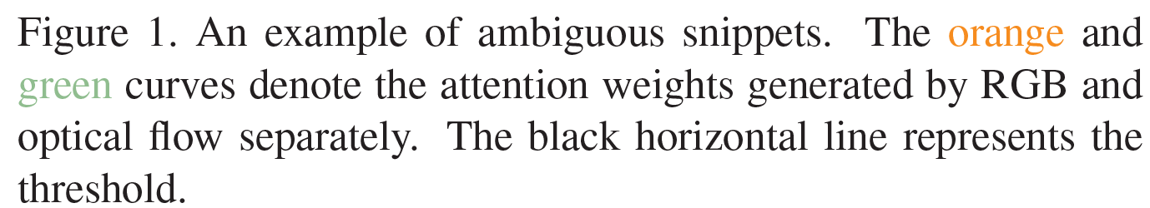
Introduction
Discriminability-Driven Graph Network (DDG-Net)
Explicitly models ambiguous snippets and discriminative snippets
Feature consistency loss
Prevent the assimilation of features
Drive the graph convolution network to generate discriminative representations

Slide 6



Problem Formulation
Given:
an untrimmed video
corresponding multi-hot action category label
Goal
a set of action instances
start and end timestamps
of the corresponding action instance
related confidence score
predicted action category

Slide 7


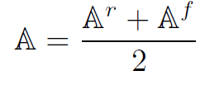



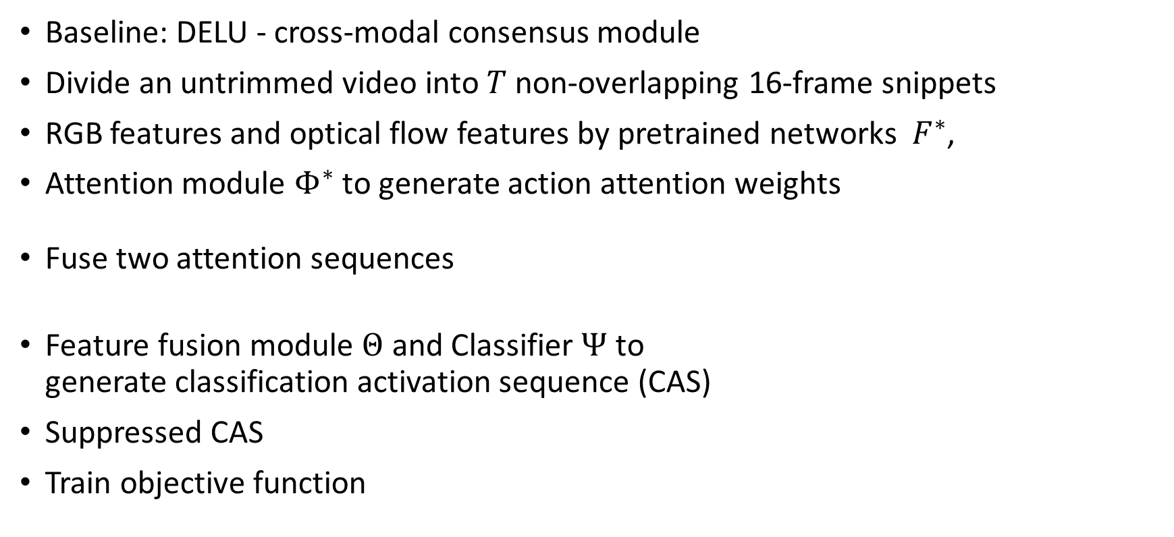
Pipeline
Baseline: DELU - cross-modal consensus module
Divide an untrimmed video into $T$ non-overlapping 16-frame snippets
RGB features and optical flow features by pretrained networks $F^{∗}$,
Attention module $Φ^{∗}$ to generate action attention weights
Fuse two attention sequences
Feature fusion module $Θ$ and Classifier $Ψ$ to
generate classification activation sequence (CAS)
Suppressed CAS
Train objective function

Slide 8
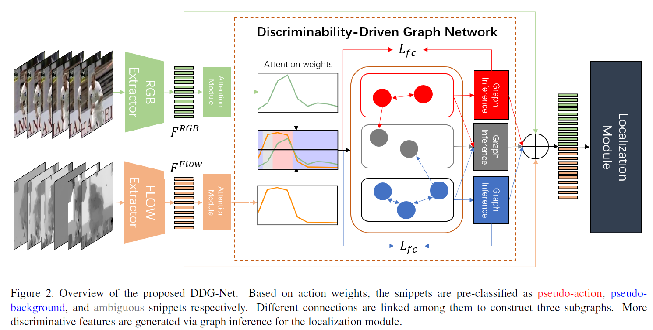
Framework

Slide 9



Graph Formulation
$$V_{a}$$
$$V_{m}$$
$$V_{b}$$

Slide 10
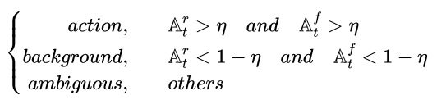
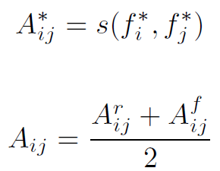
Graph Generation
No supervision to snippet-level categories → Consider the action weights of snippets as the judgment basis
Edge weights: feature similarity
Notes:
comments

Slide 11
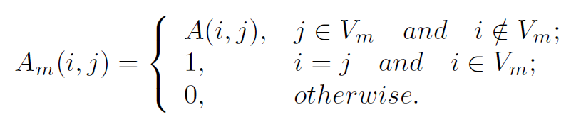
Graph Generation
No supervision to snippet-level categories → Consider the action weights of snippets as the judgment basis
Edge weights: feature similarity
Ambiguous graph: masked partly
Notes:
comments

Slide 12
Graph Generation
Exploit complementary information of discriminative snippets
Abandon confusing information from ambiguous snippets
Discriminative information is delivered to relevant snippets while the ambiguous is never spread out
Note: fusion of cross-modal adjacency matrixes and preventing the propagation of ambiguous information is vital
Notes:
comments

Slide 13
Graph Generation
No supervision to snippet-level categories → Consider the action weights of snippets as the judgment basis
Edge weights: feature similarity
Ambiguous graph: masked partly
Notes:
comments

Slide 14
Graph Inference
Notes:
comments

Slide 15


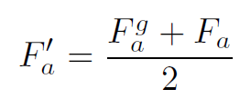



Graph Inference
Action graph and background graph: graph average and graph convolution are directly operated to obtain aggregated features following residual connection
Graph average
Graph convolution network (GCN)
Aggregated features
Enhanced features
output of
the l-th layer
Activation function LeakyReLU
Notes:
comments

Slide 16


Graph Inference
Ambiguous graph
Graph average √
Graph convolution network (GCN): difficult on training
: partition of which only contain ambiguous columns and action rows
GCN only learns to transform discriminative snippet features
Ambiguous snippet representations benefit from the enhanced features via graph inference
a diagonal matrix
Notes:
comments

Slide 17
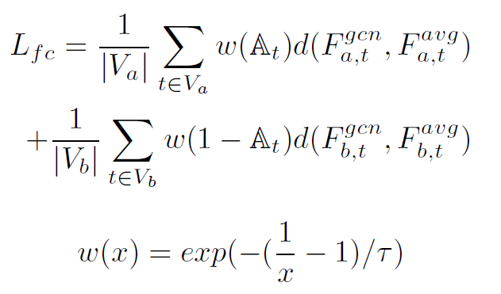
Feature Consistency Loss
GCN prefers to transform all snippet-level features close to action characteristics for the classification task → Drives the model to pursue classification performance, resulting in poor localization with chaotic features
Hope: The most discriminative representations remain unchanged through DDG-Net because they can be recognized easily --- Hard!
→ Punish the distance between graph average features and graph convolution features to realize the same function
Notes:
GCN倾向于将所有片段级特征转换为接近分类任务的动作特征 -- 驱动模型追求分类性能，导致使用混沌特征的定位较差
希望:通过DDG-Net，最具区分性的表征保持不变，因为它们很容易被识别——很难!
惩罚图平均特征和图卷积特征之间的距离，以实现相同的功能

Slide 18
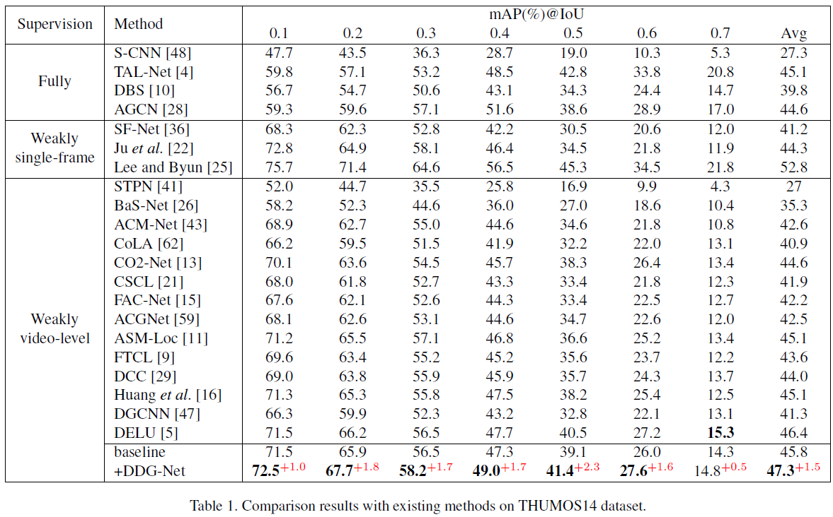
Experiments

Slide 19
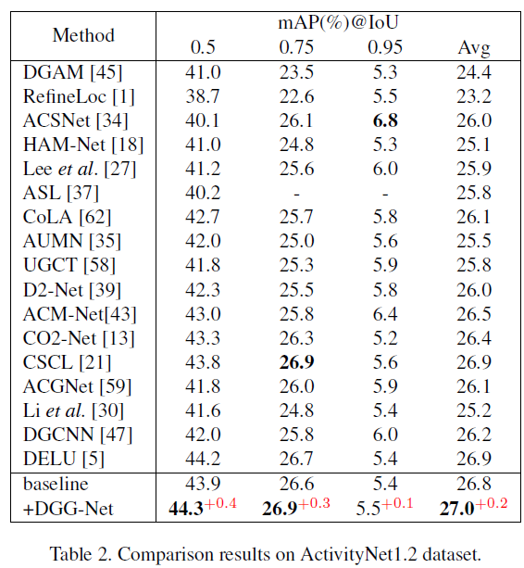
Experiments
Notes:
Make sense
But how???

Slide 20
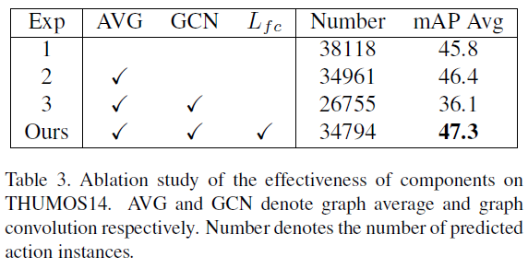
Ablation Study
Effects of components
The performance has a sharp decline of 10.3% because the GCN prefers to generate features attached to action for classification tasks, which is harmful to localization tasks

Slide 21
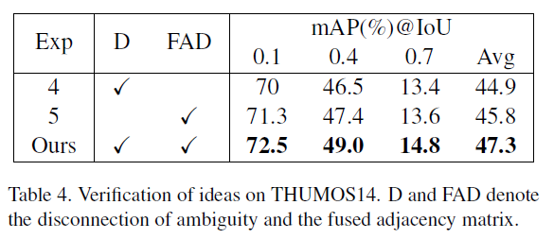
Ablation Study
Analysis of insight

Slide 22
Recall: Graph Generation
No supervision to snippet-level categories → Consider the action weights of snippets as the judgment basis
Edge weights: feature similarity
Ambiguous graph: masked partly
Notes:
comments

Slide 23
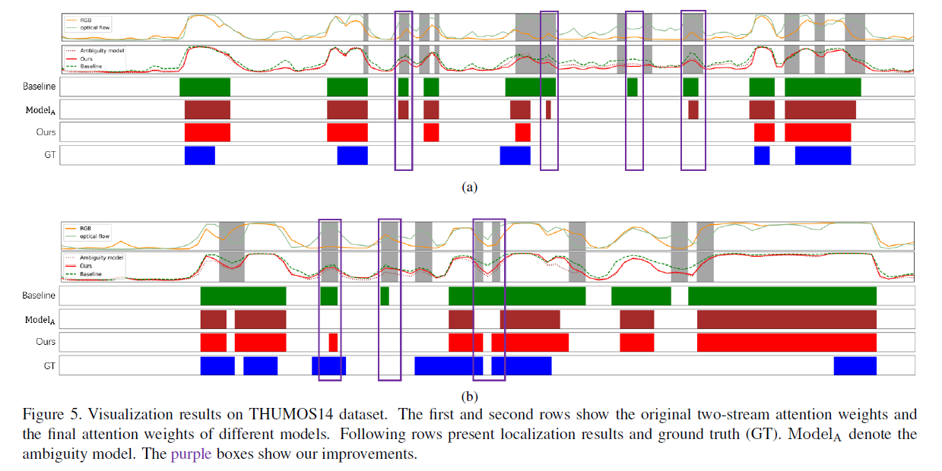
Qualitative results

Slide 24
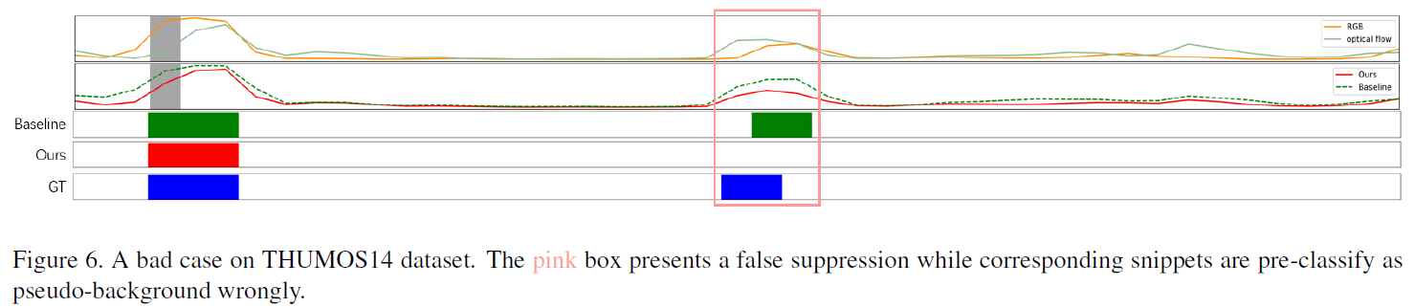
Bad Case
The action snippets are pre-classified as pseudo-background, which suppresses their attention weights
Performance of pre-classification is essential

Slide 25
Conclusion
A novel graph network for effectively enhancing the discriminability of snippet-level representations
Feature Consistency Loss
Comments
Simple but valid
A common but undiscovered question
Notes:
方法完全不能借鉴，但是想法可以

Slide 26
Writing (Column)
Abstract 0.5
Introduction 1.5
Related work 1
Base Model 1
Method 3
Experiments 3
Conclusion 0.3

Slide 27
Writing
Method – 3
  Index – 0.3
  Graph Formulation – 0.3
  Graph Generation – 1
  Graph Inference – 0.8
  Feature Consistency Loss – 0.5
  Train Objective (Loss function) – 3 lines
Experiments – 3
  Experimental Setup – 0.6
    Datasets – 0.3
    Evaluation Metrics – 3 lines
    Implement Details – 0.2
  Comparisons with SOTA Methods - 1
  Ablation Study – 1.5
  Visualization Results – 0.5
Conclusion – 0.3
Introduction – 1.5
  Background of TAL and WTAL
  Intro of WTAL and problem
  Related work and disadvantages
  Our work
  Contributions
Related Work - 1
  WTAL – 0.6
  Graph-based WTAL – 0.4
Base Model – 1
  Problem Formulation – 0.2
  Pipeline – 0.8

Slide 28
THANKS

Slide 29
Weakly-supervised temporal action localization (WTAL) is a practical yet challenging task. Due to large-scale datasets, most existing methods use a network pretrained in other datasets to extract features, which are not suitable enough for WTAL. To address this problem, researchers design several modules for feature enhancement, which improve the performance of the localization module, especially modeling the temporal relationship between snippets. However, all of them omit that ambiguous snippets deliver contradictory information, which would reduce the discriminability of linked snippets. Considering this phenomenon, we propose Discriminability-Driven Graph Network (DDG-Net), which explicitly models ambiguous snippets and discriminative snippets with well-designed connections, preventing the transmission of ambiguous information and enhancing the discriminability of snippet-level representations. Additionally, we propose feature consistency loss to prevent the assimilation of features and drive the graph convolution network to generate more discriminative representations. Extensive experiments on THUMOS14 and ActivityNet1.2 benchmarks demonstrate the effectiveness of DDG-Net, establishing new state-of-the-art results on both datasets. Source code is available at https://github.com/XiaojunTang22/ICCV2023-DDGNet.
WTAL

Slide 30
Weakly-supervised temporal action localization (WTAL) is a practical yet challenging task. Due to large-scale datasets, most existing methods use a network pretrained in other datasets to extract features, which are not suitable enough for WTAL. To address this problem, researchers design several modules for feature enhancement, which improve the performance of the localization module, especially modeling the temporal relationship between snippets. However, all of them omit that ambiguous snippets deliver contradictory information, which would reduce the discriminability of linked snippets. Considering this phenomenon, we propose Discriminability-Driven Graph Network (DDG-Net), which explicitly models ambiguous snippets and discriminative snippets with well-designed connections, preventing the transmission of ambiguous information and enhancing the discriminability of snippet-level representations. Additionally, we propose feature consistency loss to prevent the assimilation of features and drive the graph convolution network to generate more discriminative representations. Extensive experiments on THUMOS14 and ActivityNet1.2 benchmarks demonstrate the effectiveness of DDG-Net, establishing new state-of-the-art results on both datasets. Source code is available at https://github.com/XiaojunTang22/ICCV2023-DDGNet.
WTAL
Problem

Slide 31
Weakly-supervised temporal action localization (WTAL) is a practical yet challenging task. Due to large-scale datasets, most existing methods use a network pretrained in other datasets to extract features, which are not suitable enough for WTAL. To address this problem, researchers design several modules for feature enhancement, which improve the performance of the localization module, especially modeling the temporal relationship between snippets. However, all of them omit that ambiguous snippets deliver contradictory information, which would reduce the discriminability of linked snippets. Considering this phenomenon, we propose Discriminability-Driven Graph Network (DDG-Net), which explicitly models ambiguous snippets and discriminative snippets with well-designed connections, preventing the transmission of ambiguous information and enhancing the discriminability of snippet-level representations. Additionally, we propose feature consistency loss to prevent the assimilation of features and drive the graph convolution network to generate more discriminative representations. Extensive experiments on THUMOS14 and ActivityNet1.2 benchmarks demonstrate the effectiveness of DDG-Net, establishing new state-of-the-art results on both datasets. Source code is available at https://github.com/XiaojunTang22/ICCV2023-DDGNet.
WTAL
Problem
Related Wrok

Slide 32
Weakly-supervised temporal action localization (WTAL) is a practical yet challenging task. Due to large-scale datasets, most existing methods use a network pretrained in other datasets to extract features, which are not suitable enough for WTAL. To address this problem, researchers design several modules for feature enhancement, which improve the performance of the localization module, especially modeling the temporal relationship between snippets. However, all of them omit that ambiguous snippets deliver contradictory information, which would reduce the discriminability of linked snippets. Considering this phenomenon, we propose Discriminability-Driven Graph Network (DDG-Net), which explicitly models ambiguous snippets and discriminative snippets with well-designed connections, preventing the transmission of ambiguous information and enhancing the discriminability of snippet-level representations. Additionally, we propose feature consistency loss to prevent the assimilation of features and drive the graph convolution network to generate more discriminative representations. Extensive experiments on THUMOS14 and ActivityNet1.2 benchmarks demonstrate the effectiveness of DDG-Net, establishing new state-of-the-art results on both datasets. Source code is available at https://github.com/XiaojunTang22/ICCV2023-DDGNet.
WTAL
Problem
Related Wrok
Disadvantages

Slide 33
Weakly-supervised temporal action localization (WTAL) is a practical yet challenging task. Due to large-scale datasets, most existing methods use a network pretrained in other datasets to extract features, which are not suitable enough for WTAL. To address this problem, researchers design several modules for feature enhancement, which improve the performance of the localization module, especially modeling the temporal relationship between snippets. However, all of them omit that ambiguous snippets deliver contradictory information, which would reduce the discriminability of linked snippets. Considering this phenomenon, we propose Discriminability-Driven Graph Network (DDG-Net), which explicitly models ambiguous snippets and discriminative snippets with well-designed connections, preventing the transmission of ambiguous information and enhancing the discriminability of snippet-level representations. Additionally, we propose feature consistency loss to prevent the assimilation of features and drive the graph convolution network to generate more discriminative representations. Extensive experiments on THUMOS14 and ActivityNet1.2 benchmarks demonstrate the effectiveness of DDG-Net, establishing new state-of-the-art results on both datasets. Source code is available at https://github.com/XiaojunTang22/ICCV2023-DDGNet.
WTAL
Problem
Related Wrok
Disadvantages
Our work – Contribution 1

Slide 34
Weakly-supervised temporal action localization (WTAL) is a practical yet challenging task. Due to large-scale datasets, most existing methods use a network pretrained in other datasets to extract features, which are not suitable enough for WTAL. To address this problem, researchers design several modules for feature enhancement, which improve the performance of the localization module, especially modeling the temporal relationship between snippets. However, all of them omit that ambiguous snippets deliver contradictory information, which would reduce the discriminability of linked snippets. Considering this phenomenon, we propose Discriminability-Driven Graph Network (DDG-Net), which explicitly models ambiguous snippets and discriminative snippets with well-designed connections, preventing the transmission of ambiguous information and enhancing the discriminability of snippet-level representations. Additionally, we propose feature consistency loss to prevent the assimilation of features and drive the graph convolution network to generate more discriminative representations. Extensive experiments on THUMOS14 and ActivityNet1.2 benchmarks demonstrate the effectiveness of DDG-Net, establishing new state-of-the-art results on both datasets. Source code is available at https://github.com/XiaojunTang22/ICCV2023-DDGNet.
WTAL
Problem
Related Wrok
Disadvantages
Our work – Contribution 1
Contribution 2

Slide 35
Weakly-supervised temporal action localization (WTAL) is a practical yet challenging task. Due to large-scale datasets, most existing methods use a network pretrained in other datasets to extract features, which are not suitable enough for WTAL. To address this problem, researchers design several modules for feature enhancement, which improve the performance of the localization module, especially modeling the temporal relationship between snippets. However, all of them omit that ambiguous snippets deliver contradictory information, which would reduce the discriminability of linked snippets. Considering this phenomenon, we propose Discriminability-Driven Graph Network (DDG-Net), which explicitly models ambiguous snippets and discriminative snippets with well-designed connections, preventing the transmission of ambiguous information and enhancing the discriminability of snippet-level representations. Additionally, we propose feature consistency loss to prevent the assimilation of features and drive the graph convolution network to generate more discriminative representations. Extensive experiments on THUMOS14 and ActivityNet1.2 benchmarks demonstrate the effectiveness of DDG-Net, establishing new state-of-the-art results on both datasets. Source code is available at https://github.com/XiaojunTang22/ICCV2023-DDGNet.
WTAL
Problem
Related Wrok
Disadvantages
Our work – Contribution 1
Contribution 2
Experiments

Slide 36
Weakly-supervised temporal action localization (WTAL) is a practical yet challenging task. Due to large-scale datasets, most existing methods use a network pretrained in other datasets to extract features, which are not suitable enough for WTAL. To address this problem, researchers design several modules for feature enhancement, which improve the performance of the localization module, especially modeling the temporal relationship between snippets. However, all of them omit that ambiguous snippets deliver contradictory information, which would reduce the discriminability of linked snippets. Considering this phenomenon, we propose Discriminability-Driven Graph Network (DDG-Net), which explicitly models ambiguous snippets and discriminative snippets with well-designed connections, preventing the transmission of ambiguous information and enhancing the discriminability of snippet-level representations. Additionally, we propose feature consistency loss to prevent the assimilation of features and drive the graph convolution network to generate more discriminative representations. Extensive experiments on THUMOS14 and ActivityNet1.2 benchmarks demonstrate the effectiveness of DDG-Net, establishing new state-of-the-art results on both datasets. Source code is available at https://github.com/XiaojunTang22/ICCV2023-DDGNet.
WTAL
Problem
Related Wrok
Disadvantages
Our work – Contribution 1
Contribution 2
Experiments

