Slide 1
Jiahe Li
2018.10.09

Slide 2
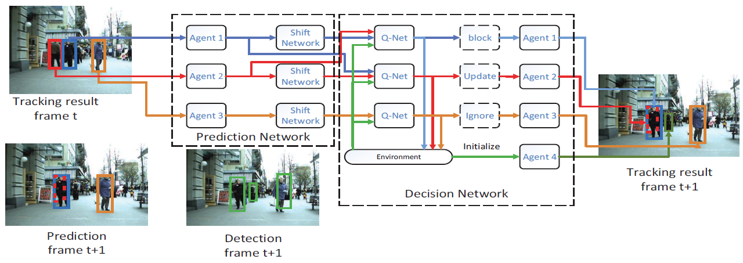
Framework

Slide 3
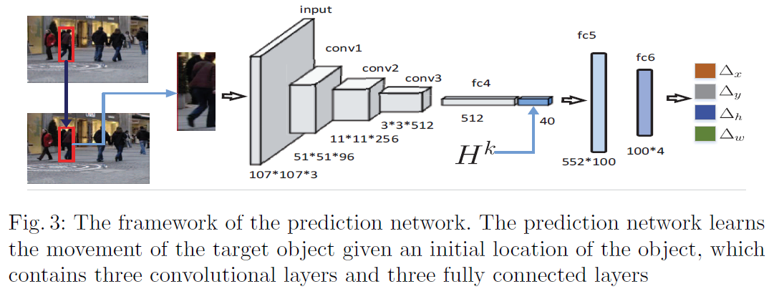
Prediction network

Slide 4
Decision network: Collaborative Deep RL
Agent
Appearance
Interaction

Slide 5
Decision network: Collaborative Deep RL
Status: visible & invisible
Action
Update
Ignore - Not reliable or missing
Block
Delete - The object disappears

Slide 6
Decision network: Collaborative Deep RL
Rewards
Update, Ignore, Block

Slide 7
Decision network: Collaborative Deep RL
Formulation

Slide 8
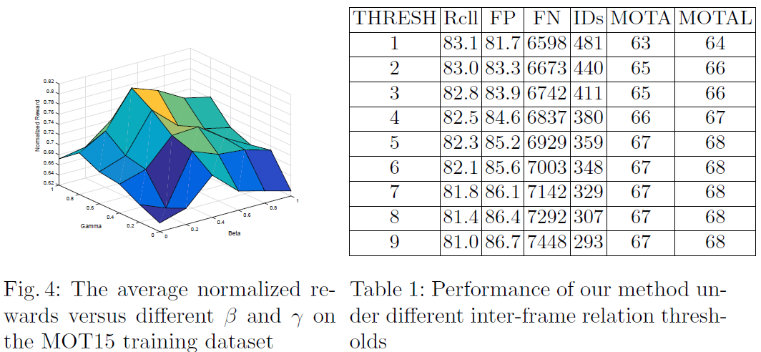
Experimental results

Slide 9
Experimental results

Slide 10
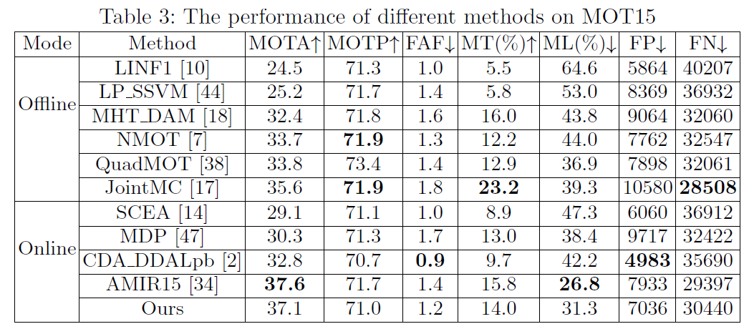
Experimental results

Slide 11
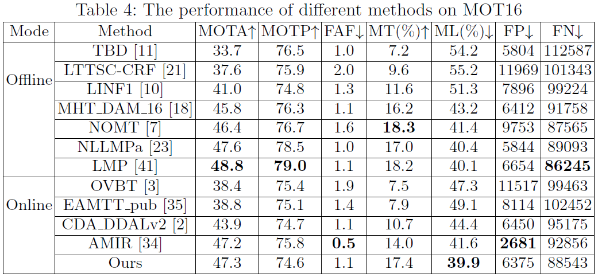
Experimental results

Slide 12
Conclusion
A collaborative deep reinforcement learning method
Prediction network
Decision network (Deep RL)

