Slide 1
CVPR19, Poster

Slide 2
Related Work
Action Segmentation: label video frames with action classes.
Types of weakly supervision signal
Video-level supervision.
Transcript supervision.
Point-level supervision.
Inspired by point annotations in image based semantic segmentation [1], only single frame of an action instance is annotated.
[1] Amy Bearman, Olga Russakovsky, Vittorio Ferrari, and Li Fei-Fei. What’s the point: Semantic segmentation with point supervision. In ECCV, 2016

Slide 3
Method
How to sample?
Sampler
Frame-wise Classifier
How to update?

Slide 4
Method
1. Sample frames to train Frame-wise classifier.
Plateau function
Sample all the frames within the plateau.
For each action class k, sample the top-h frames that that has highest P(k|x).
P.S. For the initialization, the frame-wise classifier is pre-trained with the annotated timestamp frames.

Slide 5
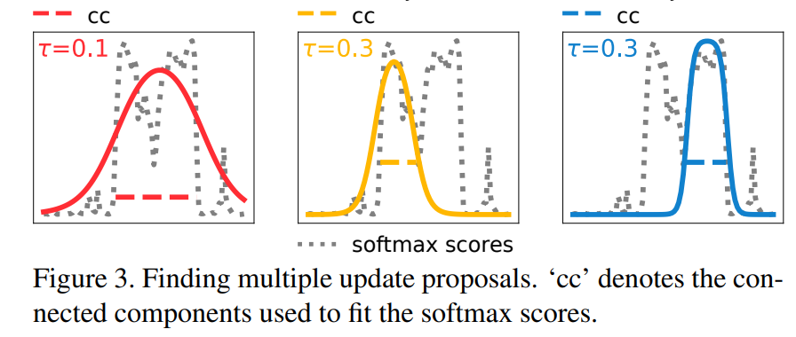
Method
2.Update the Sampler with the output of Frame-wise Classifier.
i) Find target proposals for each action instance i.
$$Q_{}^{i}=\{r_{1}^{i},r_{2}^{i},r_{3}^{i}…\}$$
$P(k|x)$, k is the action class of action instance i
$$r_{1}^{i}=(c_{1}^{i},w_{1}^{i},s_{1}^{i})$$
$$r_{2}^{i}=(c_{2}^{i},w_{2}^{i},s_{2}^{i})$$
$$r_{3}^{i}=(c_{3}^{i},w_{3}^{i},s_{3}^{i})$$
Notes:
Response score of frames of action class of i.

Slide 6
Method
2.Update the Sampler with the output of Frame-wise Classifier.
ii) Select best target proposals for each action instance.
define the confidence $ψ$ of each proposal $r_{j}^{i}∈Q_{}^{i}$ as:
$ψ\left(r_{j}^{i}\right)=p\left(r_{j}^{i}\right)−p(β^{i})$
where $p\left(β^{i}\right)=\frac{1}{|Χ|}\sum_{x∈X}{P(y^{k}|x)}$
We select the proposal $\hat{r_{}^{i}}$ with the highest confidence score for each $β^{i}$.

Slide 7
Method
2.Update the Sampler with the output of Frame-wise Classifier.
iii) Update sampler.
Let $Γ$ be the set of selected proposal for each action instance.
We pick the top R proposals in $Γ$ and updating its corresponding sampler.
$c_{}^{i}=c_{}^{i}−λ_{c}\left(c_{}^{i}−\hat{r_{c}^{i}}\right)$
$w_{}^{i}=w_{}^{i}−λ_{w}(w_{}^{i}−\hat{r_{w}^{i}})$
$s_{}^{i}=s_{}^{i}−λ_{s}(s_{}^{i}−\hat{r_{s}^{i}})$, where $i∈Γ^{R}$

Slide 8
Method

Slide 9
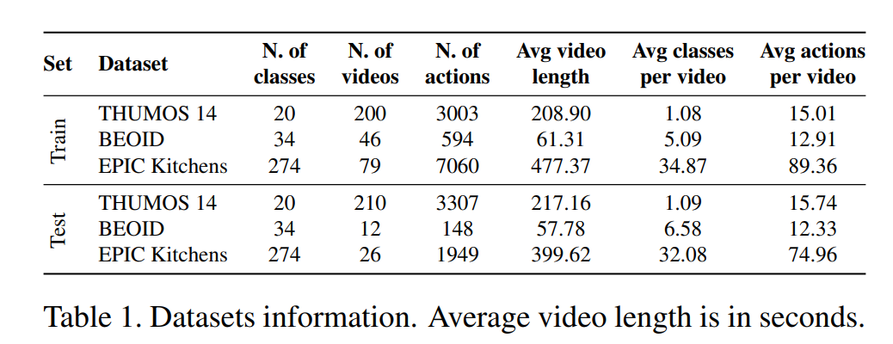
Experiment
TS: Random pick one frame between the start and the end of action.
TS in GT: Gaussian distribution centered at the center of action.

Slide 10
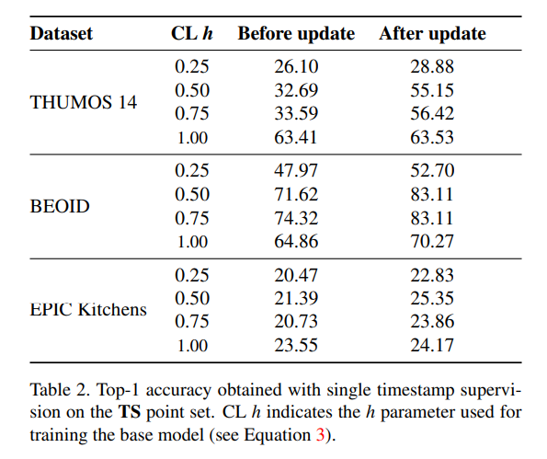
Experiment

Slide 11
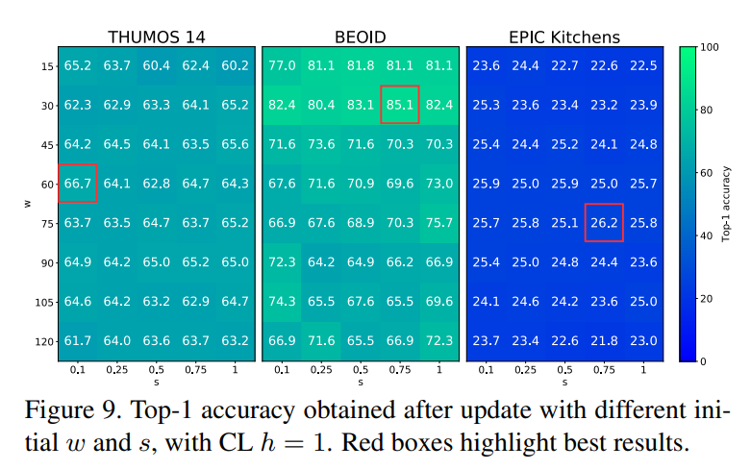
Experiment

Slide 12
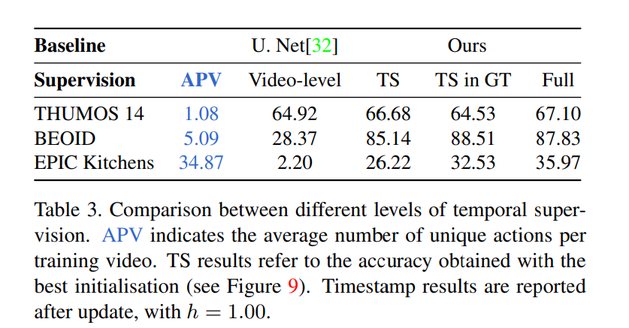
Experiment

Slide 13
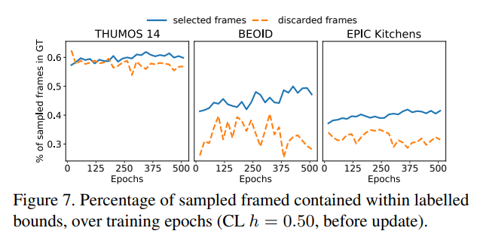
Comments
More straightforward explanation about their methods.
The performance upper bound is limited to the frame-wise classifier, which is meaningless.
The accuracy and recall of the frames sampled by the sampler should be reported.
+ An interesting topic. A good method to address this problem can be applied to many other applications.

