Slide 1
CVPR19, Oral
Notes:
卡尔斯鲁厄理工学院

Slide 2
Method
Linking Equation
where $k_{i}^{1}$ symbolizes the nearest neighbor of point $i$
Notes:
The clustering method of this paper is quiet easy. they proposed a linking equation, and according to the equation, we add connection between data points, and the connected data are then classified to one cluster. The equation 1 shows how to add connections between data points I and j.
links points (i, j) if j is the nearest neighbor of I or have the same nearest neighbor with κ 1 i = κ 1.

Slide 3
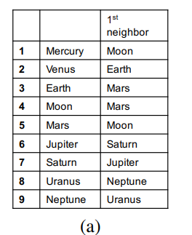
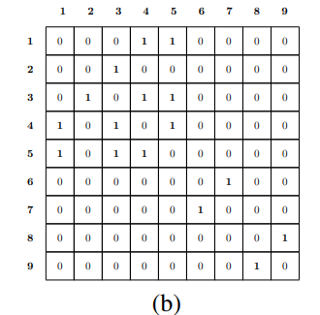
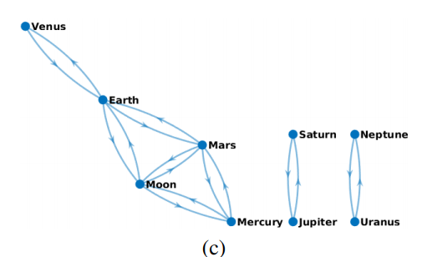
Method
An example of generating clusters using eq. (1)
First Integer Neighbor Clustering Hierarchy
Notes:
To undertand how eq(1) gernreate clusters, here is an example. Fig (a) shows 9 data points and their nearest nearest neighbors.
Actually, C is the partitions we want, that has 3 clusters. This is exactly what this paper proposed.

Slide 4
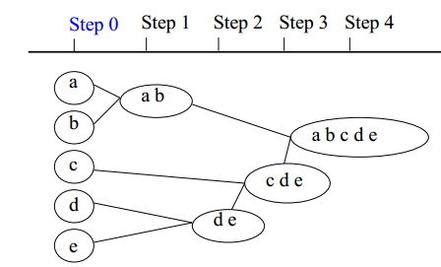
Hierarchy alg. 1: from fine to coarse
Input: First step partitions $𝒯_{1}$
Output: Set of partitions $\{𝒯_{1},𝒯_{2},𝒯_{3},…,𝒯_{L}\}$
For each step j:
Compute cluster means
(average of all data vectors in that cluster) to represent each cluster.
Get partition $𝒯_{j+1}$ of $𝒯_{j}$ via eq.(1)
If $C_{𝒯_{j+1}}$== 1:
break;
Notes:
For real applications, we need hierarchical methods to form partitions on different grain levels.
The pipeline of hierarchical clustering is very straight forward. We merge small clusters into a larger one at different steps, and stop when there is only one clusters. Once we get the representation of clusters, we can take the cluster as a normal data point, and then we get a new partition.

Slide 5
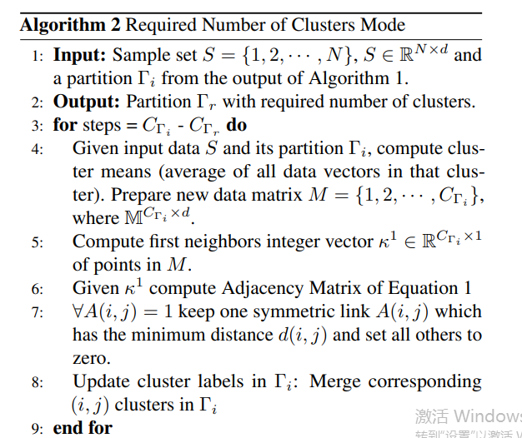
Merge alg. 2: produce required number of clusters
Notes:
Another demand for real application is we need a partition that has exact cluster numbers we want.
The difference between Merge alg and hierarchical alg is that the Merge method only to merge two clusters that with smallest distance into one cluster.
Smallest distance between an element in one cluster and an element in the other.

Slide 6
Method: Analysis
Linkage-Based Clustering Methods: Find connections of data (local cluster criterion), such as density-connected points.
Famous work: 
DBSCAN: Ester, et al. (KDD’96) OPTICS: Ankerst, et al (SIGMOD’99). DENCLUE: Hinneburg & D. Keim (KDD’98) CLIQUE: Agrawal, et al. (SIGMOD’98)
First Integer Neighbor Clustering Hierarchy
■ Discover clusters of arbitrary shape  Handle noise  One scan
■ Fast Time Complexity is O(Nlog N)  Memory save Do not need full-pair distance matrix  Parameter free
Notes:
Kmeans generate clusters with convex shape
The last 3 advantages maintain the ability of applying the alg to the large scale data.

Slide 7
Experiment
Evaluation Metrics:
Purity$∈[0,1]↑$: whether the data of a cluster belongs to the same class.
ACC$∈[0,1]↑$: $\frac{\sum_{i=1}^{N}{I(s_{i}, map(r_{i}))}}{N}$
NMI$∈[0,1]↑$: Normalized Mutual Information.
Notes:
The datasets are summarized in Table.1.
Purity is sensitive to the number of clusters, for example, If each data point is regarded as a cluster, the purity metric will be 100% percent.
ACC is a more robust metric, each class can be assigned to only one cluster.
Higher acc often means higher NMI.

Slide 8
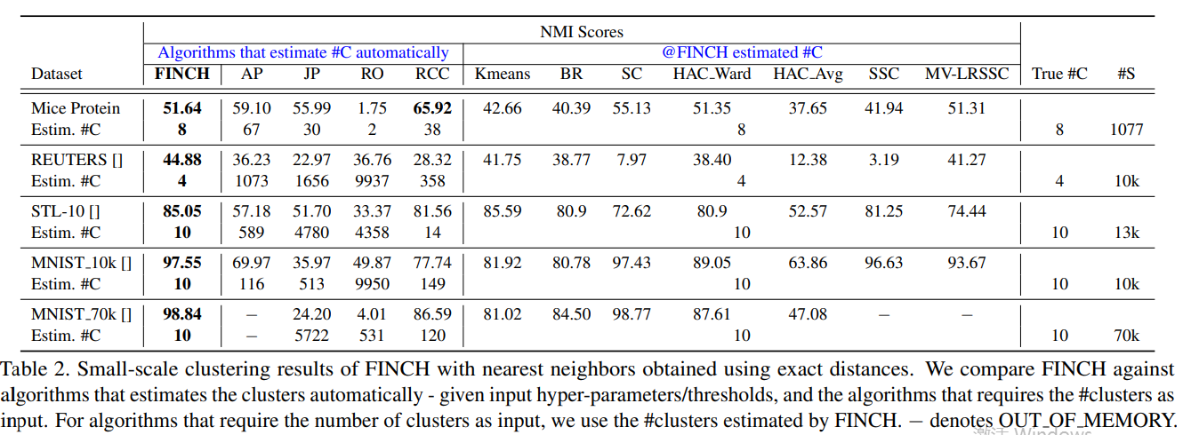
Experiment
Notes:
The previous methods are classified into 2 groups. The first part of the methods like ap, jp are the methods do not need number of clusters as input. Instead, they need a stop criterior. And for finch, we use the partition that has closest number of clusters with the ground truth.

Slide 9
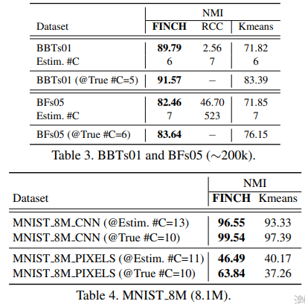
Experiment

Slide 10
Experiment
Notes:
FINCH is very fast.

Slide 11
Experiment

Slide 12
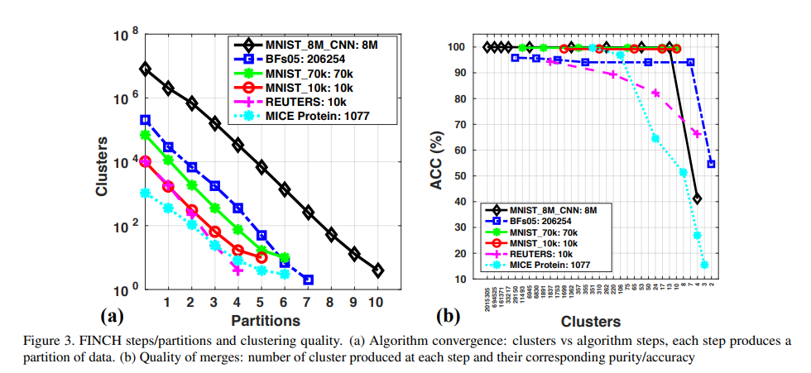
Experiment
Alg. 1 Num of clusters at different steps
Alg.2 The purity for different number of clusters
Purity
Notes:
Merge 2 clusters, the purity of cluster is not decreasing, which means we merged the right clusters..

Slide 13
Comments
+ Fully parameter-free and easily scalable to large data at a minimal computational expense,
may prove useful for many applications.
+ Comprehensive experiments.
+ Simple but work.

