Slide 1
DeepFool:
a simple and accurate method to fool deep neural networks
CVPR 2016
Notes:
EPFL：瑞士洛桑联邦理工学院 ；现读博士最后一年级 ；2014年硕士毕业； 引用量1099
Alhussein Fawzi：校友，2016博士毕业，现工作于Google DeepMind
Pascal Frossard是他的导师

Slide 2
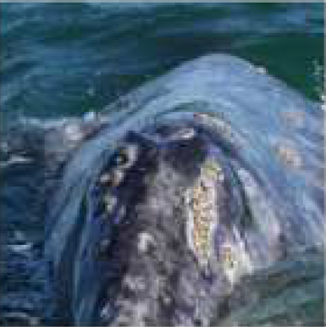
Motivation
$$+$$
$$=$$
$$x$$
$$r$$
$$x+r$$
whale
turtle

Slide 3
DeepFool for Binary Classifiers
$$ℱ≜\left\{x:f\left(x\right)=0\right\}$$

Slide 4
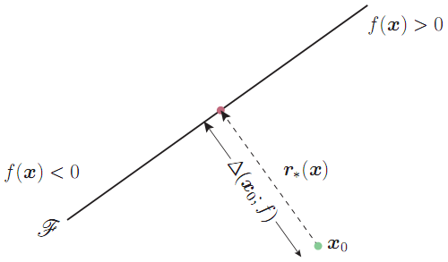
DeepFool for Binary Classifiers
$f$ is affine : $f=w^{T}x+b$
distance
direction

Slide 5
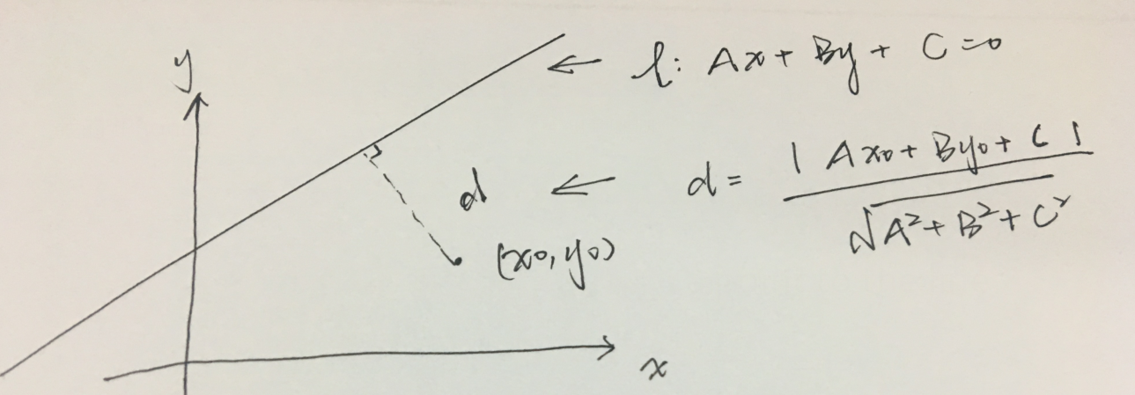
Review—The distance from a point to the line

Slide 6
DeepFool for Binary Classifiers
$f$ is general
Taylor expansion
First order approximation of Taylor expansion
$$r_{k}$$

Slide 7
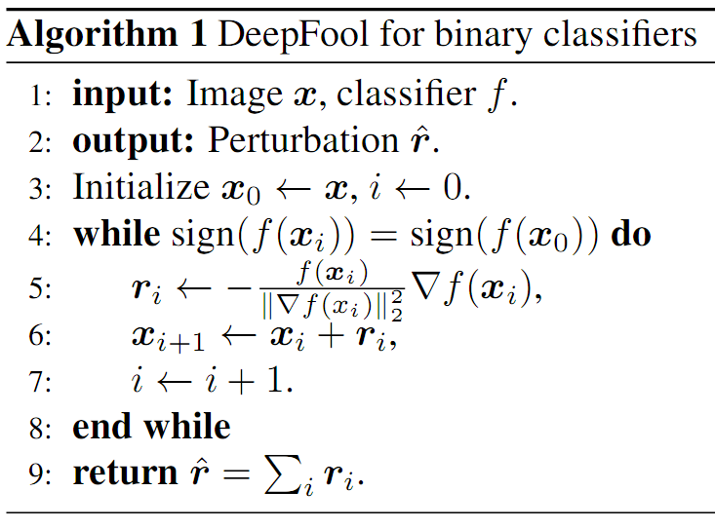
DeepFool for Binary Classifiers
$f$ is general
get ‘change’ r by iteration
how to change (distance and direction)
new point

Slide 8
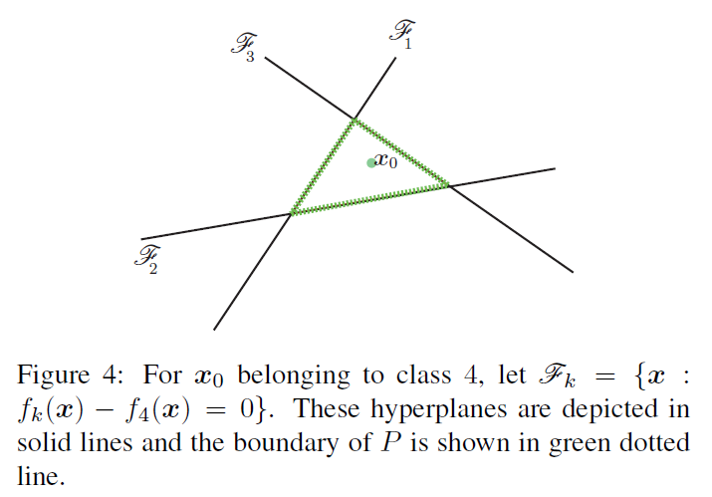
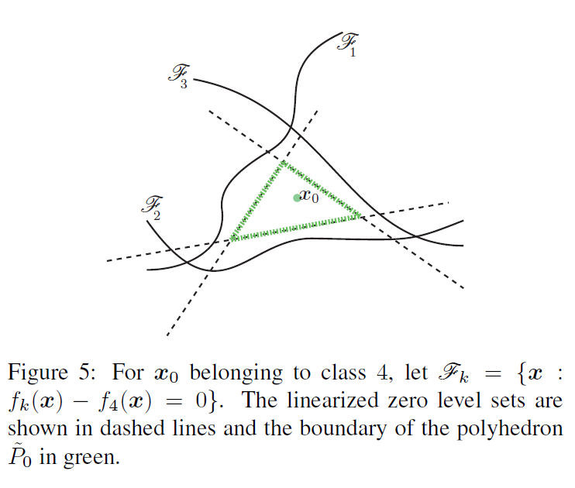
DeepFool for Multiclass Classifiers

Slide 9
DeepFool for Multiclass Classifiers
Affine multiclass classifier : $f=W^{T}x+b$
On the line: $\left(w_{k}−w_{\hat{k}\left(x_{0}\right)}\right)x+\left(b_{k}−b_{\hat{k}\left(x_{0}\right)}\right)=0,we have f_{k}\left(x_{0}\right)=f_{\hat{k}\left(x_{0}\right)}(x_{0})$
how to move $x_{0}$ : distance & direction

Slide 10
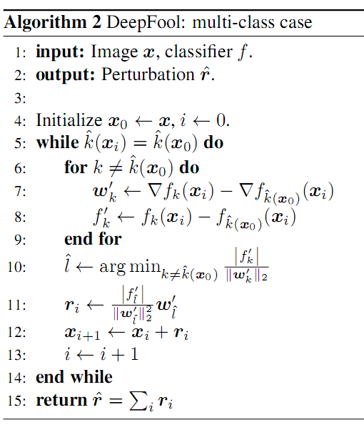
DeepFool for Multiclass Classifiers
General classifier
On the line:
$\left(∇f_{k}\left(x_{i}\right)−∇f_{\hat{k}\left(x_{0}\right)}\left(x_{i}\right)\right)\left(x−x_{i}\right)+\left(f_{k}\left(x_{0}\right)−f_{\hat{k}\left(x_{0}\right)}\left(x_{0}\right) \right)=0$
we have $f_{k}\left(x_{0}\right)=f_{\hat{k}\left(x_{0}\right)}(x_{0})$

Slide 11
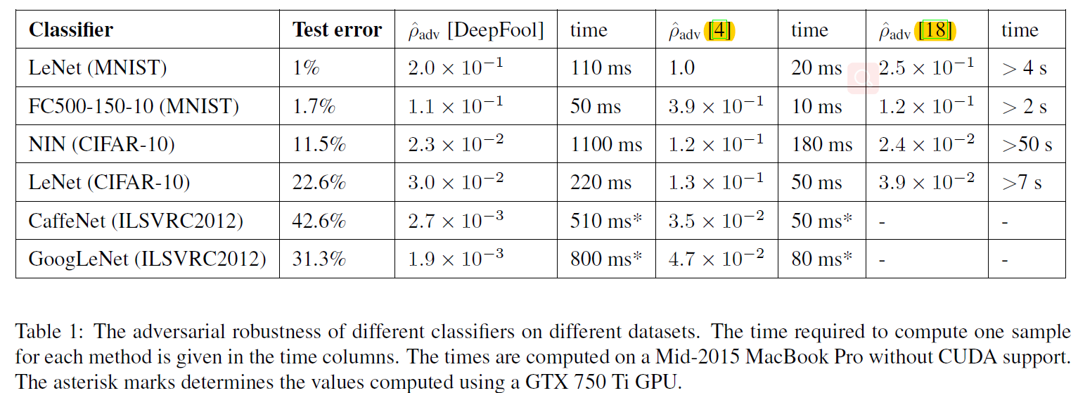
Experimental results _ perturbations

Slide 12
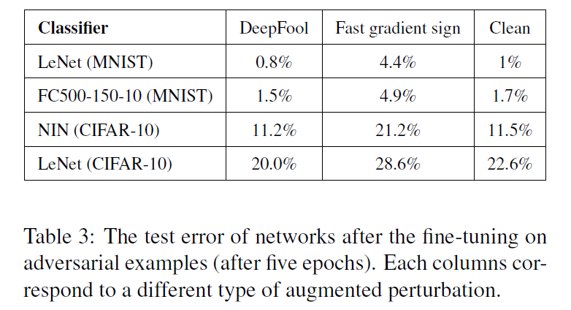
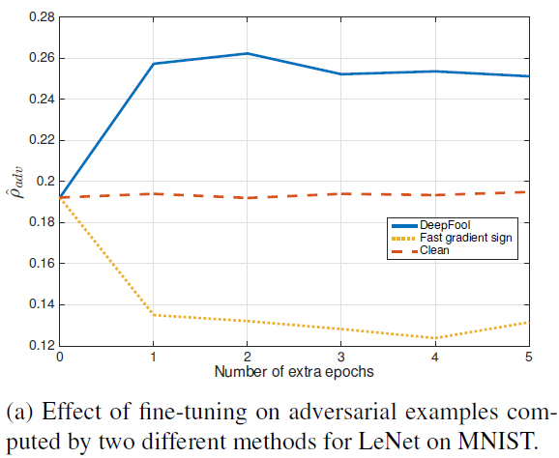
Experimental results _ fine-tuning
？

Slide 13
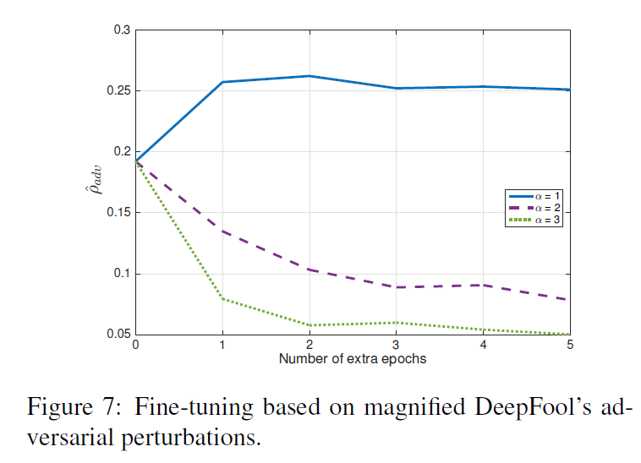
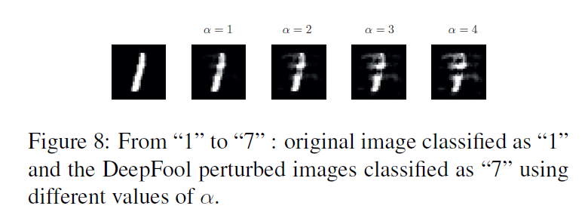
Overly perturbed images decrease the robustness of MNIST networks

Slide 14
Contribution
propose a simple method for computing adversarial samples
augmenting training data with adversarial examples significantly increases the robustness to adversarial perturbations
propose an accurate method for computing the robustness of different classifiers to adversarial perturbations
provides a better understanding of this intriguing phenomenon and of its influence factors

