Slide 1
Complement Objective Training (COT)
ICLR 2019（Poster）

Slide 2
Motivation
Standard cross entropy loss largely ignores information from the complement (incorrect) classes.
Hope models more robust adversarial attacks.
change loss function
Robustness

Slide 3
Visualization of the motivation

Slide 4
Complement Entropy
$x$: input sample
$g$: true label of $x$
${\hat{y}}_{j}$: the j-th element of prediction confidence vector (i.e. the vector generated after softmax layer)
$K:$ the number of classes
$$L\left(x,g\right)=−\sum_{j=1,j≠g}^{K}{\left(\frac{{\hat{y}}_{j}}{1−{\hat{y}}_{g}}\right)log(\frac{{\hat{y}}_{j}}{1−{\hat{y}}_{g}})}$$
$\frac{{\hat{y}}_{j}}{1−{\hat{y}}_{g}}$: conditioned on the ground-truth class not happening, the predicted probability to classify example x as class j

Slide 5
Complement Entropy
Minimizing cross entropy to increase ${\hat{y}}_{g}$
Maximizing complement entropy to neutralize ${\hat{y}}_{j≠g}$
$$L\left(x,g\right)=−\sum_{j=1,j≠g}^{K}{\left(\frac{{\hat{y}}_{j}}{1−{\hat{y}}_{g}}\right)log(\frac{{\hat{y}}_{j}}{1−{\hat{y}}_{g}})}$$
The entropy is maximized when the events are equally likely to occur, which means optimizing on the complement entropy drives ${\hat{y}}_{j}$to ${1−{\hat{y}}_{g}}/{K−1}$.

Slide 6
Complement Entropy Training
$−log⁡({\hat{y}}_{g})——$minimize
$L(x,g)——$maximize
$$L\left(x,g\right)=−\sum_{j=1,j≠g}^{K}{\left(\frac{{\hat{y}}_{j}}{1−{\hat{y}}_{g}}\right)log(\frac{{\hat{y}}_{j}}{1−{\hat{y}}_{g}})}$$

Slide 7
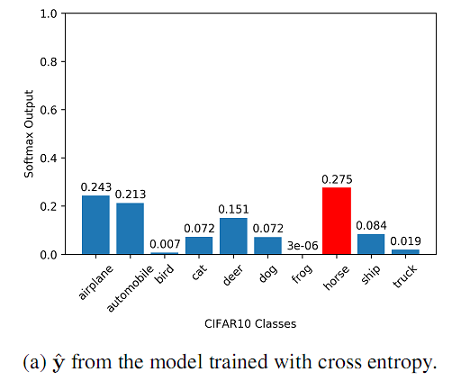
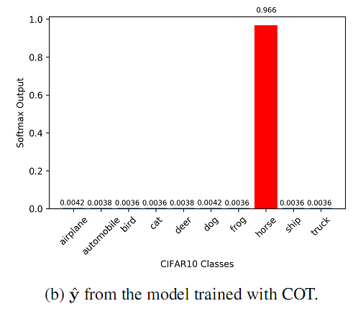
Visualizing the effect of COT
model:ResNet110
sample image:CIFAR-10

Slide 8
Review
Cross Entropy
Reverse Cross Entropy (RCE)
$1_{y}$:one hot label
$R_{y}$:reverse label
$$(0,0,0,1,0,0,0,0,0,0)$$
$$(\frac{1}{9},\frac{1}{9},\frac{1}{9},0,\frac{1}{9},\frac{1}{9},\frac{1}{9},\frac{1}{9},\frac{1}{9},\frac{1}{9})$$
$$L_{CE}^{R}\left(x,g\right)=−\sum_{j=1,j≠g}^{K}{\frac{1}{K−1}}log⁡({\hat{y}}_{j})$$

Slide 9
Comparison of RCE and Complement Entropy
RCE
COT
$$L_{CE}^{R}\left(x,g\right)=−\sum_{j=1,j≠g}^{K}{\frac{1}{K−1}}log⁡({\hat{y}}_{j})$$
$$L\left(x,g\right)=−\sum_{j=1,j≠g}^{K}{\left(\frac{{\hat{y}}_{j}}{1−{\hat{y}}_{g}}\right)log(\frac{{\hat{y}}_{j}}{1−{\hat{y}}_{g}})}$$
formula
Handcraft a weight for complement classes.
Let the model to learn the weight for complement classes.
Reversing cross entropy term？
Yes
No

Slide 10
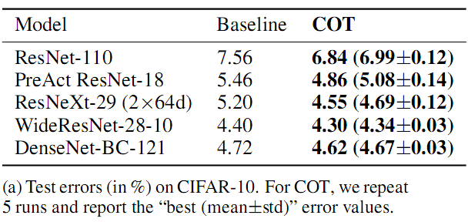
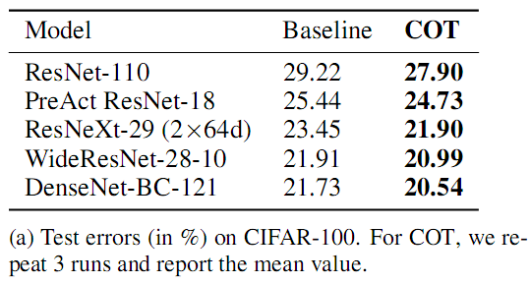
Experiment : Image Classification
Complement objective training can improve the classification accuracy.
CIFAR-10
CIFAR-100

Slide 11
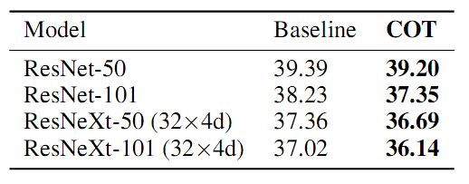
Experiment : Image Classification
Complement objective training can improve the classification accuracy.
Tiny ImageNet
ImageNet-2012
Top-1 Validation errors (in %) for the Tiny ImageNet experiments (mean values of 3 runs).
Validation errors (in %) for the ImageNet-2012 experiments.

Slide 12
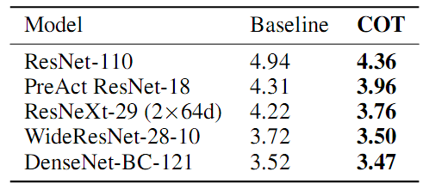
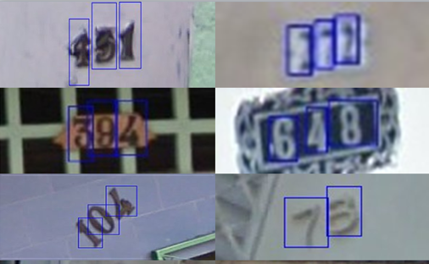
Experiment : Image Classification
Complement objective training can improve the classification accuracy.
Test errors (in %) of the baseline models and the COT-trained models on the SVHN dataset. The values presented are the mean values of 3 runs.
Notes:
The SVHN dataset (Netzer et al., 2011) consists of images extracted from Google Street View.
It can be seen as similar in flavor to MNIST ，but incorporates an order of magnitude more labeled data and comes from a real world problem

Slide 13
Experiment : Natural Language Understanding
Complement objective training can improve the model-accuracy.
Machine Translation
Speech Rec0gnition
Results of IWSLT 2015 English-Vietnamese. The BLEU scores on tst2013 are reported.
Test errors (in %) on Google Commands Dataset (mean values of 3 runs).
The higher the BLEU scores, the better the translation.

Slide 14
Experiment : Adversarial Examples
？
Notes:
attack success rate

Slide 15
Conclusion
+ Consider the information from both complement and true classes, improve performances on both Image classification task and some NLP tasks.
+ They expose their codes and we can try this loss when we train a model
- Lack of experiments showing how well their models defense against attack methods
- It makes no sense comparing classification accuracy under transfer attacks and white attacks.

