Slide 1
CVPR2020, Oral

Slide 2
A new task, namely Temporal Action Parsing(TAP)
Predict the temporal segments of the sub-actions
Triple jump
Hammer throw
rings

Slide 3
Difference between TAP and existing action tasks
Action Recognition: predict a single class label for a given video.
Action Localization: identify temporal locations of action instances in an untrimmed video.
Action Segmentation: the sub-actions are pre-defined, which are not feasible for large scale dataset.

Slide 4
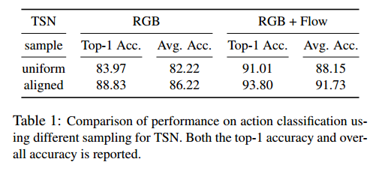
Why TAP?
Learning the temporal structures of complex actions helps promote performances for action tasks[36,52,53].
[36] Hamed Pirsiavash and Deva Ramanan. Parsing videos of actions with segmental grammars. In CVPR, pages 612–619, 2014.
[52] Limin Wang, Yu Qiao, and Xiaoou Tang. Latent hierarchical model of temporal structure for complex activity classification. IEEE Transactions on Image Processing, 23(2):810– 822, 2013.
[53] Limin Wang, Yuanjun Xiong, Zhe Wang, Yu Qiao, Dahua Lin, Xiaoou Tang, and Luc Van Gool. Temporal segment networks: Towards good practices for deep action recognition. In ECCV, pages 20–36. Springer, 2016

Slide 5
Dataset: Temporal Action Parsing of Olympics Sports (TAPOS)
Samples are all Olympics sports, instances belonging to the same sport tend to have a consistent background.
Samples are ensured to cover a complete action instance with no shot changes.
For each sample, we provide annotations of two levels of granularity, namely the action and the ranges of sub-actions.
TAPOS contains 16, 294 valid instances in total, across 21 action classes. These instances have a duration of 9.4 seconds on average.
Notes:
First two make it a suitable dataset for models that focus on the action itself.

Slide 6
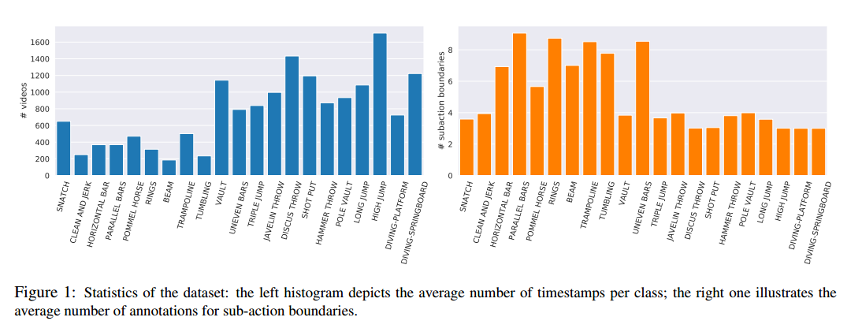
Dataset: Temporal Action Parsing of Olympics Sports (TAPOS)
Notes:
First two make it a suitable dataset for models that focus on the action itself.

Slide 7
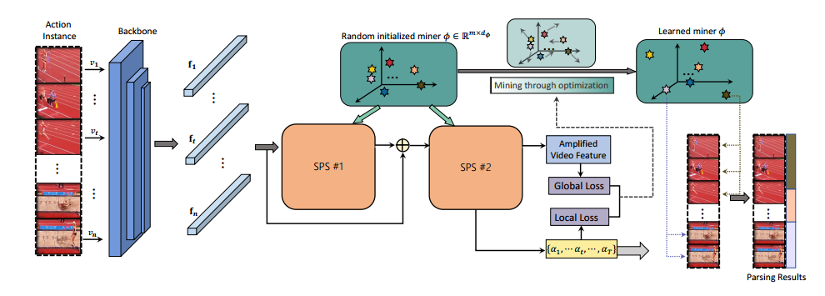
Methods
Training:
Pattern miner: learn distinct characteristics of sub-actions.
Inference:
Frame feature: calculate the response with the patterns stored in the miner.

Slide 8
Methods
Soft-Pattern-Strengthen (SPS) Unit:
The SPS unit maintains a pattern miner learn distinct characteristics of sub-actions, which could be used to regularize the input feature, amplifying its discriminative patterns.

Slide 9
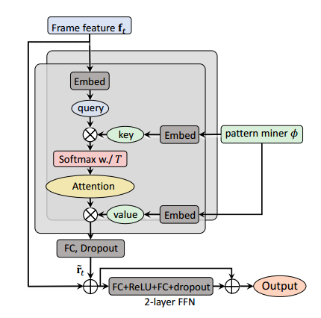
Soft-Pattern-Strengthen (SPS) Unit
Attention is All You Need.

Slide 10
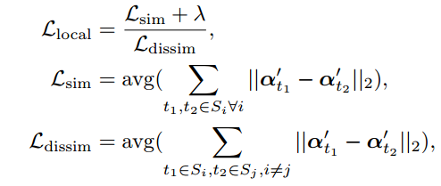
Methods

Slide 11
Experiment
Baselines:
Action boundary detection
Weakly-supervised temporal action segmentation
Metrics:

Slide 12
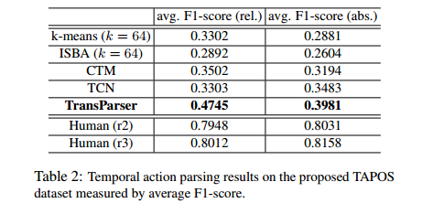
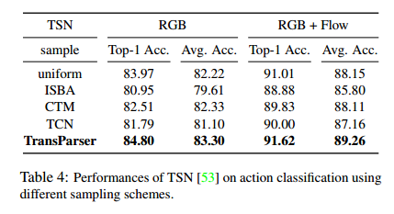
Experiment

Slide 13
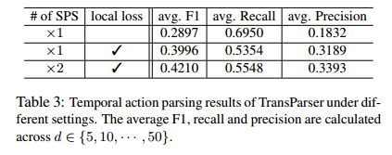
Experiment

Slide 14
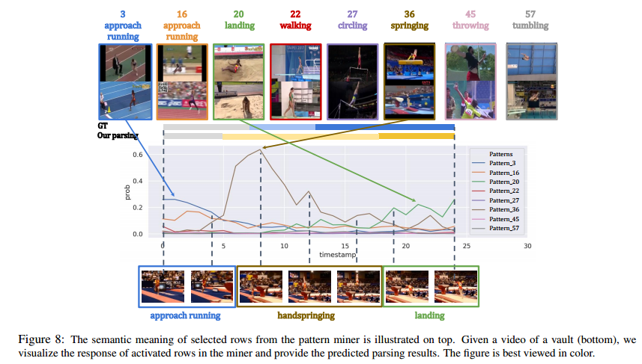
Experiment

Slide 15
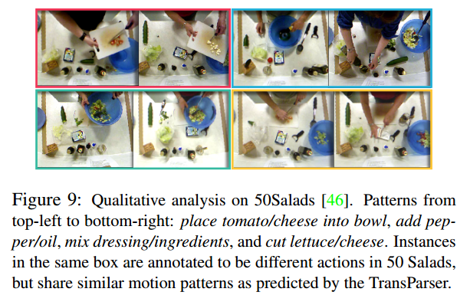
Experiment
The automatically mined patterns demonstrate different semantic meanings with human annotated sub-actions, which tend to focus on motion dynamics

Slide 16
Comments
+ A new task and new dataset.
+ Methods are impressive and results are good.
- Experiments about number of patterns.

