Slide 1
Notes:
延世大学

Slide 2
Task Discrepancy Problem
Standard training pipeline for the long-form video understanding tasks consists of two steps:
(i) Train the snippet encoder with a large-scale action recognition dataset (e.g., Kinetics400), which is often different from the dataset for the downstream task.
(ii) Train the downstream head (e.g., TAL) that takes the snippet feature sequences extracted from the pretrained encoder.
An issue here is that the mainstream pretext task for the snippet-wise video encoder is “Trimmed” Action Classification (TAC), which does not handle action boundaries and background frames.

Slide 3
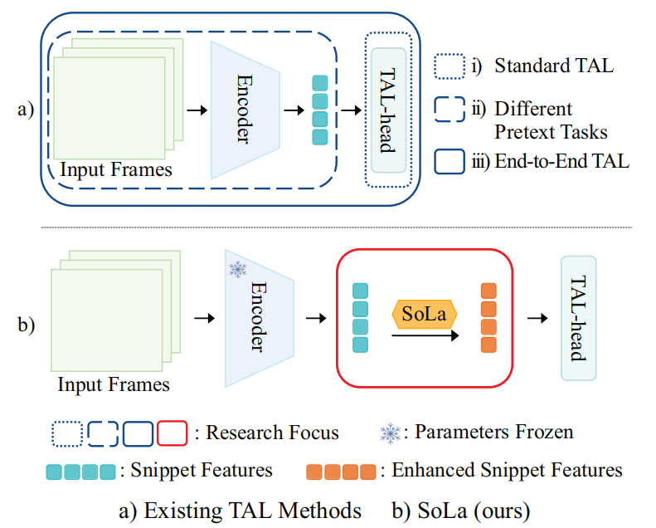
Task Discrepancy Problem
A straightforward approach to the problem is adopting a temporally sensitive pretext task to train the snippet encoder, or devising an end-to-end framework.

Slide 4
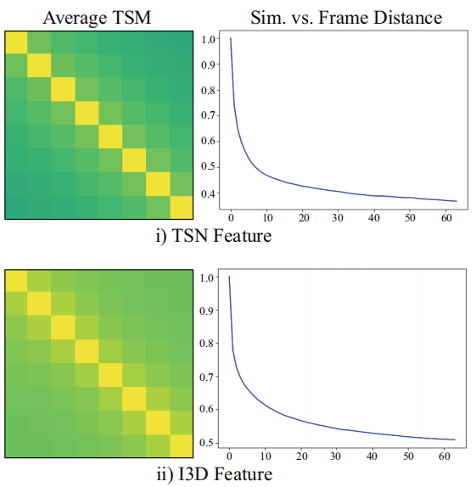
Similarity Matching
Adjacent frames are similar, while remote frames remain distinct.
Temporal Self-similarity Matrix

Slide 5
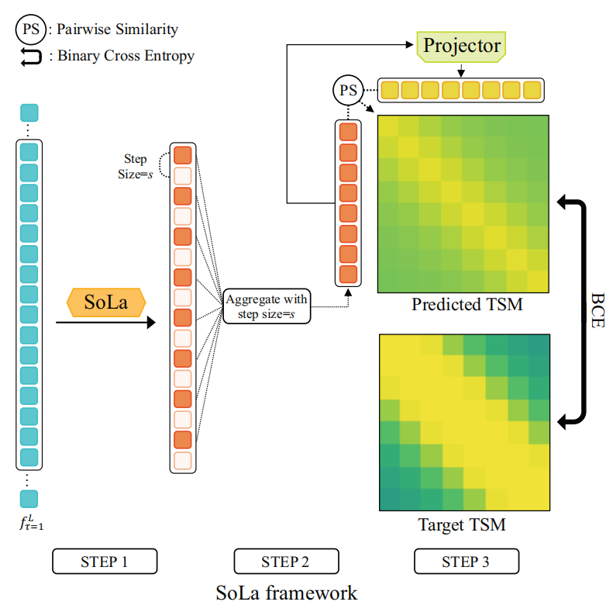
Overview of Soft-Landing Strategy
Adjacent frames are similar, while remote frames remain distinct.

Slide 6
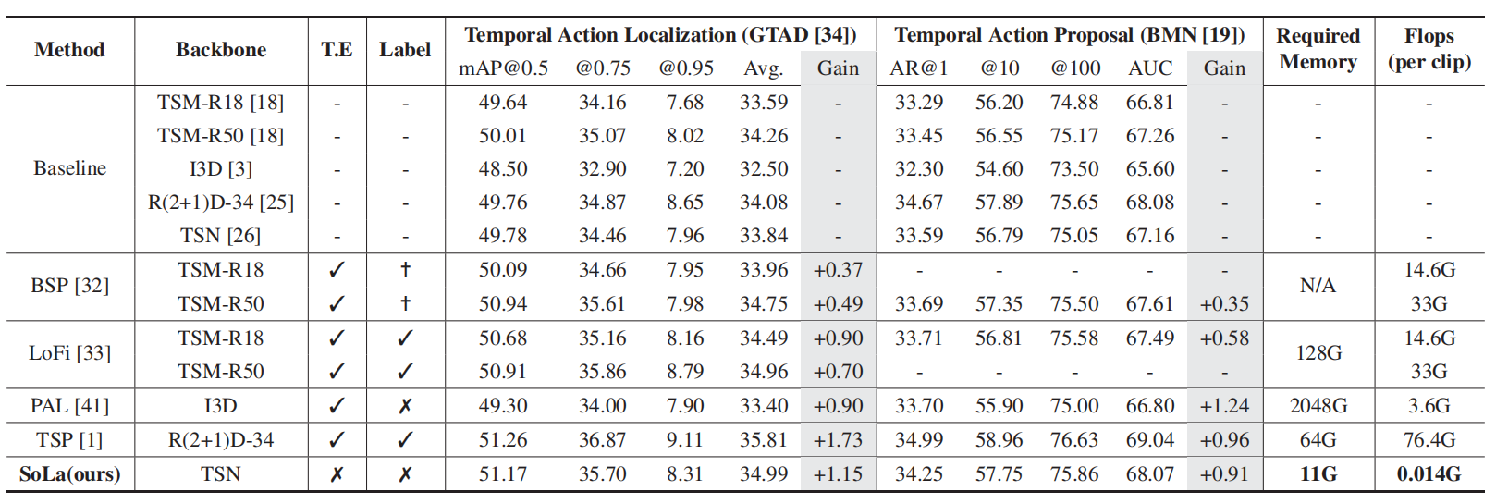
Experiments

Slide 7
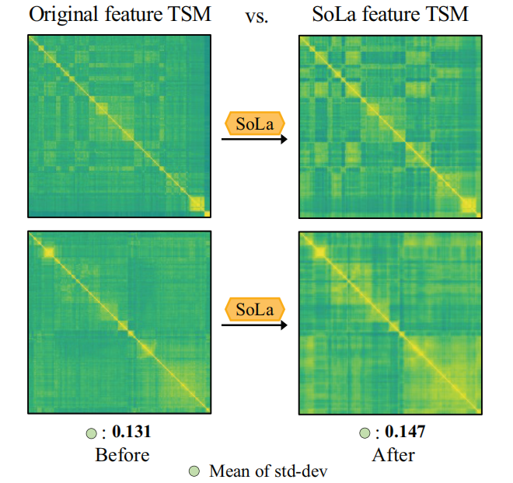
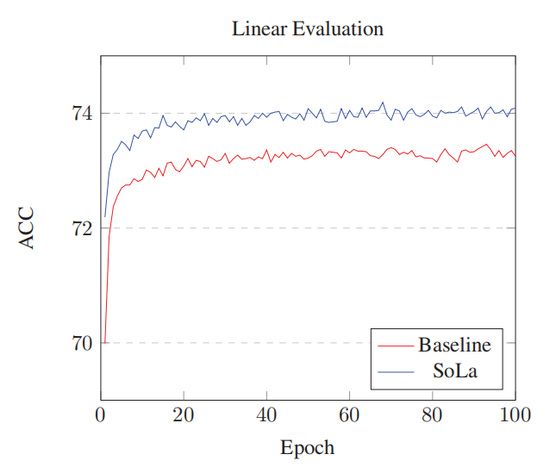
Experiments

Slide 8
Conclusion
+ 嵌入式
+ 轻量化
+ 适用于多个下游任务

Slide 9
Abstract
Temporal Action Localization (TAL) methods typically operate on top of feature sequences from a frozen snippet encoder that is pretrained with the Trimmed Action Classification (TAC) tasks, resulting in a task discrepancy problem. While existing TAL methods mitigate this issue either by retraining the encoder with a pretext task or by end-to-end finetuning, they commonly require an overload of high memory and computation. In this work, we introduce Soft-Landing (SoLa) strategy, an efficient yet effective framework to bridge the transferability gap between the pretrained encoder and the downstream tasks by incorporating a light-weight neural network, i.e., a SoLa module, on top of the frozen encoder. We also propose an unsupervised training scheme for the SoLa module; it learns with inter-frame Similarity Matching that uses the frame interval as its supervisory signal, eliminating the need for temporal annotations. Experimental evaluation on various benchmarks for downstream TAL tasks shows that our method effectively alleviates the task discrepancy problem with remarkable computational efficiency.
开门见山，提出 TAL 两阶段架构中存在的任务差异问题。

Slide 10
Abstract
Temporal Action Localization (TAL) methods typically operate on top of feature sequences from a frozen snippet encoder that is pretrained with the Trimmed Action Classification (TAC) tasks, resulting in a task discrepancy problem. While existing TAL methods mitigate this issue either by retraining the encoder with a pretext task or by end-to-end finetuning, they commonly require an overload of high memory and computation. In this work, we introduce Soft-Landing (SoLa) strategy, an efficient yet effective framework to bridge the transferability gap between the pretrained encoder and the downstream tasks by incorporating a light-weight neural network, i.e., a SoLa module, on top of the frozen encoder. We also propose an unsupervised training scheme for the SoLa module; it learns with inter-frame Similarity Matching that uses the frame interval as its supervisory signal, eliminating the need for temporal annotations. Experimental evaluation on various benchmarks for downstream TAL tasks shows that our method effectively alleviates the task discrepancy problem with remarkable computational efficiency.
紧接着介绍目前对这个问题的两种解决办法，并指出这两种解决办法的弊端：计算资源需求大、效率低

Slide 11
Abstract
Temporal Action Localization (TAL) methods typically operate on top of feature sequences from a frozen snippet encoder that is pretrained with the Trimmed Action Classification (TAC) tasks, resulting in a task discrepancy problem. While existing TAL methods mitigate this issue either by retraining the encoder with a pretext task or by end-to-end finetuning, they commonly require an overload of high memory and computation. In this work, we introduce Soft-Landing (SoLa) strategy, an efficient yet effective framework to bridge the transferability gap between the pretrained encoder and the downstream tasks by incorporating a light-weight neural network, i.e., a SoLa module, on top of the frozen encoder. We also propose an unsupervised training scheme for the SoLa module; it learns with inter-frame Similarity Matching that uses the frame interval as its supervisory signal, eliminating the need for temporal annotations. Experimental evaluation on various benchmarks for downstream TAL tasks shows that our method effectively alleviates the task discrepancy problem with remarkable computational efficiency.
介绍本文提出的方法，即文章贡献之一：软着陆模块

Slide 12
Abstract
Temporal Action Localization (TAL) methods typically operate on top of feature sequences from a frozen snippet encoder that is pretrained with the Trimmed Action Classification (TAC) tasks, resulting in a task discrepancy problem. While existing TAL methods mitigate this issue either by retraining the encoder with a pretext task or by end-to-end finetuning, they commonly require an overload of high memory and computation. In this work, we introduce Soft-Landing (SoLa) strategy, an efficient yet effective framework to bridge the transferability gap between the pretrained encoder and the downstream tasks by incorporating a light-weight neural network, i.e., a SoLa module, on top of the frozen encoder. We also propose an unsupervised training scheme for the SoLa module; it learns with inter-frame Similarity Matching that uses the frame interval as its supervisory signal, eliminating the need for temporal annotations. Experimental evaluation on various benchmarks for downstream TAL tasks shows that our method effectively alleviates the task discrepancy problem with remarkable computational efficiency.
介绍文章贡献之二：无监督训练策略

Slide 13
Abstract
Temporal Action Localization (TAL) methods typically operate on top of feature sequences from a frozen snippet encoder that is pretrained with the Trimmed Action Classification (TAC) tasks, resulting in a task discrepancy problem. While existing TAL methods mitigate this issue either by retraining the encoder with a pretext task or by end-to-end finetuning, they commonly require an overload of high memory and computation. In this work, we introduce Soft-Landing (SoLa) strategy, an efficient yet effective framework to bridge the transferability gap between the pretrained encoder and the downstream tasks by incorporating a light-weight neural network, i.e., a SoLa module, on top of the frozen encoder. We also propose an unsupervised training scheme for the SoLa module; it learns with inter-frame Similarity Matching that uses the frame interval as its supervisory signal, eliminating the need for temporal annotations. Experimental evaluation on various benchmarks for downstream TAL tasks shows that our method effectively alleviates the task discrepancy problem with remarkable computational efficiency.
介绍实验结果，本文方法相比于其他方法效率奇高

Slide 14
Introduction
Our world is full of untrimmed videos, including a plethora of Youtube videos, security camera recordings, and online streaming services. Analyzing never-ending video streams is thus one of the most promising directions of computer vision research in this era [29]. Amongst many longform video understanding tasks, the task of finding action instances in time and classifying their categories, known as Temporal Action Localization (TAL), has received intense attention from both the academia and the industry in recent years; TAL is considered to be the fundamental building block for more sophisticated video understanding tasks since it plays the basic role of distinguishing frame-of-interest from irrelevant background frames [19, 34, 40].
第一段
指出时间动作定位任务的重要性

Slide 15
Introduction
Despite its importance, training a TAL model has a unique computational challenge that hinders the naive extension of conventional image processing models, mainly due to the large size of the model input. For instance, videos in the wild can be several minutes or even hours long, implying that loading the whole video to a device for processing is often infeasible. In this context, the prevailing convention in processing a long-form video for TAL is to divide the video into non-overlapping short snippets and deal with the snippet-wise feature sequences. Specifically, a standard training pipeline for the long-form video understanding tasks consists of two steps: (i) Train the snippet encoder with a large-scale action recognition dataset (e.g., Kinetics400), which is often different from the dataset for the downstream task; (ii) Train the downstream head (e.g., TAL) that takes the snippet feature sequences extracted from the pretrained encoder.
第二段
视频越来越长，传统方法无法处理

Slide 16
Introduction
Despite its importance, training a TAL model has a unique computational challenge that hinders the naive extension of conventional image processing models, mainly due to the large size of the model input. For instance, videos in the wild can be several minutes or even hours long, implying that loading the whole video to a device for processing is often infeasible. In this context, the prevailing convention in processing a long-form video for TAL is to divide the video into non-overlapping short snippets and deal with the snippet-wise feature sequences. Specifically, a standard training pipeline for the long-form video understanding tasks consists of two steps: (i) Train the snippet encoder with a large-scale action recognition dataset (e.g., Kinetics400), which is often different from the dataset for the downstream task; (ii) Train the downstream head (e.g., TAL) that takes the snippet feature sequences extracted from the pretrained encoder.
介绍常用的两阶段时间动作定位流程，分为两步：提取特征、动作检测

Slide 17
Introduction
An issue here is that the mainstream pretext task for the snippet-wise video encoder is “Trimmed” Action Classification (TAC), which does not handle action boundaries and background frames. Although the current pipeline achieves remarkable performance in TAL tasks due to the power of large action recognition datasets, recent works [1, 32, 33, 41] point out the task discrepancy problem that is inherent in this two-staged approach. The task discrepancy problem, first introduced in [33], comes from the pretrained snippet encoder’s insensitivity to different snippets within the same action class. It results in a temporally invariant snippet feature sequence, making it hard to distinguish foreground actions from backgrounds. A straightforward approach to the problem is adopting a temporally sensitive pretext task to train the snippet encoder [1, 32], or devising an end-to-end framework [20, 33], which are briefly described in Figure 1 (a). However, as all previous methods involve retraining the snippet encoder, an excessive use of memory and computation is inevitable.
指出目前两阶段时间动作定位框架存在的问题：任务差异问题

Slide 18
Introduction
An issue here is that the mainstream pretext task for the snippet-wise video encoder is “Trimmed” Action Classification (TAC), which does not handle action boundaries and background frames. Although the current pipeline achieves remarkable performance in TAL tasks due to the power of large action recognition datasets, recent works [1, 32, 33, 41] point out the task discrepancy problem that is inherent in this two-staged approach. The task discrepancy problem, first introduced in [33], comes from the pretrained snippet encoder’s insensitivity to different snippets within the same action class. It results in a temporally invariant snippet feature sequence, making it hard to distinguish foreground actions from backgrounds. A straightforward approach to the problem is adopting a temporally sensitive pretext task to train the snippet encoder [1, 32], or devising an end-to-end framework [20, 33], which are briefly described in Figure 1 (a). However, as all previous methods involve retraining the snippet encoder, an excessive use of memory and computation is inevitable.
给出最直观的两种解决办法，并指出这两种解决办法的通病：计算资源消耗太大

Slide 19
Introduction
To tackle the task discrepancy problem, we propose a new approach, namely Soft-Landing (SoLa) strategy, which is neither memory nor computationally expensive. SoLa strategy is a novel method which incorporates a light-weight neural network, i.e., Soft-Landing (SoLa) module, between the pretrained encoder and the downstream head. The properly trained SoLa module will act like a middleware between the pretext and the downstream tasks, mitigating the task discrepancy problem (Figure 1 (b)). Since the task adaptation is solely done by the SoLa module, the parameters of the pretrained encoder are fixed in our SoLa strategy. The use of a frozen encoder significantly differentiates our approach from previous methods that mainly focus on designing an appropriate training methodology for a snippet encoder. In addition, our SoLa strategy only requires an access to the pre-extracted snippet feature sequence, being fully compatible with the prevailing two-stage TAL framework.
介绍过上述两种解决办法的通病后，顺势引出本文的方法

Slide 20
Introduction
To tackle the task discrepancy problem, we propose a new approach, namely Soft-Landing (SoLa) strategy, which is neither memory nor computationally expensive. SoLa strategy is a novel method which incorporates a light-weight neural network, i.e., Soft-Landing (SoLa) module, between the pretrained encoder and the downstream head. The properly trained SoLa module will act like a middleware between the pretext and the downstream tasks, mitigating the task discrepancy problem (Figure 1 (b)). Since the task adaptation is solely done by the SoLa module, the parameters of the pretrained encoder are fixed in our SoLa strategy. The use of a frozen encoder significantly differentiates our approach from previous methods that mainly focus on designing an appropriate training methodology for a snippet encoder. In addition, our SoLa strategy only requires an access to the pre-extracted snippet feature sequence, being fully compatible with the prevailing two-stage TAL framework.
介绍本文方法的思路：软着陆方法，即在两阶段中间加入 SoLa 模块

Slide 21
Introduction
To tackle the task discrepancy problem, we propose a new approach, namely Soft-Landing (SoLa) strategy, which is neither memory nor computationally expensive. SoLa strategy is a novel method which incorporates a light-weight neural network, i.e., Soft-Landing (SoLa) module, between the pretrained encoder and the downstream head. The properly trained SoLa module will act like a middleware between the pretext and the downstream tasks, mitigating the task discrepancy problem (Figure 1 (b)). Since the task adaptation is solely done by the SoLa module, the parameters of the pretrained encoder are fixed in our SoLa strategy. The use of a frozen encoder significantly differentiates our approach from previous methods that mainly focus on designing an appropriate training methodology for a snippet encoder. In addition, our SoLa strategy only requires an access to the pre-extracted snippet feature sequence, being fully compatible with the prevailing two-stage TAL framework.
介绍方法的优势：
1. 不改变骨干网络
2. 对两阶段框架嵌入性好

Slide 22
Introduction
We also propose Similarity Matching, an unsupervised training scheme for the SoLa module that involves neither frame-level data manipulation nor temporal annotations. Our training strategy circumvents the need for strong frame-level data augmentation which most existing unsupervised representation learning techniques [5, 10] rely on. This strategy perfectly suits our condition where frame-level data augmentation is impossible, as we only have an access to pre-extracted snippet features. The new loss is based on a simple empirical observation: “adjacent snippet features are similar, while distant snippet features remain distinct”. Coupled with the Simsiam [6] framework, Similarity Matching not only prevents the collapse, but also induces temporally sensitive feature sequences, resulting in a better performance in various downstream tasks.
介绍无监督训练思路，作者用“相近帧相近、远离帧相异”作为监督信号。同时说明优点：不需要目标数据集的标注，只需要目标数据集的数据

Slide 23
Introduction
The contributions of the paper can be summarized as follows:
• To tackle the task discrepancy problem, we introduce a novel Soft-Landing (SoLa) strategy, which does not involve retraining of the snippet encoder. As we can directly deploy the “frozen” pretrained snippet encoder without any modification, our SoLa strategy offers easier applicability compared to previous works that require snippet encoders to be retrained.
• We propose Similarity Matching, a new self-supervised learning algorithm for the SoLa strategy. As frame interval is utilized as its only learning signal, it requires neither data augmentation nor temporal annotation.
• With our SoLa strategy, we show significant improvement in performance for downstream tasks, outperforming many of the recent works that involve computationally heavy snippet encoder retraining.
总结本文贡献：
1. 软着陆方法
2. 无监督训练
3. 实验结果不错

