Slide 1
Notes:
Face Recognition
CVPR18 2篇， domain adaptation

Slide 2
Related work
Instance re-weighting
Using GAN as a data augmenter
Deep Network to learn a domain invariant representation
Using metric(MMD,KL) to measure the shift among domains.
Maximize domain discriminator loss to perform domain adaptation.
Notes:
本文提出了一种基于图片生成的方法来生成domain invariant representation

Slide 3
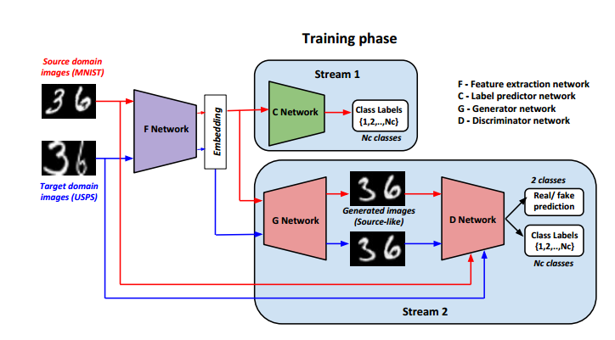
Pipeline
concate
Notes:
F Produce class consistent embeddings

Slide 4
$$x_{g}=[F\left(x\right),z,l]$$
$$D_{data}\left(G(x_{g})\right)$$
G
D
$$D_{cls}\left(G(x_{g})\right)$$
$$z∈ℝ^{d},𝒩(0,1)$$
$$l∈{\{0,1\}}^{(N_{c}+1)}$$

Slide 5
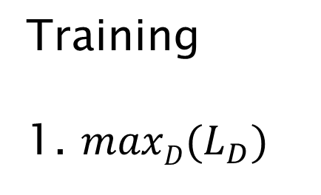
Training
1. $maxD⁡(L_{D})$
source
cls
F
C
target
cls
f/r
f/r
$$L_{D}=L_{data,src}+L_{cls,src}+L_{adv,tgt}$$
cls
G
D
f/r
$$L_{data,src}=\frac{1}{k}\sum_{i=1}^{k}{\log\left(D_{data}\left(s_{i}\right)\right)+log⁡(1−D_{data}(G(x_{g}^{s})))}$$
f/r
$$L_{cls,src}=\frac{1}{k}\sum_{i=1}^{k}{log⁡(D_{cls}(s_{i}))}$$
$$L_{adv,tgt}=\frac{1}{k}\sum_{i=1}^{k}{log⁡(1−D_{data}(G(x_{g}^{t})))}$$
Notes:
D具有分类能力，同时能够将生成的source domain的图片和真实的source domain的图片识别。

Slide 6

Training
2. $minG⁡(L_{G})$
$$L_{G}=\frac{1}{K}\sum_{I=1}^{k}{−log\left(D_{cls}\left(G\left(x_{g}^{s}\right)\right)\right)+log⁡(1−D_{data}(G(x_{g}^{s})))}$$
source
cls
F
C
target
cls
f/r
f/r
cls
G
D
f/r
f/r
Notes:
G对source domain的embedding有很好的性能，能够让source domain的embedding还原成完全真实的结果。

Slide 7
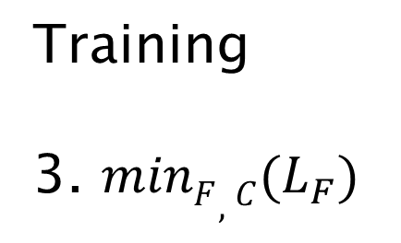
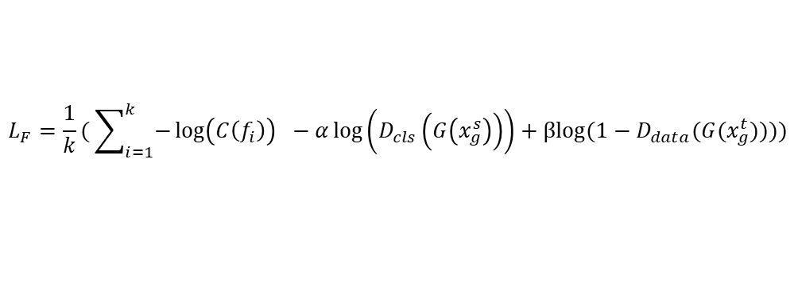
Training
3. $minF,C⁡(L_{F})$
$$L_{F}=\frac{1}{k}( \sum_{i=1}^{k}{−\log\left(C\left(f_{i}\right)\right)} −α\log\left(D_{cls}\left(G\left(x_{g}^{s}\right)\right)\right)+βlog⁡(1−D_{data}(G(x_{g}^{t}))))$$
source
cls
F
C
target
cls
f/r
f/r
cls
G
D
f/r
f/r
Notes:
F: 对source domain生成的embedding要具有分类信息， 同时保证target 的embedding具有domain invariant.
Produce class consistent embeddings

Slide 8
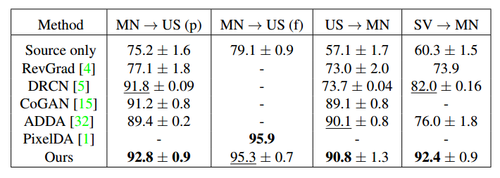
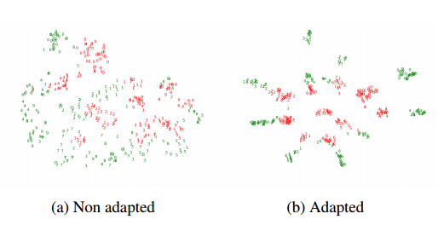
Experiment
DIGITS classification
MNIST(60000,10000 for train and test)
USPS(7291,2007 for train and test)
SVHN(73257 images)
Notes:
MNIST and USPS are large datasets of handwritten digits captured under constrained conditions.
SVHN dataset, on the other hand was obtained by cropping house numbers in Google Street View images and hence captures much more diversity.

Slide 9
Experiment
Object recognition
Office31(A(2817 ),W(795 ),D(498 ))
Notes:
The small dataset size poses a challenge to our approach since we rely on GAN which demands more data for better image generation. G: 64*64

Slide 10
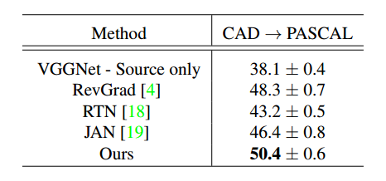
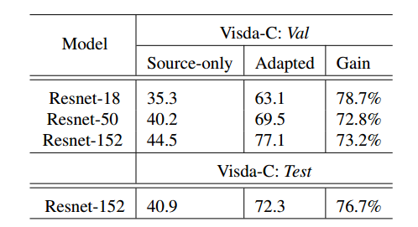
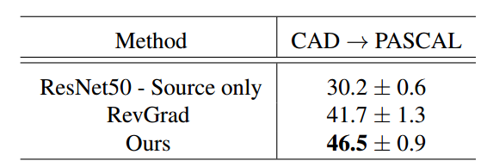
Experiment
Synthetic to Real
CAD->Pascal VOC VISDA Challenge
Notes:
randomly initialized weights performed very poorly on the target dataset.

Slide 11
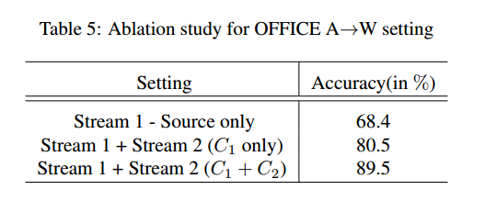
Experiment
Ablation Study
Notes:
mismatched mappings where embeddings get mapped to images of wrong classes

Slide 12
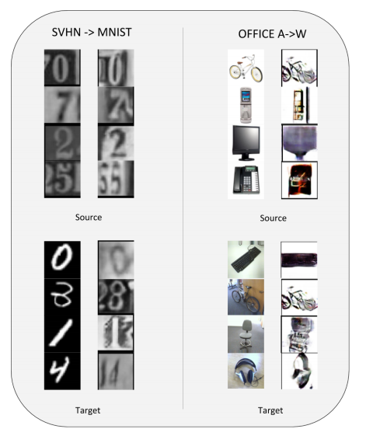
Experiment
The quality of image generation is better in the digits experiments compared to the Office experiments.
The generator is able to produce source-like images for both the source and target inputs in a class-consistent manner.
There is mode collapse in the generations produced in the Office experiments.

Slide 13
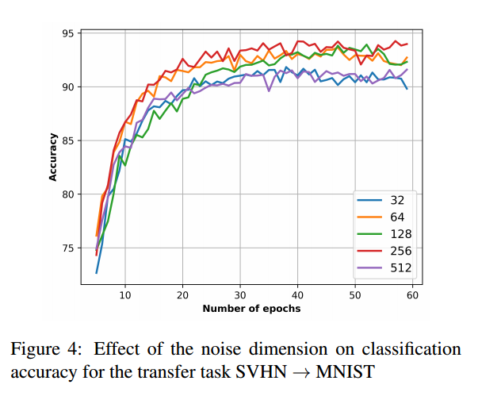
Experiment

Slide 14
Conclusion
Provide an adversarial image generation approach for UDA problem.
Achieve good performance even in case where image generation process is bound to fail.

