Slide 1
Adversarial Attack Beyond the Image Space

Slide 2
Motivation
Image-space adversaries don’t exit in the physical world
Demonstrate the possibility of causing neural networks failure by easy perturbations of real-world 3D objects and scenes

Slide 3
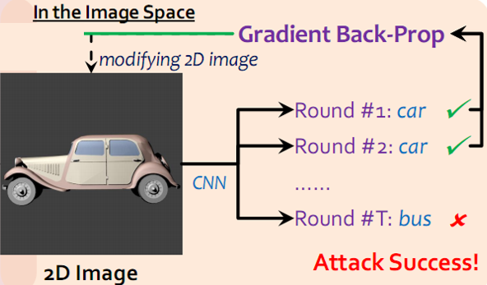
Framework
2D adversarial attack

Slide 4
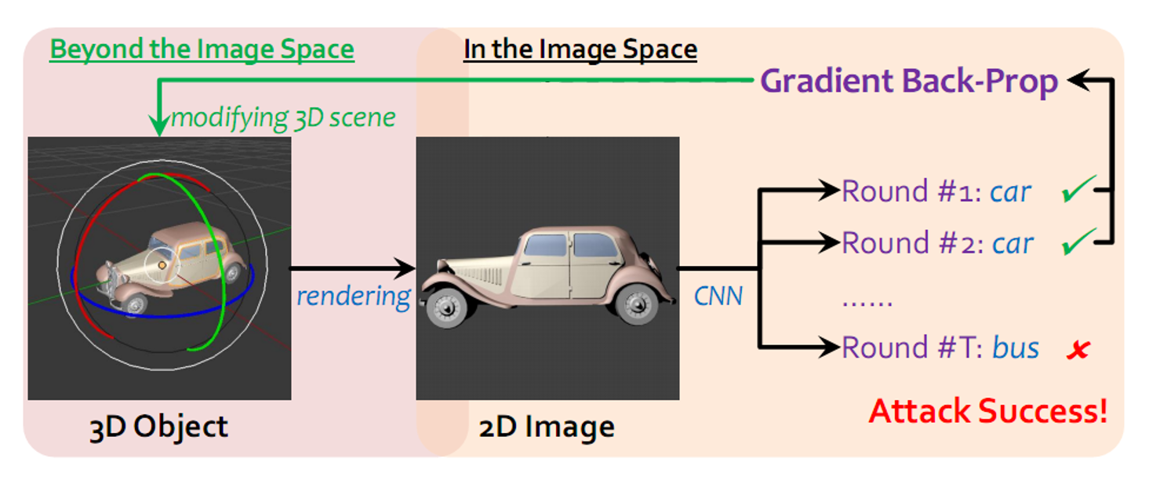
Framework
3D adversarial attack

Slide 5
Render
Differentiable [1]
Non-Differentiable [2]
Surface normal N
illumination L
material m
Color C
Translation T
Rotation R
Lighting L
[1] G. Liu, D. Ceylan, E. Yumer, J. Yang, and J. M. Lien. Material Editing Using a Physically Based Rendering Network. ICCV, 2017
[2] Blender Online Community. Blender – a 3D modelling and rendering package. https://www.blender.org/,2017. Blender Foundation, Blender Institute, Amsterdam.
Notes:
m: describe the point-wise light reflection for both diffuse and specular surfaces
3D object classification: L-5 dimension
2 for the magnitude of the environment and point light source
3 for the position of the point light source
3D visual question answering : L-12 dimension
represents the energy and position of 3 point light sources

Slide 6
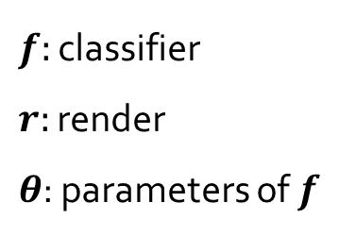
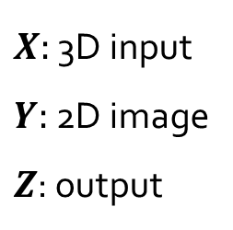
Approach
$$Z=f[r\left(X\right);θ] where r\left(X\right)=Y$$
$X:$ 3D input
$Y:$ 2D image
$Z$: output
$f:$ classifier
$r:$ render
$θ$: parameters of $f$
$$r$$
$$f$$
$$X$$
$$Y$$
$$Z$$

Slide 7
Approach
Loss function: $ℒ\left(Z\right)=Z_{c^{′}}$ where $c^{′}$ is the original true label
Target: minimize $ℒ(Z)$

Slide 8
Approach
$$∆α_{t}=∇_{α_{t−1}}ℒ\left(f\left[r\left(X,α_{t−1}\right)\right]\right)=∇_{α_{t−1}}ℒ∘f∘r(X,α_{t−1})$$
differentiable render
$$α∈the parameters of the render$$
update parameters
$α_{t}=α_{t−1}+η∙$ $∆α_{t−1}$
$$\frac{∂ℒ(Z)}{∂α_{d}}≈\frac{L\left(f\left[r\left(X,α_{d}+δ\right)\right]\right)−L\left(f\left[r\left(X,α_{d}−δ\right)\right]\right)}{2×δ}$$
non-differentiable render

Slide 9
Approach

Slide 10
Evaluation
Succ. : Success rate of attacks
Perceptibility: the major criterion of visual imperceptibility
$$∆Y=r\left(X+∆X\right)−r(X)$$
$$p\dot{=}p\left(∆Y\right)={(\frac{1}{W_{N}×H_{N}}\sum_{w=1}^{W_{N}}{\sum_{h=1}^{H_{N}}{{\left\|∆y_{w,h}\right\|}_{2}^{2}}})}^{1/2}$$

Slide 11
Experiment _ 3D Object Classiﬁcation
Data: ShapeNetCore-v2 dataset
Classifier: AlexNet and ResNet-34
Differentiable Render
Notes:
ShapeNetCore : contains 55 rigid objective categories

Slide 12
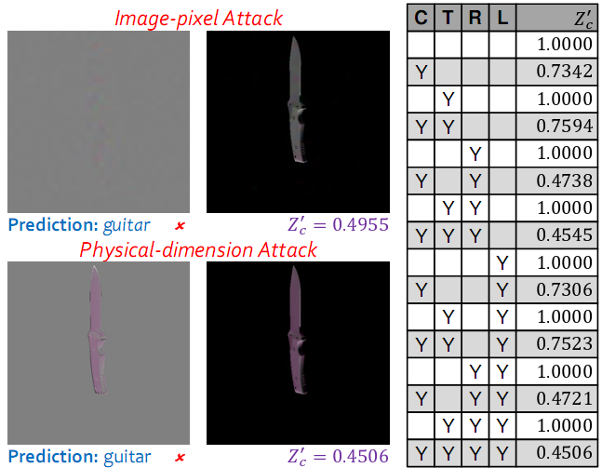
Experiment _ 3D Object Classiﬁcation
Non-Differentiable Render
Succ.
AlexNet: 14/102
RseNet-34: 6/102
Notes:
the detailed description of physical operations that can cause classification to fail

Slide 13
Experiment _ 3D VQA
Data: CLEVR dataset
Baseline algorithm: Inferring and Executing Program (IEP)
Differentiable Render
J. Johnson, B. Hariharan, L. van der Maaten, J. Hoffman, L. Fei-Fei, C. L. Zitnick, and R. Girshick. Inferring and Executing Programs for Visual Reasoning. ICCV, 2017.

Slide 14
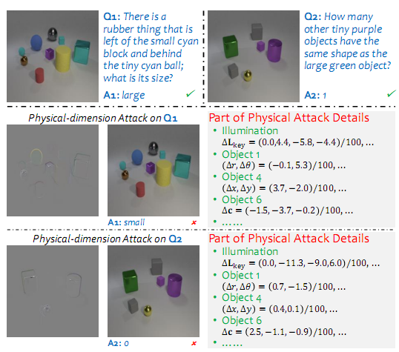
Experiment _ 3D VQA
Non-Differentiable Render
Succ. : 22/100

Slide 15
Conclusion & Comments
+ Good motivation
It’s a patchwork of other people’s
Notes:
Demonstrate the possibility of causing neural networks failure by easy perturbations of real-world 3D

