Slide 1
Beyond Vision: A Multimodal Recurrent Attention Convolutional Neural Network for Unified Image Aesthetic Prediction Tasks
Xiaodan Zhang, Xinbo Gao, Wen Lu, Lihuo He, and Jie Li
TMM2020

Slide 2
Contributions
Inspired by the human attention mechanism, a recurrent attention neural network is used to extract visual features
A multimodal network called MRACNN is proposed to jointly learn the visual features and textual features for image aesthetic prediction
We collect the AVA comment dataset and the photo.net comment dataset. These datasets can advance the research on multimodal modelling in image aesthetics

Slide 3
AVA dataset with comments

Slide 4
MRACNN architecture
EMD Loss

Slide 5
Vision Stream—feature extractor
Base network: VGG-16 or other type of network architecture
Input: image resized to 224x224
Output: tensor with dimension (W, H, D), represented as:
where L = W x H

Slide 6
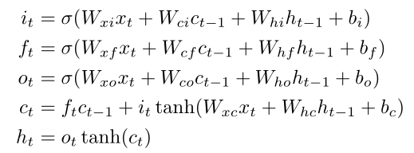
Vision Stream—LSTM
LSTM:
Attention:

Slide 7
Language Stream—Text-CNN

Slide 8
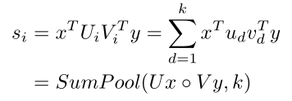
Multimodal Factorized Bilinear Pooling
Given the visual feature and the textual feature , the multimodal bilinear models can be defined as:
It can also be rewritten as:

Slide 9
Experiments—Feature Extractor

Slide 10
Experiments—Ablation Study

Slide 11
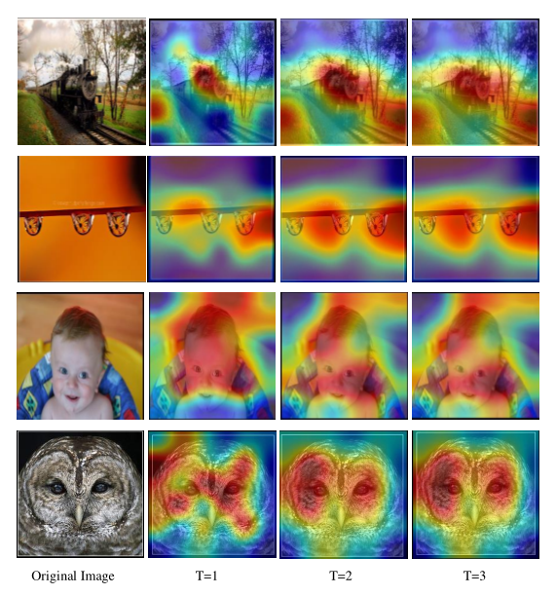
Experiments—Attention Map

Slide 12
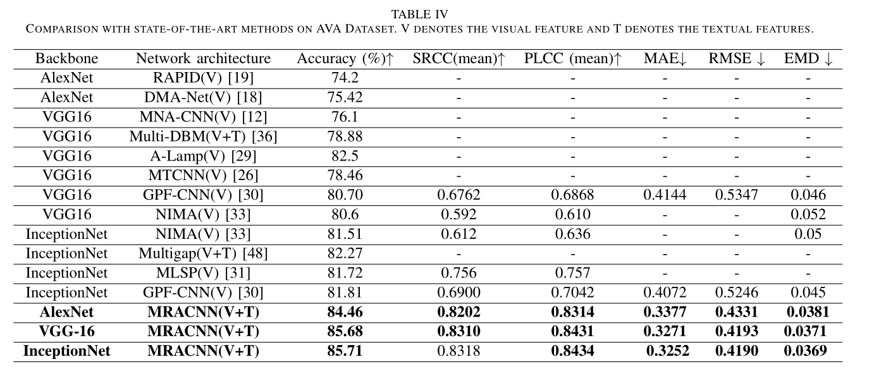
Experiments—Performance Comparison

Slide 13
Experiments—Performance on Photo.net

Slide 14
Comments
Pros: recurrent attention CNN, multimodal framework
Cons: text data may not be available in the real scenario, spatial information not considered in attention module

