Slide 1
Collaborative Global-Local Networks for Memory-Efficient Segmentation of Ultra-High Resolution Images
CVPR 2019 Oral
Wuyang Chen1, Ziyu Jiang1, Zhangyang Wang1, Kexin Cui1 and Xiaoning Qian2
Texas A&M University 美国德州农工大学

Slide 2
Ultra-High Resolution Images
Aerial image
Skin pathology image
Notes:
/pə'θɒlədʒɪ/

Slide 3
Ultra-High Resolution Images

Slide 4
Network Structure

Slide 5
Why two branches?

Slide 6
Deep feature map sharing

Slide 7
Regularization and Aggregation
Aggregation:
Concatenation + 3x3 Conv
$L_{2}$norm of local and global braches

Slide 8
Special for ISIC binary segmentation

Slide 9
Experiment Ablation Study
AGG: Aggregation of G and L branches.
Fmreg: regulation, $L_{2}$norm
shallow: only a single layer’s feature shared (not specified)
deep: all layers’ feature shared

Slide 10
Experiment Compare with STOA

Slide 11
Experiment Compare with STOA

Slide 12
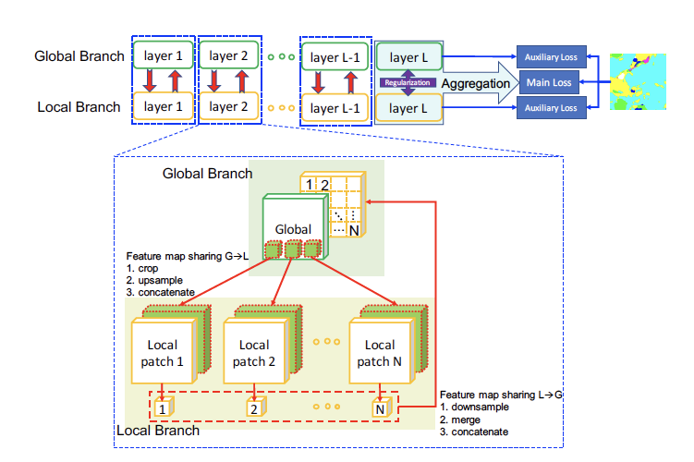
Conclusions
Only mIoU and memory, no speed comparison.
Drawback of crop:
Middle partition

