Slide 1
Exploring Self-attention for Image Recognition
CVPR 2020
李琦玥
2020.07.20

Slide 2
Index
Convolutional Networks
Contribution & Motivation
Pairwise & Patchwise
Self-attention Block
Comparisons
Conclusion

Slide 3
Convolutional Networks
GoogLeNet, VGG, ResNet, DenseNet, squeeze-and-excitation
Discrete convolution
$$\left(F∗k\right)\left(p\right)=\sum_{s+t=p}{F\left(s\right)k(t)}$$
F: discrete function k: discrete filter
Stationarity of the filter
the same filter k is applied across the image F
E.g. lacks rotation invariance,
Notes:
一次卷积中，卷积核是不变的，所以有一定局限性
临近部分信息的聚集并不一定能够适应整体内容
比如旋转不变性

Slide 4
Their work
Explore variations of the self-attention operator
Assess their effectiveness as the basic building block for image recognition models
Pairwise self-attention
Generalizes standard dot-product attention
Fundamentally a set operator
Patchwise self-attention
Strictly more powerful than convolution
Notes:
探索self-attention的两种运算
评估它们作为图片识别基础组成模块的效用
一般化标准的点乘注意力机制
本质上是集合运算符
比卷积严格更强（我认为是指在文中所进行的对比中）

Slide 5
Motivation
Convolutional Networks : feature aggregation - combining features from all locations tapped by the kernel feature transformation - successive linear mappings and nonlinear scalar functions
Decouple feature aggregation - their focus feature transformation - perceptron layers process each feature vector separately
Notes:
认为可以分为两部分，
特征提取：将kernel提取的内容组合起来
特征转化：之后的线性和非线性度量方程
感知层对每个特征分别处理

Slide 6
Motivation
Feature aggregation
a fixed kernel that applies pretrained weights to linearly combine feature values from a set of nearby locations
Present a number of alternative aggregation schemes
Construct high-performing image recognition architectures that interleave feature aggregation (via self-attention) and feature transformation (via elementwise perceptrons)
Notes:
特征提取
卷积：一个固定的kernel，应用预训练好的权重来线性组合特征内容
固定，缺乏根据特征的内容适应性
论文：给出一系列可选择的提取框架
构建表现力较好的图片识别结构
fixed and do not adapt to the content of the features
A perceptron layer consists of a linear mapping and a nonlinear scalar function

Slide 7
Pairwise Self-attention
$⨀$ Hadamard product
i spatial index of feature vector $x_{i}$
(i.e. its location in the feature map)
R(i) local footprint of the aggregation
β produces the feature vectors β($x_{j}$) that are aggregated by the adaptive weight vectors α($x_{i}$, $x_{j}$)
Notes:
对应位置相乘
X：feature map上一点
Y：经过self-attention模块计算后得到的特征图上的对应点
R(i)：i周围局部区域，类比于卷积核所在区域
Β：相当于对 xj 进行embedding 之后的结果
从上述计算公式中可以看出，pairwise self-attention方式和卷积方式最大的区别在于：卷积核的权重在学习完成后就是一个固定的标量，再用这个标量与特征图上一点的每个维度相乘。而在pairwise self-attention方法中，权重通过 alpha 计算得到，而且计算结果是一个向量，再用这个向量与 beta 对位相乘。
考虑到了特征在不同通道上的权重大

Slide 8
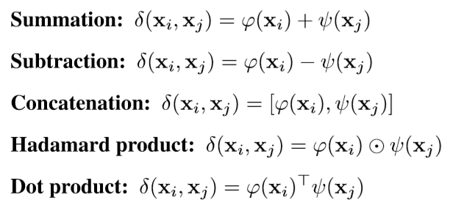
Pairwise Self-attention
δ outputs a single vector that represents the features $x_{i}$ and $x_{j}$
γ maps this vector into a vector that can be combined with β($x_{j}$)
Notes:
在尝试不同 δ 函数的选择是就不必考虑向量的维度问题，将维度匹配问题交给 γ 函数解决。γ={Linear→ReLU→Linear}
将位置信息纳入计算过程：
The horizontal and vertical coordinates along the feature map are first normalized to the range [−1,1] in each dimension. These normalized twodimensional coordinates are then passed through a trainable linear layer, which can map them to an appropriate range for each layer in the network.
This linear mapping outputs a two-dimensional position feature pi for each location i in the feature map. For each pair (i,j) such that j ∈R(i), we encode the relative position information by calculating the difference pi−pj. The outputof δ(xi,xj) is augmented by concatenating [pi −pj] prior to the mapping γ.

Slide 9
Patchwise Self-attention
$x_{R(i)}$ patch of feature vectors in the footprint R(i)
${α(x}_{R(i)})$ a tensor of the same spatial dimensionality
${α(x}_{R(i)})j$ vector at location j in this tensor
Notes:
xR(i) 是R(i)所在区域的特征图
α(xR(i))是 tensor,其实是权重tensor
patchwise self-attention与pairwise self-attention的区别就在于patchwise self-attention中没有对(xi,xj)的配对计算，而是整个区域用来计算得到一个权重张量，再用下标 j 来索引这个张量与 beta 对位相乘

Slide 10
Patchwise Self-attention
δ combines the feature vectors $x_{j}$ from the patch $x_{R(i)}$
γ maps a vector produced by δ($x_{R(i)}$)
to a tensor of appropriate dimensionality
comprises weight vectors for all locations j

Slide 11
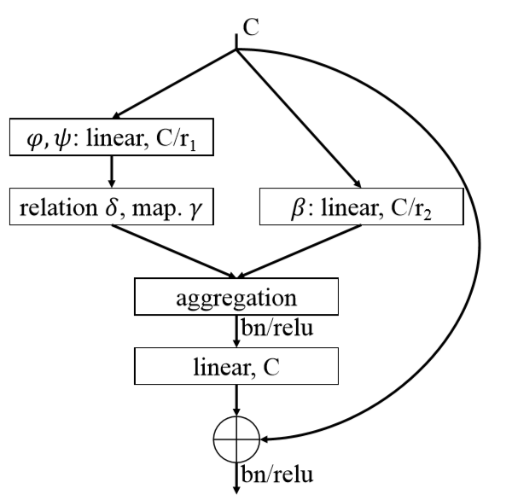
Network Architectures
Residual network
Self-attention Block
C channel dimensionality
Left
evaluates the attention weights
Right
transforms the input features and reduces their dimensionality for efficient processing
Notes:
刚刚所说的实际上是提出的两种运算操作，框架是残差网络
图中是self attention的模块
C：通道维度
左路：α的操作，进行加权
中路：β，转化输入特征，降维更有效处理
结合，进行标准化，然后一个最后线性网络，维度重归C
combined features are passed through a normalization and an elementwise nonlinearity, and are processed by a final linear layer that expands their dimensionality back to C.

Slide 12
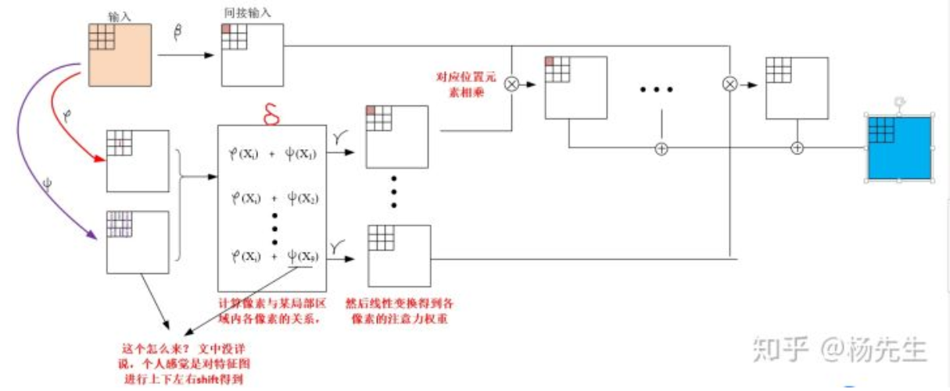
Network Architectures

Slide 13
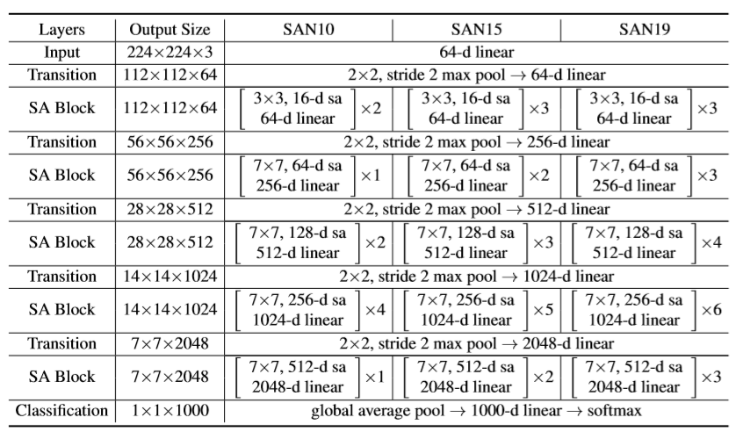
Comparison
ResNet26 Resnet38 ResNet50
Notes:
具体的结构，不必多说
SAN后的数字，就是用的attention block的个数

Slide 14
Comparison
Scalar attention
Notes:
Scalar：聚合的权重在不同的位置可以不同，与图像内容有关
Β前面的权重是一个标量，所有通道可以共享，不同通道上没有对应的注意力权重

Slide 15
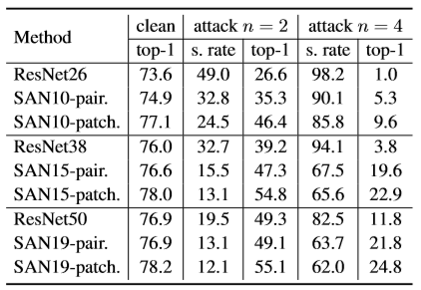
Comparison（ImageNet）
PGD attack ε=8，ρ=2
n number of attack iterations
s.rate success rate
Top-1 accuracy under attack
Notes:
ε 单位像素最大扰动
ρ 攻击步长
First, networks based purely on pairwise self-attention match or outperform convolutional baselines. This indicates that the success of deep learning in computer vision is not inextricably tied to convolutional networks: there is an alternative route to comparable or higher discriminative power, with different and potentially beneficial structural properties such as permutation- and cardinality-invariance.
Our second major finding is that patchwise self-attention models substantially outperform convolutional baselines. This suggests that patchwise self-attention, which generalizes convolution, may yield strong accuracy gains across applications in computer vision.
Finally, our experiments indicate that vector self-attention is particularly powerful and substantially outperforms scalar (dot-product) attention, which has been the predominant formulation to date.

Slide 16
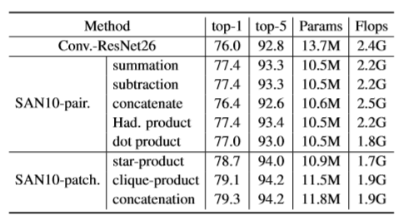
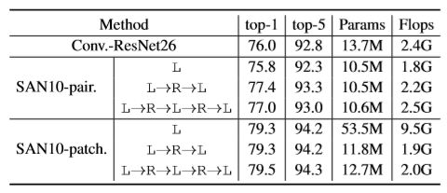
Comparison
Mapping function

Slide 17
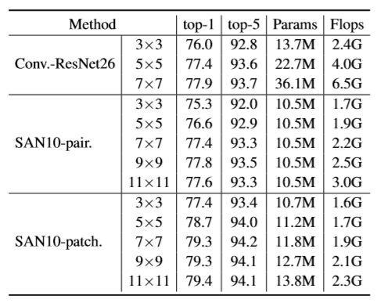
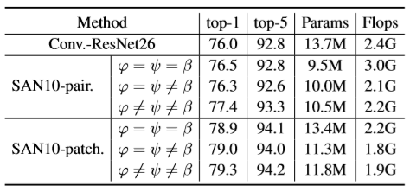
Comparison
Transformation function
Footprint size

Slide 18
Comparison
Patchwise do not have the permutation or cardinality invariance of pairwise attention, but are strictly more powerful than convolution

Slide 19
Comparison
PGD attack ε=8，ρ=2
n number of attack iterations
s.rate success rate
Top-1 accuracy under attack
Notes:
ε 单位像素最大扰动
ρ 攻击步长
First, networks based purely on pairwise self-attention match or outperform convolutional baselines. This indicates that the success of deep learning in computer vision is not inextricably tied to convolutional networks: there is an alternative route to comparable or higher discriminative power, with different and potentially beneficial structural properties such as permutation- and cardinality-invariance.
Our second major finding is that patchwise self-attention models substantially outperform convolutional baselines. This suggests that patchwise self-attention, which generalizes convolution, may yield strong accuracy gains across applications in computer vision.
Finally, our experiments indicate that vector self-attention is particularly powerful and substantially outperforms scalar (dot-product) attention, which has been the predominant formulation to date.

Slide 20
Conclusion
Pairwise : an alternative route of convolutional networks to comparable or higher discriminative power
Patchwise : an alternative route to comparable or higher discriminative power
Vector self-attention is particularly powerful
Notes:
Pairwise：准确率没有很大提升，但是耗费资源变少，提供了卷积的替代
Patchwise：更强
向量的self-attention是非常强的
另一方面，CUHK的两位作者实际上做了很多point-wise的内容研究，我觉得这个和论文中的思想可能也有一定的关系
First, networks based purely on pairwise self-attention match or outperform convolutional baselines. This indicates that the success of deep learning in computer vision is not inextricably tied to convolutional networks: there is an alternative route to comparable or higher discriminative power, with different and potentially beneficial structural properties such as permutation- and cardinality-invariance.
Our second major finding is that patchwise self-attention models substantially outperform convolutional baselines. This suggests that patchwise self-attention, which generalizes convolution, may yield strong accuracy gains across applications in computer vision.
Finally, our experiments indicate that vector self-attention is particularly powerful and substantially outperforms scalar (dot-product) attention, which has been the predominant formulation to date.

Slide 21
Thanks
Notes:
【后记】
才发现腾讯会议演示者视图共享竟然……（一把辛酸泪）
害怕自己太过紧张无法阻止语言，特意把英语翻译了一遍写在注释……不过还好自己写了一遍，有点印象，理解也更深了，要不会更加车祸
希望以后能看着英文讲中文update颅内实时翻译技能，或者熟练到不用看ppt都能讲

