Slide 1
GIQA: Generated Image Quality Assessment

Slide 2
Motivation
Image quality assessment is important for generative models
previous NR-IQA mainly focuses on natural or distortion-specific images, instead of generated images
previous metrics for generative models, like IS or FID, focus on the assessment of the generative models, not each single generated image

Slide 3
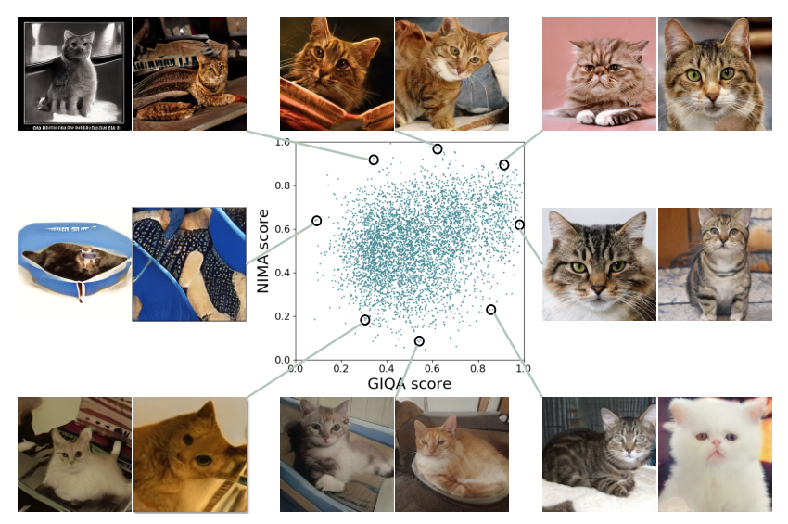

Slide 4
Methods: learning-based
pseudo labels
: pseudo labels for image I
: maximum quality score for the generated image, 0.9 in experiments
for most models, the quality of generated images is becoming better and better as the training iteration increases
$$S_{p}\left(I\right)$$
$$S_{g}$$

Slide 5
Methods: learning-based
Multiple binary classifiers as regressor
set N thresholds
for each , divide the training data into positive and negative samples
for each , train an binary classifier on the dataset described above
the final predicted score is the average of the N predicted scores:
$$0<T^{1}<T^{2}<⋯<T^{N}=1$$
$$T^{i}$$
$$T^{i}$$
$$S_{\text{MBC}}\left(I_{g}\right)=\frac{1}{N}\sum_{i=1}^{N}{{\hat{c}}^{i}}$$

Slide 6
Methods: data-based
Gaussian Mixture Model (GMM)
estimate the parameters by EM algorithm
K Nearest Neighbour (KNN)
x: feature of the image
x^k: kth nearest neighbor of x
$$p\left(x|λ\right)=\sum_{i=1}^{M}{w^{i}g\left(x|μ^{i},Σ^{i}\right)}$$
$$p\left(x\right)=\frac{1}{K}\sum_{k=1}^{K}{\frac{1}{{‖x−x^{k}‖}^{2}}}$$

Slide 7
Generative model evaluation
Quality
Diversity
S`: GIQA trained on generated data and evaluated on real data
$$QS\left(G\right)=\frac{1}{N_{g}}\sum_{i=1}^{N_{g}}{S\left(I_{g}^{i}\right)}$$
$$DS\left(G\right)=\frac{1}{N_{r}}\sum_{i=1}^{N_{r}}{S′\left(I_{r}^{i}\right)}$$

Slide 8
Experiments
LGIQA: Labeled Generated Image Quality Assessment dataset
BC-GIQA: use only one binary classifier
IR-GIQA: directly regress on the score
SGM-GIQA: single gaussian model

Slide 9
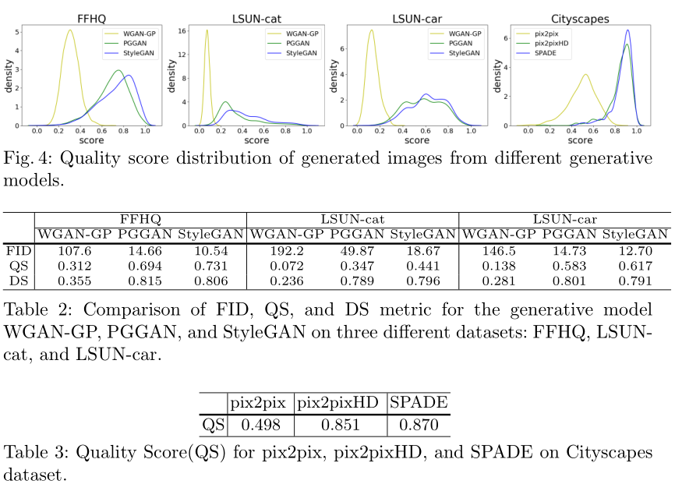
Generative model assessment

Slide 10
Conclusion
the first to propose the topic of generated image quality assessment (GIQA). They proposed three novel methods from two perspectives
The method is general and available to many applications
release the LGIQA dataset for evaluating different GIQA methods

Slide 11
Comments
In the learning based method, the pseudo labels may contain too much noise
All methods are unsupervised, so the performance may be limited

