Slide 1
Incorporating Semi-Supervised and Positive-Unlabeled Learning for Boosting Full Reference Image Quality Assessment
CVPR 2022

Slide 2
Motivation
Semi-supervised learning (SSL)
- It can use less expensive and easily accessible unlabeled data
Positive-unlabeled (PU) learning
The unlabeled data often has a different distribution from labeled data
PU learning can find and exclude negative samples for SSL

Slide 3
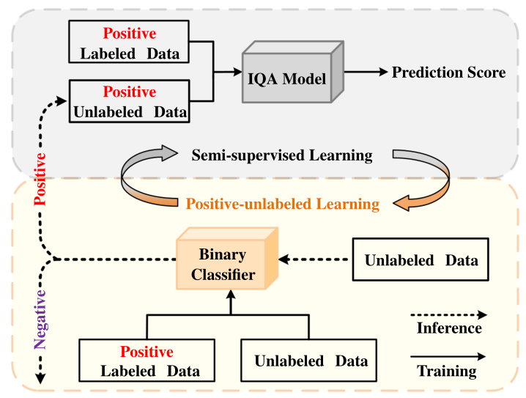
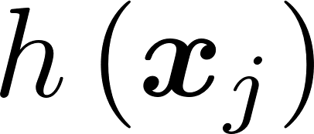
Framework and Notations
: input two-tuple
: ground truth MOS
: learned quality mapping
: positive labeled data
: unlabeled data
: binary classifier

Slide 4
PU learning
For a positive sample, we simply adopt the cross-entropy (CE) loss
Each unlabeled sample should be either positive or negative sample
To prevent the classifier from producing 1 for all samples, we introduce a negative-enforcing (NE) loss for constraining that there is at least one negative sample in each mini-batch
Total PU learning loss:

Slide 5
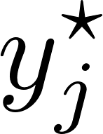
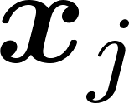
Semi-supervised learning
For labeled data, we adopt the MSE loss
For unlabeled data, we only consider the positive unlabeled samples
where denotes the pseudo MOS for
We obtain by the moving average strategy
Total SSL loss:

Slide 6
JSPL Model
We jointly optimize both the SSL and PU learning module:
Training steps:
update the binary classifier
pseudo MOS is updated for each unlabeled sample
the positive unlabeled samples are incorporated with the mini-batch of labeled samples to update the FR-IQA network

Slide 7
Network structure

Slide 8
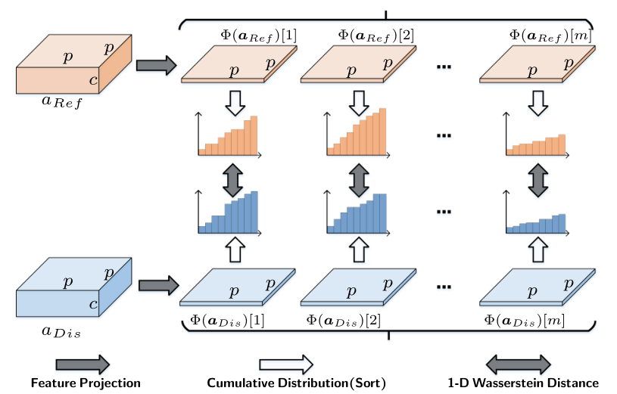
Local sliced Wasserstein (LocalSW) distance
Divide feature maps into patches
Pass into a projection operator
Sort and calculate difference for each channel to form the LocalSW distance map

Slide 9
Experiment settings
Labeled Data
LIVE, CSIQ, TID2013, KADID-10k and PIPAL
Unlabeled Data
1000 patches from DIV2K and Flickr2K as reference images
ESRGAN Synthesis, 50 distorted images for each reference image
DnCNN Synthesis, 50 for each reference image
KADID-10k Synthesis, 100 for each reference image

Slide 10
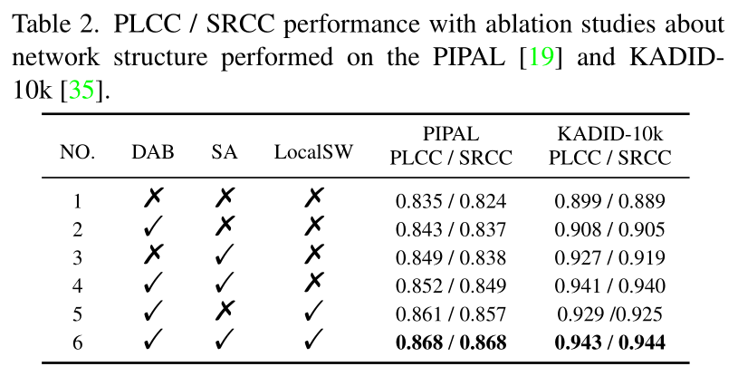
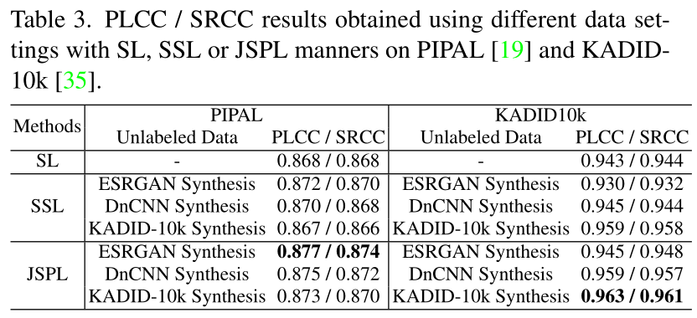
Ablation study

Slide 11
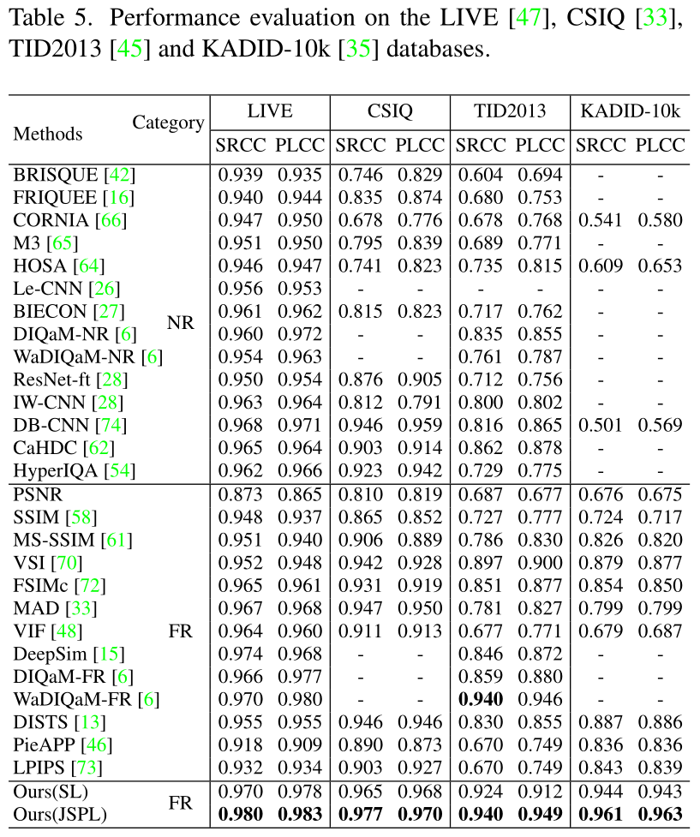
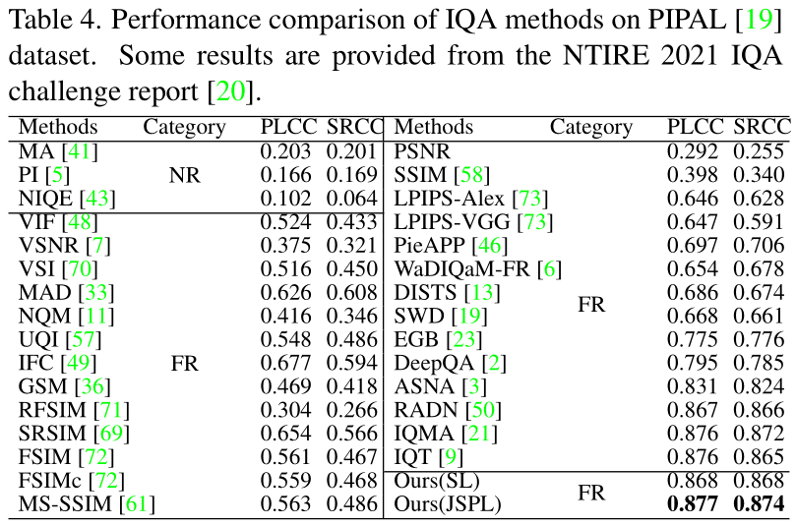
Performance comparison

Slide 12
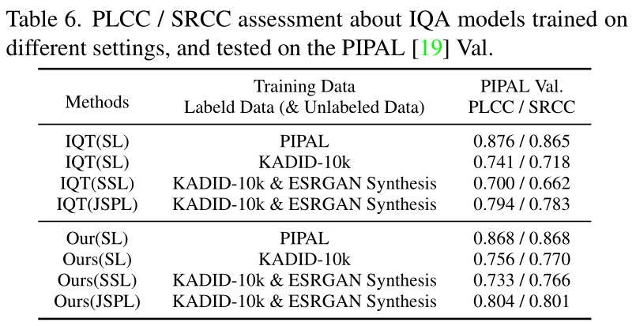
Generalization ability

Slide 13
Comments
Pros
The writing is good
The motivation and experiments are convincing
Cons
no experimental results for the classifier

