Slide 1
Feature Selection for Zero-Shot Gesture Recognition
FG 2020
（IEEE International Conference on Automatic Face and Gesture Recognition）
Notes:
普渡大学西拉法叶分校

Slide 2
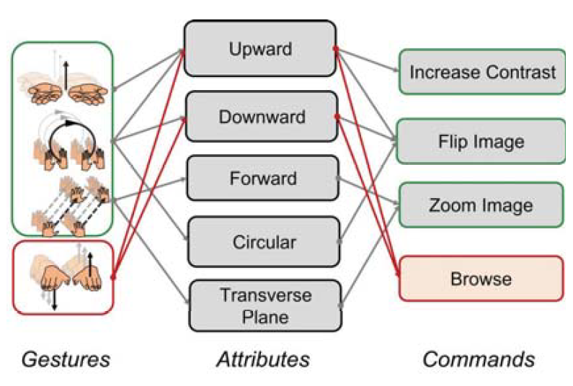
Background
Assign a pre-determined categorical label and cannot recognize new categories that might appear after the training stage
Zero-shot Learning (ZSL)
Zero-shot Gesture Learning (ZSGL)
Having a high-level description
Uncountable number of classes
Online Algorithm
Notes:
ZSL: object detection
ZSGL: unexplored
一些特定的问题（比如苹果apple肯定学不出梨pear）
How? Having a high-level
Usage? Uncountable or Online

Slide 3
Key Problems
Domain-shift problems
Disparate seen and unseen data distributions
A sequence of high-level properties / attributes / semantic descriptors
recognize the presence / absence, recognize the class label
ZSL to ZSGL – temporal problems ill-defined
Lack of large-scale attribute-based datasets coupled with the intrinsic complexities associated with the temporal data

Slide 4
Methodology
Share attribute space
$s$ - a set of training (seen) classes
$u$ - a set of unseen classes
$z_{s}$ - number of seen classes
$z_{u}$ - number of unseen classes
$a$ – number of attributes
$m_{s}$ - number of instances in seen data
$X∈R^{d×m_{s}}$ - input feature matrix
$Y∈{\left\{−1,1\right\}}^{m_{s}×z_{s}}$ - ground truth labels
$Σ∈{[0,1]}^{m_{s}×a}$ - per instance description
$S∈{[0,1]}^{a×z_{s}}$ - per class description
$V∈R^{d×a}$ - weight matrix

Slide 5
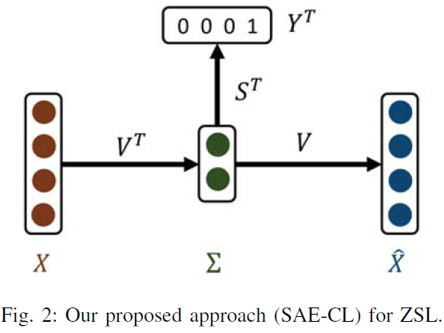
Loss
Semantic-Classification Loss
latent representations should have semantic meaning
Reconstruction Loss
learnt latent space representations contain enough information

Slide 6
SAE with Classification Loss (SAE-CL)
Overall Loss
weighted sum of reconstruction loss and semantic classification loss
$AV+VB=C$ Sylvester Equation

Slide 7
Feature Extraction
Raw features: coordinates of both the left and right hand of the gesture performer with respect to the shoulder
Sampled Raw Features: trivial concatenation
Re-sampled to a fixed number of frames using interpolation techniques
Concatenate features corresponding to each frame
Engineered Features: designed based on prior knowledge
$A_{x}^{+}$ - sum of positive values along x-axis for both hands
$A_{x}^{−}$ - sum of negative values along x-axis for both hands
$R_{x}^{}$ - range of motion along x-axis for both hands
$M_{x}^{}$ - mean of all values along x-axis for both hands

Slide 8
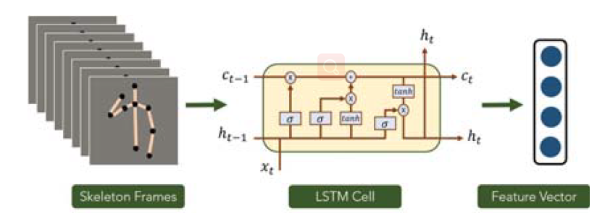
Feature Extraction
Deep Features: BLSTM
Last layer of a trained BLSTM is used as a feature vector
5-fold cross validation
2 LSTM cells
32 hidden size
0.5 dropout

Slide 9
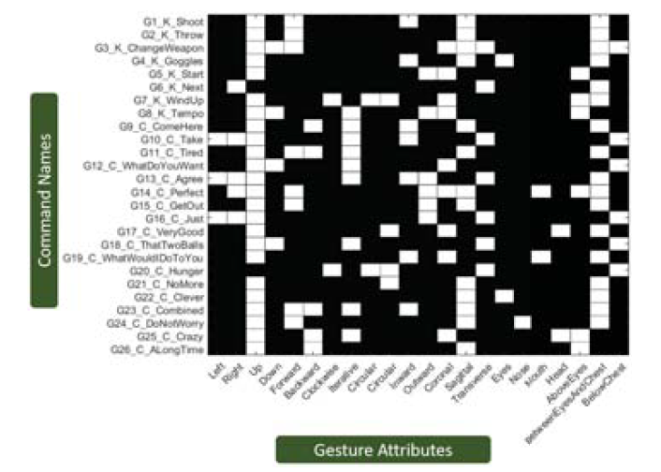
Experiments
Dataset: 26 classes
Comparisons
Command
Names
Data Imbalance
Want -
Each attribute to be present in half of the seen and absent in the other half
But -
Some either present or absent for most classes
Gesture
Attributes
Notes:
一些主流的ZSL方法进行了比较

Slide 10
Data Imbalance
Data augmentation
Re-struct the mis-classification costs of DAP
$p$ - the probability of encountering an example from the minority class
$(1−p)/p$ - punish weight for error corresponding to minority classes
Large attribute-based datasets
standard deviation of the accuracies is considerably high
unseen class accuracies majorly depend on the seen-unseen class splits
Deep Learning not Effective
Notes:
quite possible that there might be some attributes that are present in only one class making it very difficult for the learning algorithm to predict that attribute

Slide 11
Comments
Simple but instructive
Use different features (raw, traditional method and deep learning) and make reasonable explanations
Possible improvement: $V^{T}→V^{−1} ?$
Raise a problem: how to collect data to
benefit ZSL ?

Slide 12
THANKS

