Slide 1
Learning Conditional Knowledge Distillation for Degraded-Reference Image Quality Assessment
ICCV 2021

Slide 2
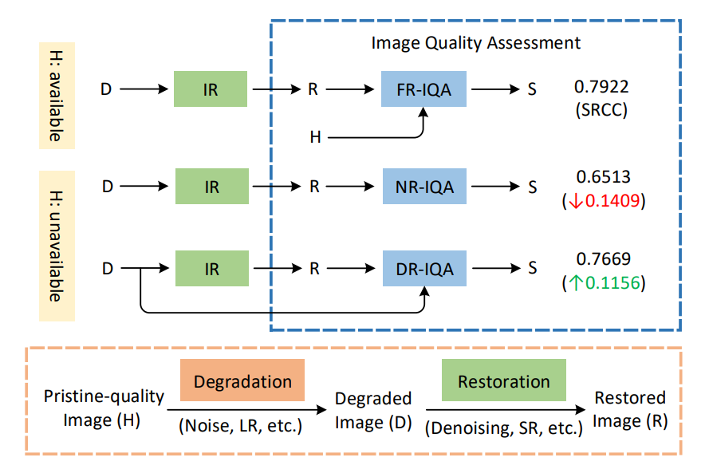
Degraded-reference IQA (DR-IQA)
Pristine-quality images provide strong information for IQA
DR-IQA extracts reference information from degraded images in image restoration (IR) tasks

Slide 3
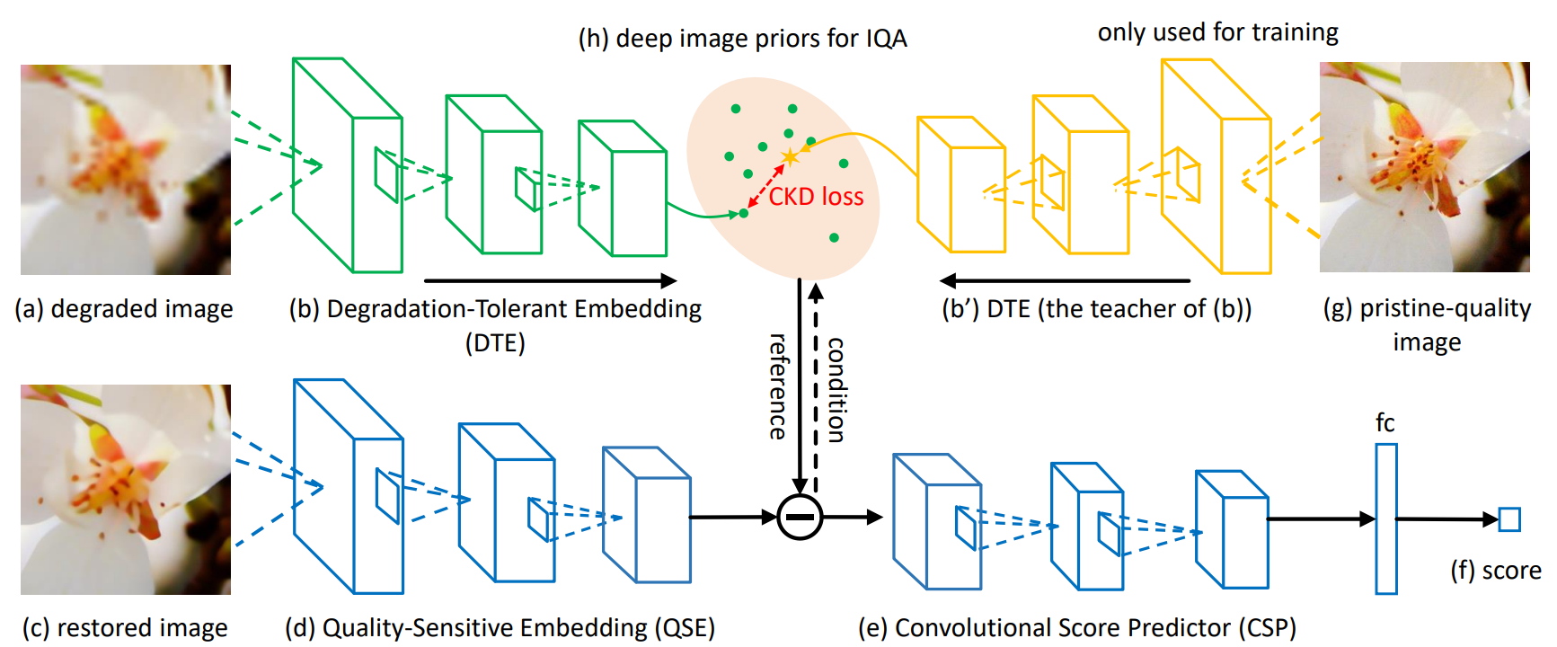
Conditional Knowledge Distillation Network (CKDN)

Slide 4
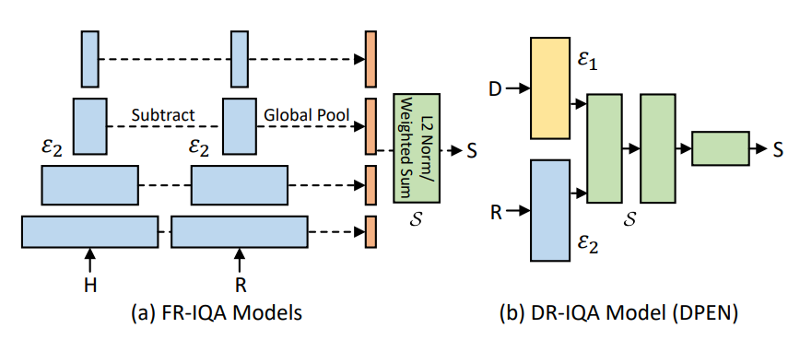
Comparison of FR-IQA and DR-IQA
H, D, R: the pristine image, the degraded image and the restored image
: degradation-tolerant embedding module (DTE)
: quality-sensitive embedding module (QSE)
: convolutional score predictor (CSP)

Slide 5
Loss functions
Score regression:
learning deep image priors from pristine-quality images:
full loss:

Slide 6
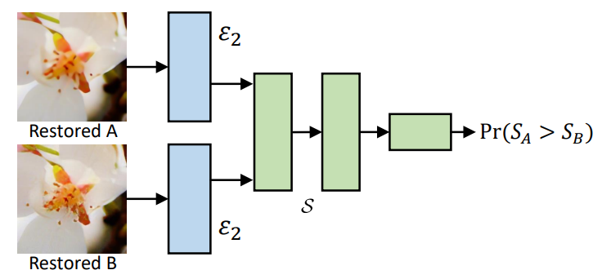
Pretraining QSE
Where

Slide 7
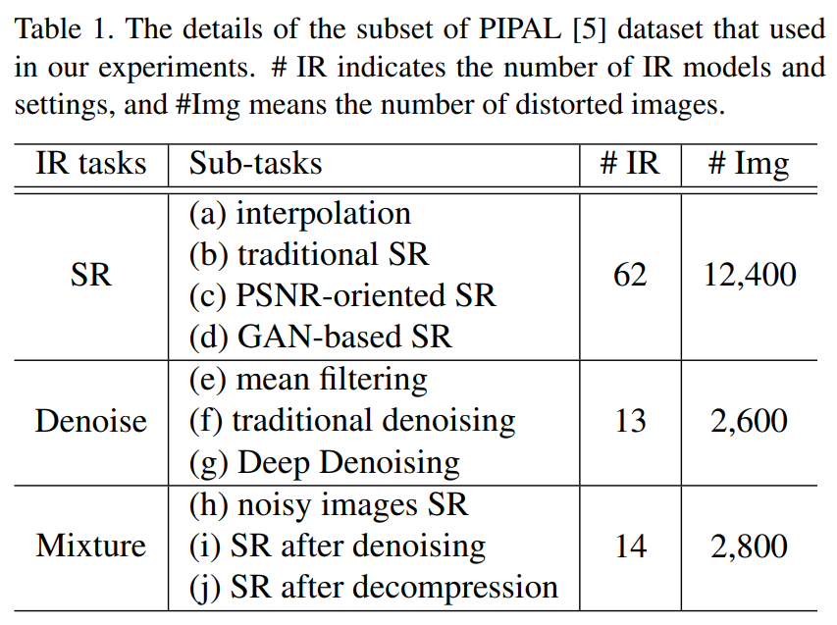
Experiment setup
Datasets: a subset of PIPAL
Training split: 175 reference images for training and 25 images for validation. 50 IR algorithms for training and 39 algorithms for validation

Slide 8
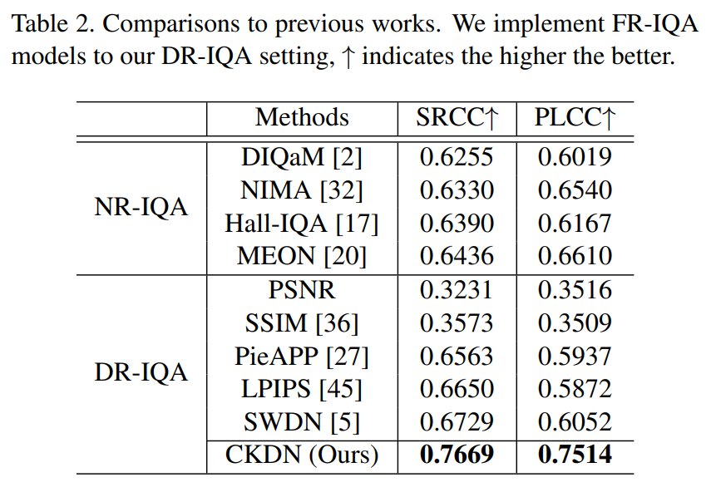
Performance comparison

Slide 9
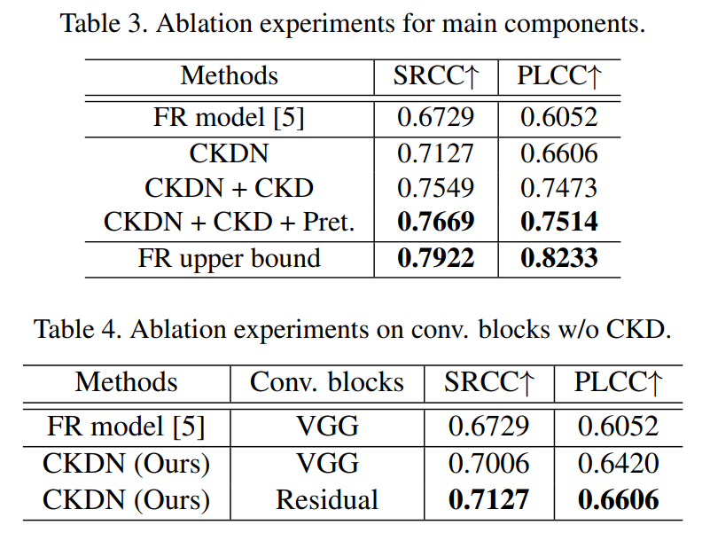
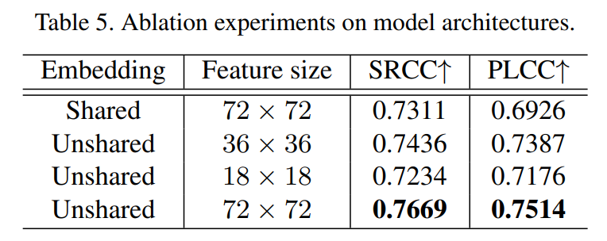
Ablation Studies

Slide 10
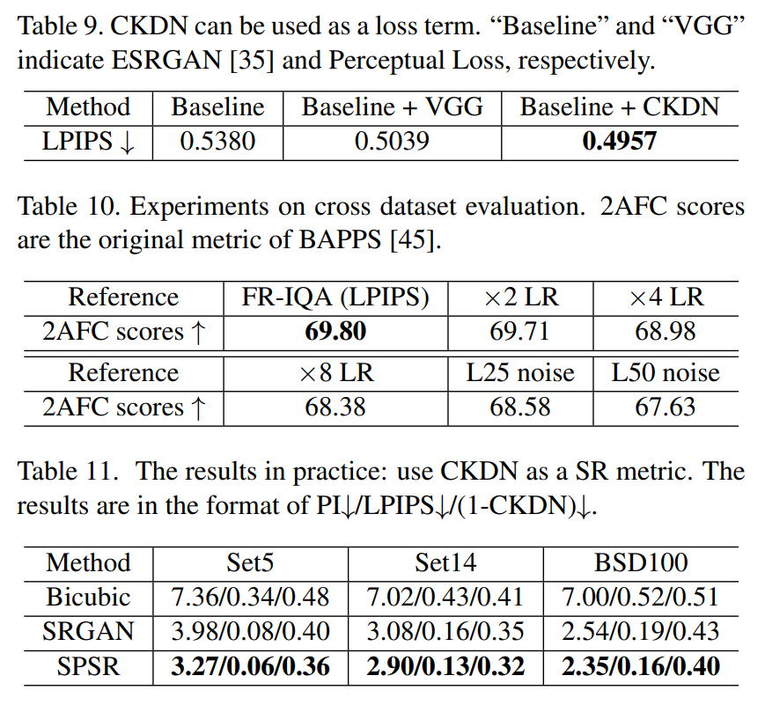
Further Results

Slide 11
Comments
Pros:
The idea is novel and practical
The CKD training strategy is effective
Code available
Cons:
There is some redundancy in the writing

