Slide 1
ICCV2021

Slide 2
Motivation
Problem: Training temporal action detection in videos requires large amounts of labeled data, yet such annotation is expensive to collect.
Solution: Incorporating labeled data, weakly-labeled data and unlabeled data to train action detection model could help reduce annotation cost.

Slide 3
Motivation
Semisupervised Action Detection (SSAD): labeled data + unlabeled data
Omnisupervised Action Detection (OSAD): labeled data + weakly-labeled data + unlabeled data

Slide 4
Method
Video:
Features:
Proposals:
Proposal Features:
$𝒮$: labeled data
$𝒲$: weakly-labeled data
$𝒰$: unlabeled data

Slide 5
Method
Steps:

Slide 6
SSAD
Baseline = Semi-Supervised Learning (SSL) algorithms + Fully-Supervised Action Detection (FSAD)
SSN = Classification module + Completeness module + Regression module

Slide 7
SSL
Mean Teacher: optimizes the output consistency between two different augmentations of the same instance.
MixMatch: enforces a linear output between input points.
FixMatch: combines consistency-based and pseudo-label methods.
SSAD:

Slide 8
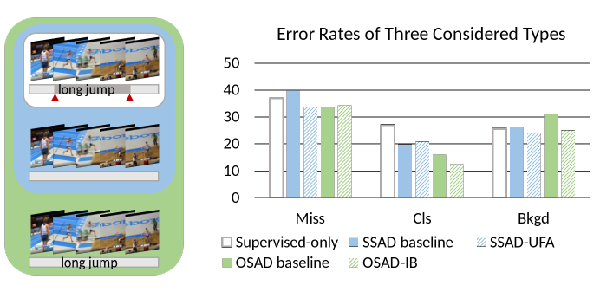
SSAD
Problem: Compared to the supervised-only model, the main type of error in SSAD baseline is Miss.
Solution: Since actions are basically defined by the movement of foreground objects, the model can better recognize complete action clips by paying more attention to the foreground.
→ Unsupervised foreground attention (UFA) module

Slide 9
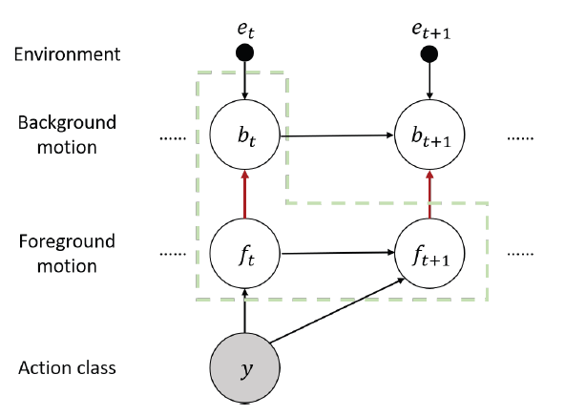
UFA
The module needs to estimate the motion of foreground from background, while there is a correlation between the foreground movement and the background movement before the movement.
The module needs to find out the conditional independence between the foreground movement and the background movement.
Conditional independence:
Loss function:

Slide 10
OSAD
OSAD = SSAD + weakly-labeled data
OSAD Baseline:

Slide 11
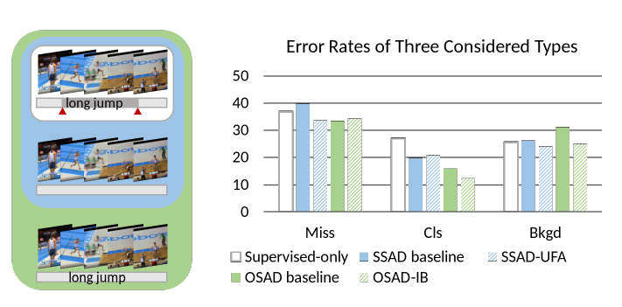
OSAD
Problem: The model classifies nonaction frames as action frames (action-context confusion).
Reason: The recognition model is expected to classify the weakly-labeled videos based on action information, while actually the model tends to take a “shortcut” instead and learns to classify action based on the scene information
Solution: filter out the scene information and only keep the action information.
→ Information Bottleneck (IB)

Slide 12
IB
Information Bottleneck (IB): filter out the scene information and only keep the action information.

Slide 13
Experiment
THUMOS14: 20 action classes, 200 videos for training, 213 annotated videos for testing.
ActivityNet: The version 1.2 consists of 4,819 training, 2,383 validation, and 2,480 test videos with 100 categories.

Slide 14
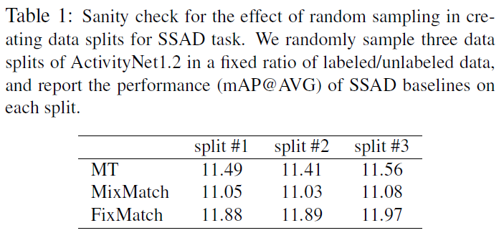
Experiment

Slide 15
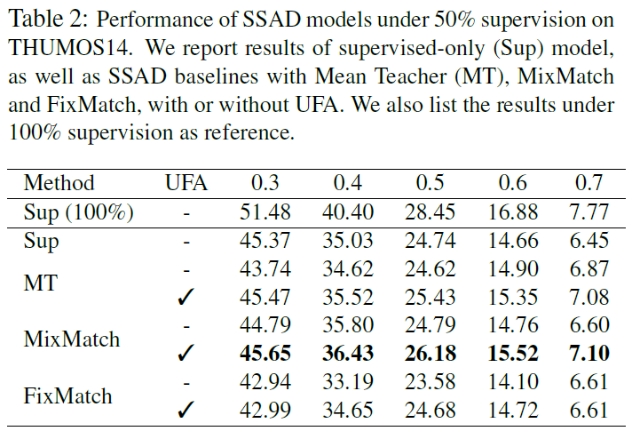
Experiment

Slide 16
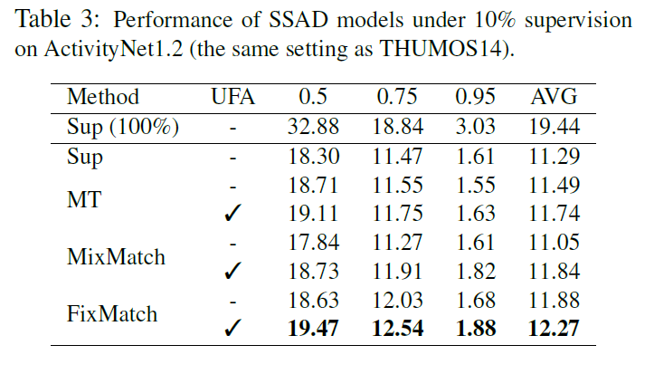
Experiment

Slide 17
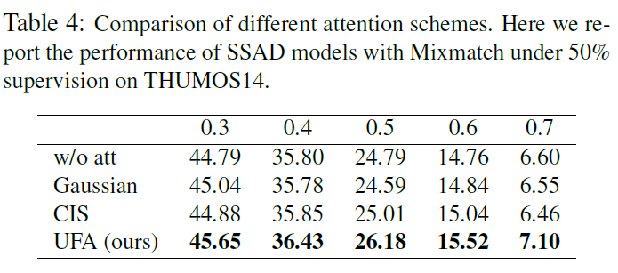
Experiment

Slide 18
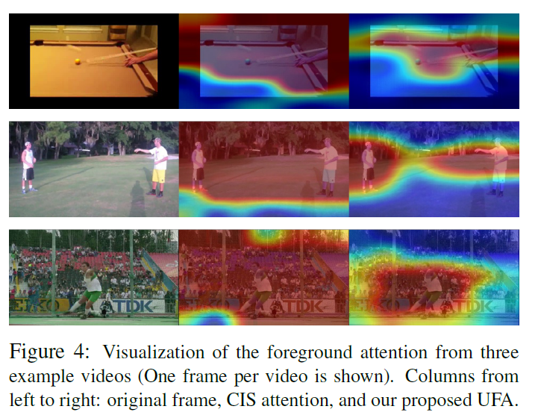
Experiment

Slide 19
Experiment

Slide 20
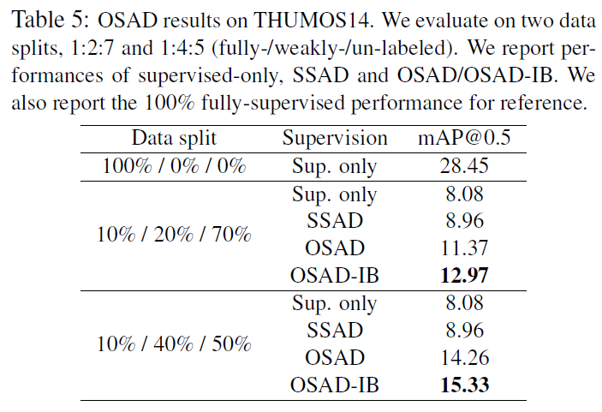
Experiment

Slide 21
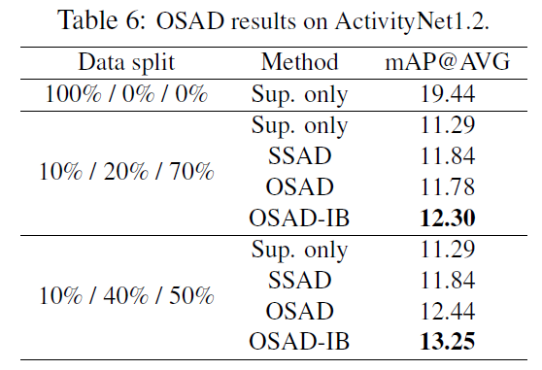
Experiment

Slide 22
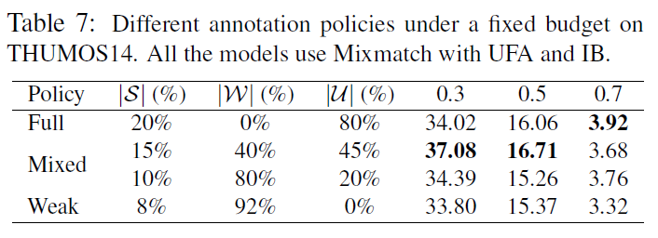
Experiment

