Slide 1
Reducing Flipping Errors in Deep Neural Networks

Slide 2
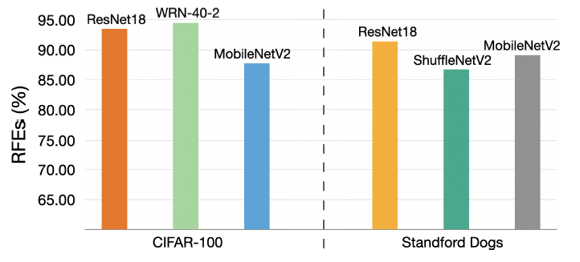
Motivation
How many test (unseen) samples that a DNN misclassifies in the last epoch were ever correctly classified by the DNN before the last epoch? (Wrongly Flipped Samples WFSs)
Relative Flipping Error:
RFE $=\frac{\# WFSs}{\# Mislcassified Test Samples}$
An observation
Notes:
Relative Flipping Error (RFE) is
the ratio of WFSs to the total number of misclassified test
samples (MTSs) in the last epoch

Slide 3
Idea
Once a DNN has made a correct prediction on a sample
Limit the behavior change on this sample
To maintain the correct local classification boundaries near this sample
To avoid wrong flipping

Slide 4
Idea
Once a DNN has made a correct prediction on a sample
Limit the behavior change on this sample
To maintain the correct local classification boundaries near this sample
To avoid wrong flipping
Do not use one-hot label as the groundtruth,
Use the adaptive soft distribution instead !

Slide 5
The Flipping Error Reduction (FER) Framework – Global Picture
Standard Training Procedure (STD)
FER
Training dataset $𝒟={\left\{\left(x_{i},y_{i}\right)\right\}}_{i=1}^{n}$
The behavior on a sample
$x_{i}$: input sample
soft distribution: $b\left(x\right)=σ(f(x)/τ)$
$y_{i}$: one-hot label
softmax
a temperature
Minimizing the cross-entropy loss
Some operations on $b(x)$ $→$ $𝒪(b\left(x\right))$ ….
$$ℒ_{CE}\left(x\right)=ℋ(f\left(x\right),y)$$
Minimizing the weighted loss
$$ℒ_{FER}\left(x\right)=w⋅ℒ_{CE}\left(x\right)+(1−w)ℒ(𝒪(b\left(x\right)))$$

Slide 6
The Flipping Error Reduction (FER) Framework - Details
FER
The behavior on a sample: $b\left(x\right)=σ(f(x)/τ)$
In the $k$-th epoch, suppose that the DNN has made correct predictions in $j$ epochs for sample $x$
Index set: $S=\{s_{1},s_{2},…,s_{j}\}$
Behaviors in $j$ epochs are:$[b_{s_{1}}\left(x\right),b_{s_{2}}\left(x\right),…,b_{s_{j}}\left(x\right)]$
The weighted behavior: ${\hat{b}}_{k}\left(x\right)=e^{−μc_{s_{j}}}{\hat{b}}_{k−1} \left(x\right)+\left(1−e^{−μc_{s_{j}}}\right)b_{s_{j}}(x)$
$c_{j}$: the probability for the ground-truth class in the $j$-th epoch
Notes:
Once $x$ correctly classified, maintain its behavior

Slide 7
Epochs with wrong predictions
The Flipping Error Reduction (FER) Framework - Details
Epochs with correct predictions
FER
The weighted behavior: ${\hat{b}}_{k}\left(x\right)=e^{−μc_{s_{j}}}{\hat{b}}_{k−1} \left(x\right)+\left(1−e^{−μc_{s_{j}}}\right)b_{s_{j}}(x)$
$c_{j}$: the probability for the ground-truth class in the $j$-th epoch
Example: $x∈class 1$
Index set: $S=\{\}$
$$b$$
$$b_{1}={\left(0.1,0.9\right)}^{T}$$
$$c$$
$$c_{1}=0.1$$
Epoch #1
$$\hat{b}$$
$${\hat{b}}_{1}=b_{1}={\left(0.1,0.9\right)}^{T}$$

Slide 8
Epochs with wrong predictions
The Flipping Error Reduction (FER) Framework - Details
Epochs with correct predictions
FER
The weighted behavior: ${\hat{b}}_{k}\left(x\right)=e^{−μc_{s_{j}}}{\hat{b}}_{k−1} \left(x\right)+\left(1−e^{−μc_{s_{j}}}\right)b_{s_{j}}(x)$
$c_{j}$: the probability for the ground-truth class in the $j$-th epoch
Example: $x∈class 1$
Index set: $S=\{\}$
$$b$$
$$b_{1}={\left(0.1,0.9\right)}^{T}$$
$$b_{2}={\left(0.6,0.4\right)}^{T}$$
$$c$$
$$c_{1}=0.1$$
$$c_{2}=0.6$$
Epoch #1
Epoch #2
$$\hat{b}$$
$${\hat{b}}_{1}={\left(0.1,0.9\right)}^{T}$$
$${\hat{b}}_{2}=b_{2}={\left(0.6,0.4\right)}^{T}$$

Slide 9
Epochs with wrong predictions
The Flipping Error Reduction (FER) Framework - Details
Epochs with correct predictions
FER
The weighted behavior: ${\hat{b}}_{k}\left(x\right)=e^{−μc_{s_{j}}}{\hat{b}}_{k−1} \left(x\right)+\left(1−e^{−μc_{s_{j}}}\right)b_{s_{j}}(x)$
$c_{j}$: the probability for the ground-truth class in the $j$-th epoch
Example: $x∈class 1$
Index set: $S=\{2\}$
$$b$$
$$b_{1}={\left(0.1,0.9\right)}^{T}$$
$$b_{2}={\left(0.6,0.4\right)}^{T}$$
$$b_{3}={\left(0.4,0.6\right)}^{T}$$
$$c$$
$$c_{1}=0.1$$
$$c_{2}=0.6$$
$$c_{3}=0.4$$
Epoch #1
Epoch #2
Epoch #3
$$\hat{b}$$
$${\hat{b}}_{1}={\left(0.1,0.9\right)}^{T}$$
$${\hat{b}}_{2}={\left(0.6,0.4\right)}^{T}$$
$${\hat{b}}_{3}=e^{−μ×0.6}{\hat{b}}_{2} \left(x\right)+\left(1−e^{−μ×0.6}\right)b_{2}(x)$$

Slide 10
Epochs with wrong predictions
The Flipping Error Reduction (FER) Framework - Details
Epochs with correct predictions
FER
The weighted behavior: ${\hat{b}}_{k}\left(x\right)=e^{−μc_{s_{j}}}{\hat{b}}_{k−1} \left(x\right)+\left(1−e^{−μc_{s_{j}}}\right)b_{s_{j}}(x)$
$c_{j}$: the probability for the ground-truth class in the $j$-th epoch
Example: $x∈class 1$
Index set: $S=\{2\}$
$$b$$
$$b_{1}={\left(0.1,0.9\right)}^{T}$$
$$b_{2}={\left(0.6,0.4\right)}^{T}$$
$$b_{3}={\left(0.4,0.6\right)}^{T}$$
$$b_{4}={\left(0.7,0.3\right)}^{T}$$
$$c$$
$$c_{1}=0.1$$
$$c_{2}=0.6$$
$$c_{3}=0.4$$
$$c_{4}=0.7$$
Epoch #1
Epoch #2
Epoch #3
Epoch #4
$$\hat{b}$$
$${\hat{b}}_{1}={\left(0.1,0.9\right)}^{T}$$
$${\hat{b}}_{2}={\left(0.1,0.9\right)}^{T}$$
$${\hat{b}}_{3}$$
$${\hat{b}}_{4}=e^{−μ×0.6}{\hat{b}}_{3} \left(x\right)+\left(1−e^{−μ×0.6}\right)b_{2}(x)$$

Slide 11
Epochs with wrong predictions
The Flipping Error Reduction (FER) Framework - Details
Epochs with correct predictions
FER
The weighted behavior: ${\hat{b}}_{k}\left(x\right)=e^{−μc_{s_{j}}}{\hat{b}}_{k−1} \left(x\right)+\left(1−e^{−μc_{s_{j}}}\right)b_{s_{j}}(x)$
$c_{j}$: the probability for the ground-truth class in the $j$-th epoch
Example: $x∈class 1$
Index set: $S=\{2,4\}$
$$b$$
$$b_{1}={\left(0.1,0.9\right)}^{T}$$
$$b_{2}={\left(0.6,0.4\right)}^{T}$$
$$b_{3}={\left(0.4,0.6\right)}^{T}$$
$$b_{4}={\left(0.7,0.3\right)}^{T}$$
$$b_{5}={\left(0.8,0.2\right)}^{T}$$
$$c$$
$$c_{1}=0.1$$
$$c_{2}=0.6$$
$$c_{3}=0.4$$
$$c_{4}=0.7$$
$$c_{5}=0.8$$
Epoch #1
Epoch #2
Epoch #3
Epoch #4
Epoch #5
$$\hat{b}$$
$${\hat{b}}_{1}={\left(0.1,0.9\right)}^{T}$$
$${\hat{b}}_{2}={\left(0.1,0.9\right)}^{T}$$
$${\hat{b}}_{3}$$
$${\hat{b}}_{4}$$
$${\hat{b}}_{5}=e^{−μ×0.7}{\hat{b}}_{4} \left(x\right)+\left(1−e^{−μ×0.7}\right)b_{4}(x)$$

Slide 12
Epochs with wrong predictions
The Flipping Error Reduction (FER) Framework - Details
Epochs with correct predictions
FER
The weighted behavior: ${\hat{b}}_{k}\left(x\right)=e^{−μc_{s_{j}}}{\hat{b}}_{k−1} \left(x\right)+\left(1−e^{−μc_{s_{j}}}\right)b_{s_{j}}(x)$
$c_{j}$: the probability for the ground-truth class in the $j$-th epoch
Example: $x∈class 1$
Index set: $S=\{2,4,5\}$
$$b$$
$$b_{1}={\left(0.1,0.9\right)}^{T}$$
$$b_{2}={\left(0.6,0.4\right)}^{T}$$
$$b_{3}={\left(0.4,0.6\right)}^{T}$$
$$b_{4}={\left(0.7,0.3\right)}^{T}$$
$$b_{5}={\left(0.8,0.2\right)}^{T}$$
$$b_{6}={\left(0.1,0.9\right)}^{T}$$
$$c$$
$$c_{1}=0.1$$
$$c_{2}=0.6$$
$$c_{3}=0.4$$
$$c_{4}=0.7$$
$$c_{5}=0.8$$
$$c_{6}=0.1$$
Epoch #1
Epoch #2
Epoch #3
Epoch #4
Epoch #5
Epoch #6
$$\hat{b}$$
$${\hat{b}}_{1}={\left(0.1,0.9\right)}^{T}$$
$${\hat{b}}_{2}={\left(0.1,0.9\right)}^{T}$$
$${\hat{b}}_{3}$$
$${\hat{b}}_{4}$$
$${\hat{b}}_{5}$$
$${\hat{b}}_{6}=e^{−μ×0.8}{\hat{b}}_{5} \left(x\right)+\left(1−e^{−μ×0.8}\right)b_{5}(x)$$

Slide 13
Epochs with wrong predictions
The Flipping Error Reduction (FER) Framework - Details
Epochs with correct predictions
FER
The weighted behavior: ${\hat{b}}_{k}\left(x\right)=e^{−μc_{s_{j}}}{\hat{b}}_{k−1} \left(x\right)+\left(1−e^{−μc_{s_{j}}}\right)b_{s_{j}}(x)$
$c_{j}$: the probability for the ground-truth class in the $j$-th epoch
Example: $x∈class 1$
Index set: $S=\{2,4,5\}$
$$b$$
$$b_{1}={\left(0.1,0.9\right)}^{T}$$
$$b_{2}={\left(0.6,0.4\right)}^{T}$$
$$b_{3}={\left(0.4,0.6\right)}^{T}$$
$$b_{4}={\left(0.7,0.3\right)}^{T}$$
$$b_{5}={\left(0.8,0.2\right)}^{T}$$
$$b_{6}={\left(0.1,0.9\right)}^{T}$$
$$c$$
$$c_{1}=0.1$$
$$c_{2}=0.6$$
$$c_{3}=0.4$$
$$c_{4}=0.7$$
$$c_{5}=0.8$$
$$c_{6}=0.1$$
Epoch #1
Epoch #2
Epoch #3
Epoch #4
Epoch #5
Epoch #6
$$…$$
$$\hat{b}$$
$${\hat{b}}_{1}={\left(0.1,0.9\right)}^{T}$$
$${\hat{b}}_{2}={\left(0.1,0.9\right)}^{T}$$
$${\hat{b}}_{3}$$
$${\hat{b}}_{4}$$
$${\hat{b}}_{5}$$
$${\hat{b}}_{6}$$

Slide 14
The Flipping Error Reduction (FER) Framework - Details
FER
The weighted behavior: ${\hat{b}}_{k}\left(x\right)=e^{−μc_{s_{j}}}{\hat{b}}_{k−1} \left(x\right)+\left(1−e^{−μc_{s_{j}}}\right)b_{s_{j}}(x)$
Restrict the behavior changes of the DNN on correctly-classified samples:
$$ℒ_{cor}=αℒ_{CE}\left(x\right)+β⋅𝒦(σ\left(f(x)/τ\right),{\hat{b}}_{k}(x))$$
$𝒦$: KL divergence
For wrong-classified samples:
$$ℒ_{wro}=ℒ_{CE}\left(x\right)$$

Slide 15
The Flipping Error Reduction (FER) Framework - Details
FER
The weighted behavior: ${\hat{b}}_{k}\left(x\right)=e^{−μc_{s_{j}}}{\hat{b}}_{k−1} \left(x\right)+\left(1−e^{−μc_{s_{j}}}\right)b_{s_{j}}(x)$
Restrict the behavior changes of the DNN on correctly-classified samples:
$$ℒ_{cor}=αℒ_{CE}\left(x\right)+β⋅𝒦(σ\left(f(x)/τ\right),{\hat{b}}_{k}(x))$$
$𝒦$: KL divergence
For wrong-classified samples:
$$ℒ_{wro}=ℒ_{CE}\left(x\right)$$
The final loss
$$1_{T(x)}=\left\{\begin{aligned}1, x correct \\ &0, x wrong\end{aligned}\right.$$
$$ℒ_{FER}=1_{T(x)}ℒ_{cor}\left(x\right)+(1−1_{T(x)})ℒ_{CE}\left(x\right)$$

Slide 16
FER vs Label Smoothing Regularizer (LSR)
FER
The weighted behavior: ${\hat{b}}_{k}\left(x\right)=e^{−μc_{s_{j}}}{\hat{b}}_{k−1} \left(x\right)+\left(1−e^{−μc_{s_{j}}}\right)b_{s_{j}}(x)$
The final loss: $ℒ_{FER}=1_{T(x)}ℒ_{cor}\left(x\right)+(1−1_{T(x)})ℒ_{CE}\left(x\right)$
LSR
$$y_{smooth}={\left(\frac{ε}{m},…,\frac{ε}{m},1−ε,\frac{ε}{m},…,\frac{ε}{m}\right)}^{T}$$
Label smoothing:
$${y_{hot}=\left(0,…,0,1,0,…,0\right)}^{T}$$
The final loss: $ℒ_{LSR}=ℒ_{CE}\left(x,y_{smooth}\right)$

Slide 17
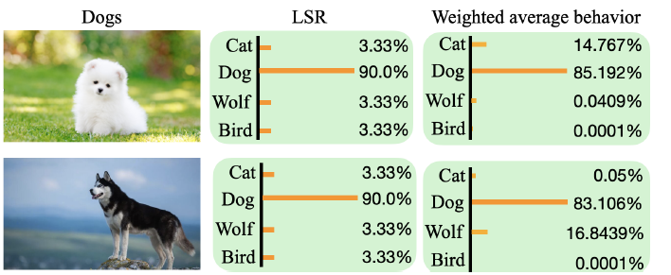
FER vs Label Smoothing Regularizer (LSR)
FER : ${\hat{b}}_{k}\left(x\right)=e^{−μc_{s_{j}}}{\hat{b}}_{k−1} \left(x\right)+\left(1−e^{−μc_{s_{j}}}\right)b_{s_{j}}(x)$
LSR:
$$y_{smooth}={\left(\frac{ε}{m},…,\frac{ε}{m},1−ε,\frac{ε}{m},…,\frac{ε}{m}\right)}^{T}$$
$${y_{hot}=\left(0,…,0,1,0,…,0\right)}^{T}$$
Notes:
Due to the body type differences, the dog in the
first row is more visually similar to a cat while the the dog in
the second row is more visually similar to a wolf. Different
from LSR that assigns them the same soft label, FER uses
the weighted average behavior that assigns different probabilities
to different classes.

Slide 18
Experiments - Can FER Reduce Flipping Errors?
Dataset
CIFAR-100, Stanford Dogs
Model
ResNet18, WRN-40-2, ShuffleNetV2, MobileNetV2
Metric
(Flipping Error) FE $=\frac{\# WFSs}{\# Test Samples}$
Why not RFE?
(Relative Flipping Error) RFE $=\frac{\# WFSs}{\# Misclassified Test Samples}$

Slide 19
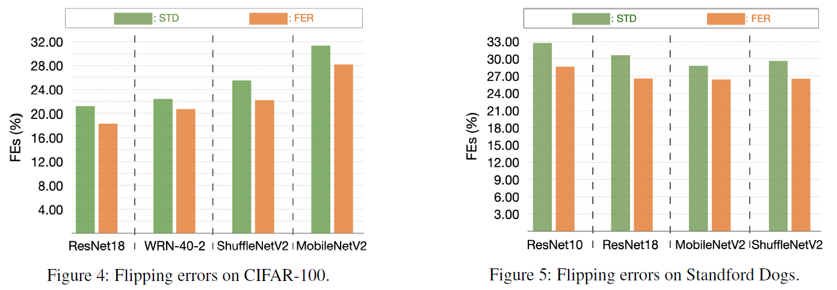
Experiments - Can FER Reduce Flipping Errors?

Slide 20
Experiments – Ablation Study
Strategies
FER
$$S_{2}:$$
$${\hat{b}}_{k}\left(x\right)=e^{−μc_{s_{j}}}{\hat{b}}_{k−1} \left(x\right)+\left(1−e^{−μc_{s_{j}}}\right)b_{s_{j}}(x)$$
$$ℒ_{cor}=αℒ_{CE}\left(x\right)+β⋅𝒦(σ\left(f(x)/τ\right),{\hat{b}}_{k}(x))$$
$$S_{1}:$$
$$ℒ_{FER}=1_{T(x)}ℒ_{cor}\left(x\right)+(1−1_{T(x)})ℒ_{CE}\left(x\right)$$
FER w/o $S_{1}$: ${\hat{b}}_{k}\left(x\right)=e^{−μc_{s_{j}}}{\hat{b}}_{k−1} \left(x\right)+\left(1−e^{−μc_{s_{j}}}\right)b_{s_{j}}\left(x\right), ℒ=ℒ_{cor}\left(x\right)$
FER w/o $S_{2}$: ${\hat{b}}_{k}\left(x\right)=b_{s_{j}}\left(x\right),ℒ_{FER}=1_{T(x)}ℒ_{cor}\left(x\right)+(1−1_{T(x)})ℒ_{CE}\left(x\right)$
LWR (without both): ${\hat{b}}_{k}\left(x\right)=b_{s_{j}}\left(x\right),ℒ=ℒ_{cor}\left(x\right)$
Notes:
using the weighted average of multiple correct behaviors instead of one single behavior to restrict a DNN.

Slide 21
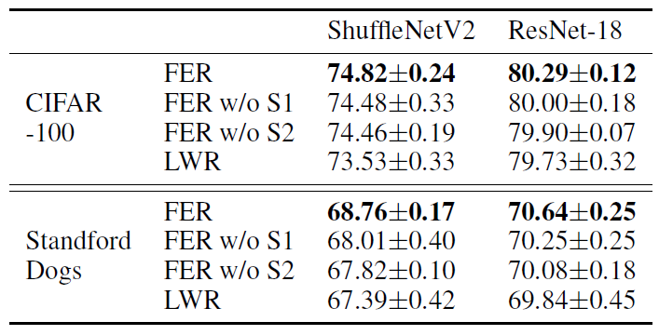
Experiments – Ablation Study
Strategies
Metric: “the performance on datasets”
Notes:
using the weighted average
of multiple correct behaviors instead of one single behavior
to restrict a DNN.

Slide 22
FER
Experiments – Ablation Study
$${\hat{b}}_{k}\left(x\right)=e^{−μc_{s_{j}}}{\hat{b}}_{k−1} \left(x\right)+\left(1−e^{−μc_{s_{j}}}\right)b_{s_{j}}(x)$$
Hyperparameters
$$ℒ_{cor}=αℒ_{CE}\left(x\right)+β⋅𝒦(σ\left(f(x)/τ\right),{\hat{b}}_{k}(x))$$
$$α=1−0.9\frac{k}{M}, β=0.9\frac{k}{M}$$
$$ℒ_{FER}=1_{T(x)}ℒ_{cor}\left(x\right)+(1−1_{T(x)})ℒ_{CE}\left(x\right)$$
Why?
$M:$ the number of total training epoch
Metric
“effects”

Slide 23
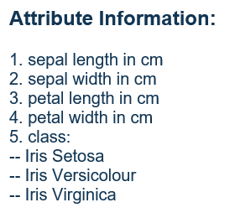
Experiments – Generalization of Models
Dataset
2 regular classification datasets: CIFAR-100, Tiny-ImageNet
3 fined-grained classification datasets: CUB-200-2011, Stanford Dogs, FGVC-Aircraft
2 tabular datasets: Arcene, Iris
Model
ResNet18, WRN-40-2, ShuffleNetV2, MobileNetV2
Compared Methods
Standard Training Procedure (STD), Label Smoothing Regularizer (LSR)
SD, CS-KD, TF-Reg
Max Entropy:
$$ℒ=ℒ_{CE}+H(b(x))$$
Metric
Test accuracy
Notes:
SD，CS-KD和TF-Reg是三种知识蒸馏的方法
Knowledge distillation is a learned label smoothing regularization

Slide 24
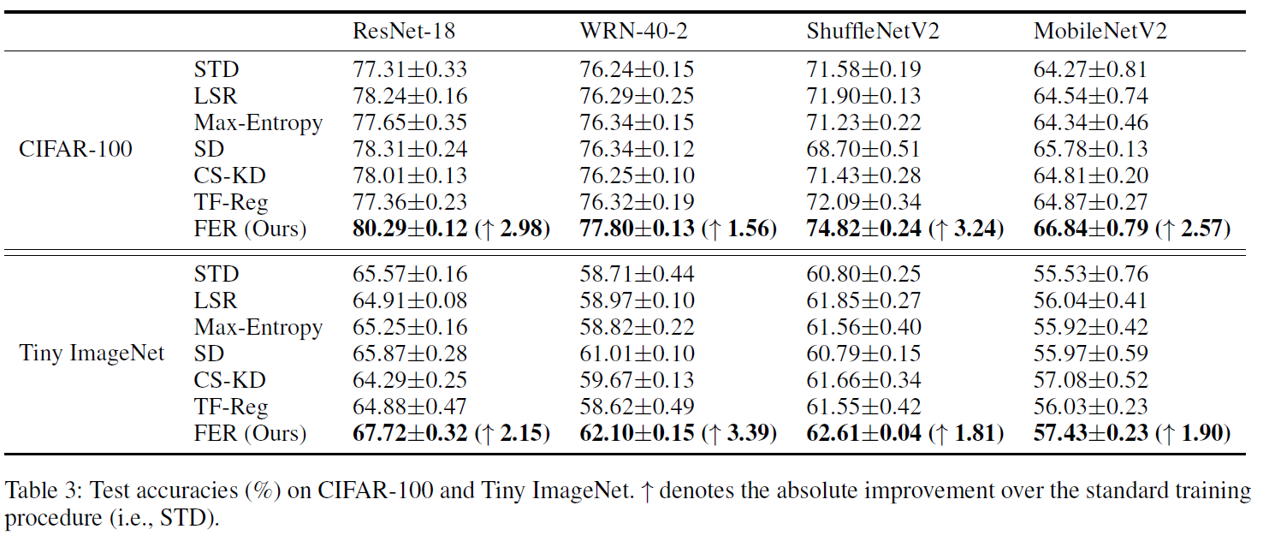
Experiments – Generalization of Models

Slide 25
Experiments – Robustness
We use the open-source implementation to replace 30%, 60%, and 80% of the training labels in CIFAR-100 by random noise to generate three different levels of noisy data.
Note that all the test labels are kept intact for evaluation.

Slide 26
Experiments – Transferability
Specifically, we first train ResNet-18 on CIFAR-100, and then freeze the feature encoder and train a linear classifier on STL-10 and Tiny ImageNet.
Notes:
STL-10
10 classes: airplane, bird, car, cat, deer, dog, horse, monkey, ship, truck.
It is inspired by the CIFAR-10 dataset but with some modifications. In particular, each class has fewer labeled training examples than in CIFAR-10, but a very large set of unlabeled examples is provided to learn image models prior to supervised training.

Slide 27
Comments
+ A novel observation
+ A new label smoothing method
+ Test FER on different types of benchmark datasets
Experiments are a little confusing
Just provide a weighted method, no why

