Slide 1
Stabilized Medical Image Attack
ICLR 2021 Spotlight
Gege Qi, Lijun GONG, Yibing Song, Kai Ma, Yefeng Zheng
Notes:
Lijun GONG, Yibing Song, Kai Ma, Yefeng Zheng：腾讯
gege Qi:PKU master
ICLR: 7 7 8

Slide 2
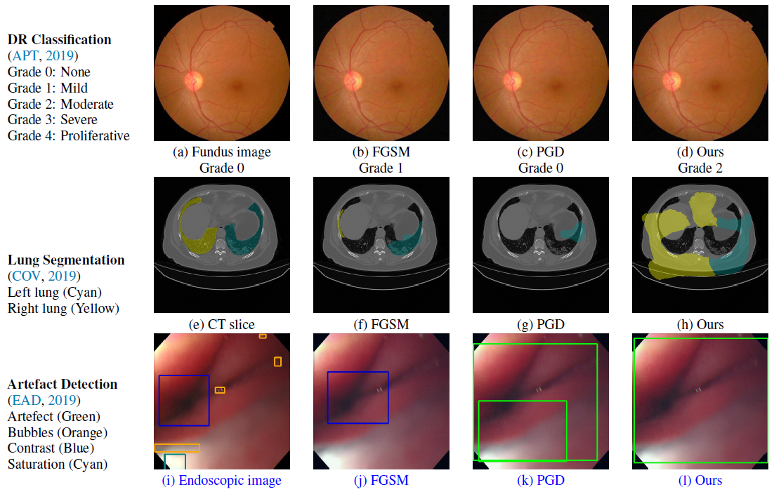
Motivation: Medical Images VS. Natural Images
Beyond regular RGB cameras, there are various types of medical imaging equipments.
√
Existing investigations on medical adversarial
attacks are limited.
√
√
Notes:
DR：：糖尿病性视网膜病变评分

Slide 3
Review
$$\tilde{x}=x+r$$
DNN: $f$
$$ℒ(f\left(θ,\tilde{x}\right),Y,⋯)$$
$$r=∇_{\tilde{x}}ℒ(f\left(θ,\tilde{x}\right),Y,⋯)$$

Slide 4
Proposed Method – Objective Function
$$ℒ_{SMIA}$$
a loss deviation term: $ℒ_{DEV}$
a loss stabilization term: $ℒ_{STA}$
Step 1:
$$ℒ_{DEV}=ℒ(f(θ,x),Y)$$
Step 2:
$$ℒ_{STA}=−ℒ(f(θ,x+η),f(θ,x+W∗η))$$
$$r=∇_{x}ℒ(f(θ,x),Y)$$
$W$ is a Gaussian kernel and convolves with the current perturbation
$$η=ε∙sign(r)$$
cross entropy loss
KL-Divergence
where $η^{′}=W∗η−η$

Slide 5
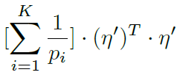
Proposed Method – $ℒ_{STA}$
$$G_{\tilde{x}}=$$
$$=\frac{1}{2}{\left(η^{′}\right)}^{T}(J^{T}G_{f}J)η^{′}$$
$$∝$$
minimize $D_{KL}⟺$ minimize $\sum_{i=1}^{K}{\frac{1}{p_{i}}}$ and minimize $({η^{′})}^{T}⋅η^{′}$
minimize $\sum_{i=1}^{K}{\frac{1}{p_{i}}}$: enforces the CNN prediction to update towards a constant vector $(\frac{1}{K},…,\frac{1}{K})$
minimize $({η^{′})}^{T}⋅η^{′}$: decreases the variances of $η^{′}$

Slide 6
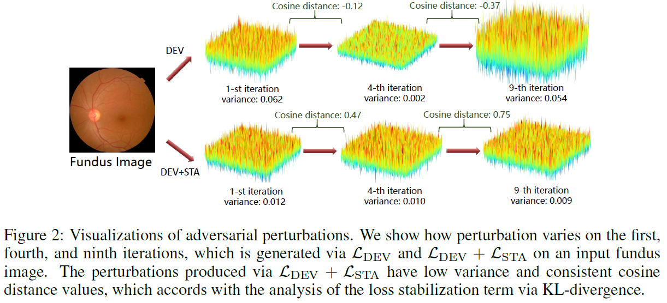
Proposed Method – $ℒ_{STA}$

Slide 7
Experiments-DataSets & Evaluation & Compared Methods
Diabetic Retinopathy Grading
APTOS-2019: 3,662 fundus images, 5 defined categories
Kaggle-DR: randomly select 11,000 fundus images from its original training set, 5 defined categories
Artefact Detection
EAD-2019: 2,500 images collected from endoscopic video frames and annotated artefact regions with seven defined categories.
Lung Segmentation
COVID-19: 20 CT scans for lungs infected by COVID-19.
ResNet50 integrated with GNN
mean accuracy
the multi-scale booster framework
IoU and mean Average Precision (mAP)
U-Net
mean accuracy and Jaccard index
Compared Methods
FGSM-2014, PGD-2017, DeepFool-2016, DAG-2017
Notes:
糖尿病性视网膜病变评分
眼底图像
内窥镜视频

Slide 8
Experiments-Ablation Study
Cos: the cosine distance between two consecutive perturbations (to calculate the similarity of directions in the CNN attack space)

Slide 9
Experiments-Comparisons with SOTA
Notes:
Meanwhile, we compute the variance of all the generated perturbations,
which is shown as “Var” in the results

Slide 10
Comments
+ The authors focus on medical images
+ $ℒ_{STA}$ is proposed
+ Enforcing perturbation directions consistent is interesting.
Motivation $→$ Proposed method ?
Why Gaussian smoothing?
Why perturbations with low variance are better?
The comparison methods are somewhat outdated.
Some conclusions have no theoretical analysis.

