Slide 1
延世大学

Slide 2
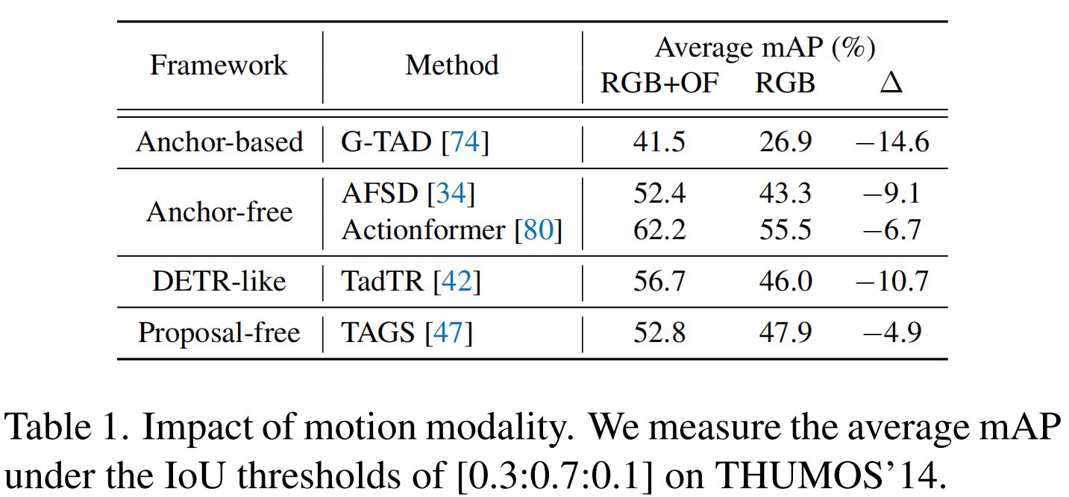
Problem
Most existing action detectors take as input two-stream data consisting of RGB frames and motion cues, e.g., optical flow. However, two-stream action detectors impose a cycle of dilemmas for real-world applications due to the heavy computational cost of motion modality.
Importance of two-stream:

Slide 3
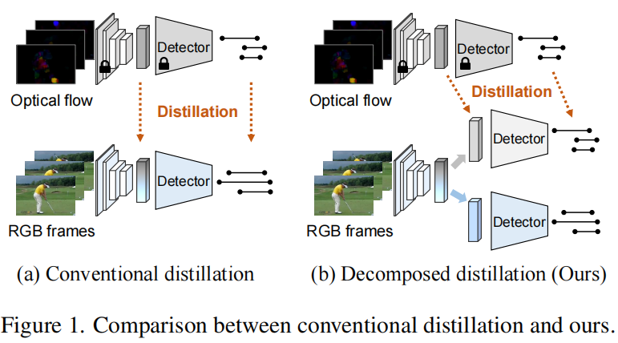
Solution
Only use RGB stream!!!
Specifically, build strong RGB-based action detectors by decomposed cross-modal knowledge distillation.
Why not directly knowledge distillation???
Difficult to learn (RGB and motion information are entangled with each other)

Slide 4
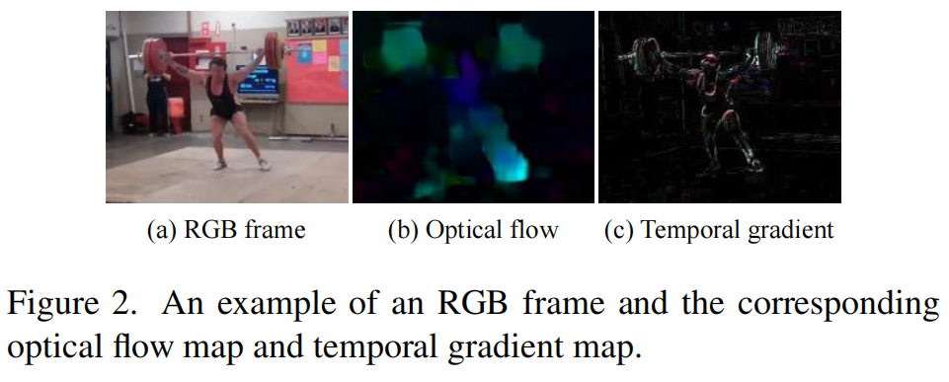
Tips
Temporal gradient: difference between two consecutive frames.
Distillation approaches:
1) The first approach utilizes the teacher’s predictions as pseudo-ground truths and encourages the student to mimic the behavior of the teacher.
2) The second approach encourages the matching of the intermediate features from the student and the teacher.

Slide 5
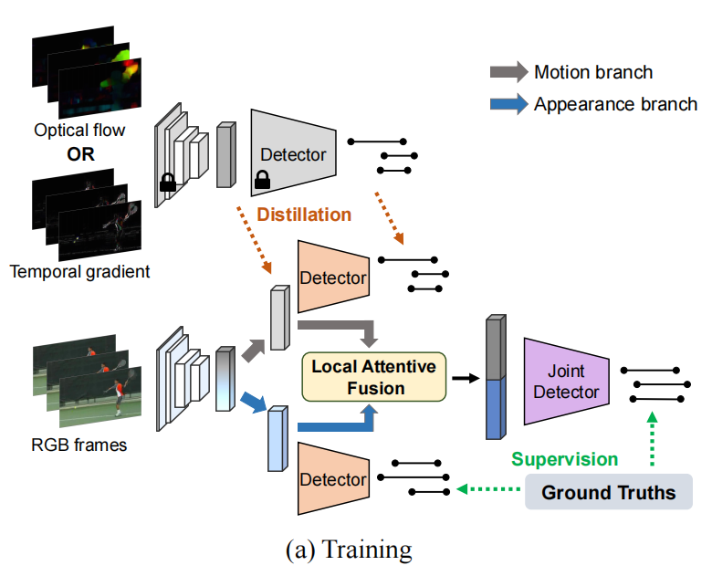
Method
Motion branch + Appearance branch

Slide 6
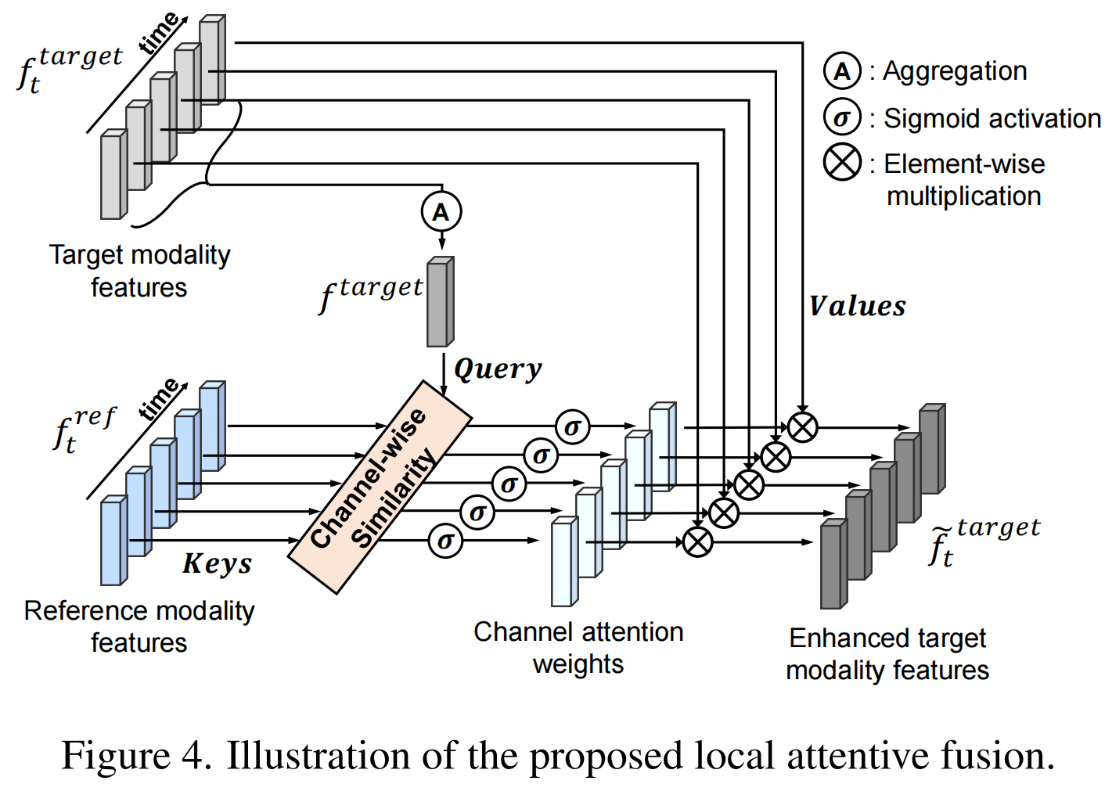
Local Attentive Fusion
Motion branch + Appearance branch
Find similarity in different modalities

Slide 7
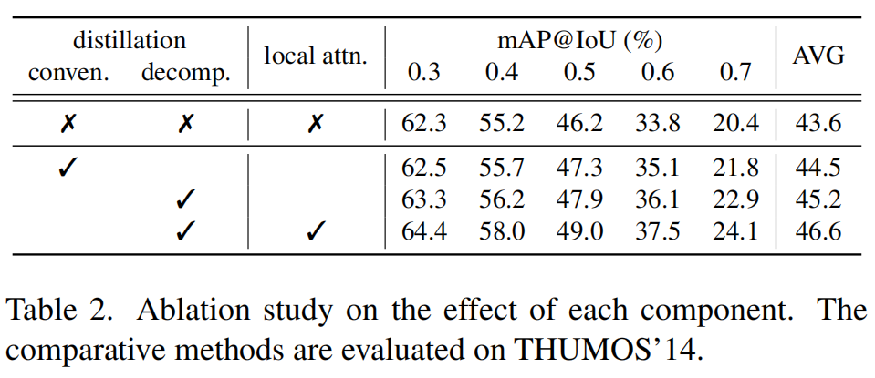
Experiments
Datasets: THUMOS’14 and ActivityNet1.3
Evaluation metrics: mAPs at different IOU
Backbone: TSM18
Detection head: Actionformer

Slide 8
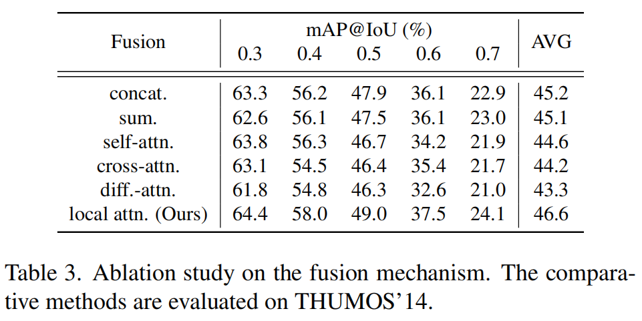
Experiments
a

Slide 9
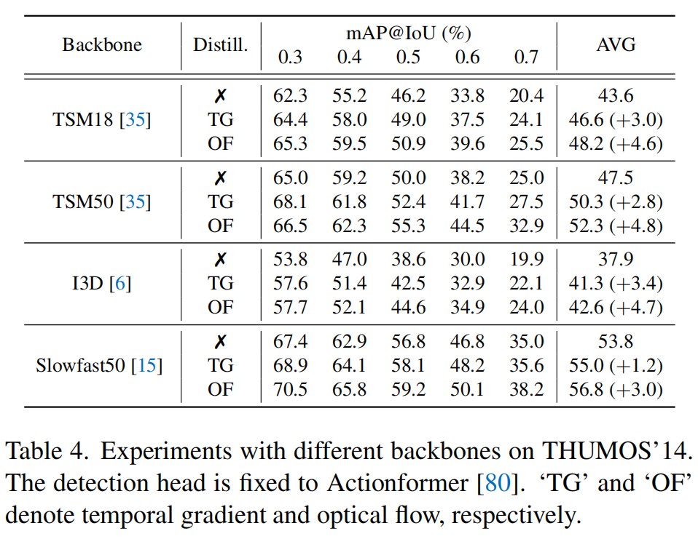
Experiments
a

Slide 10
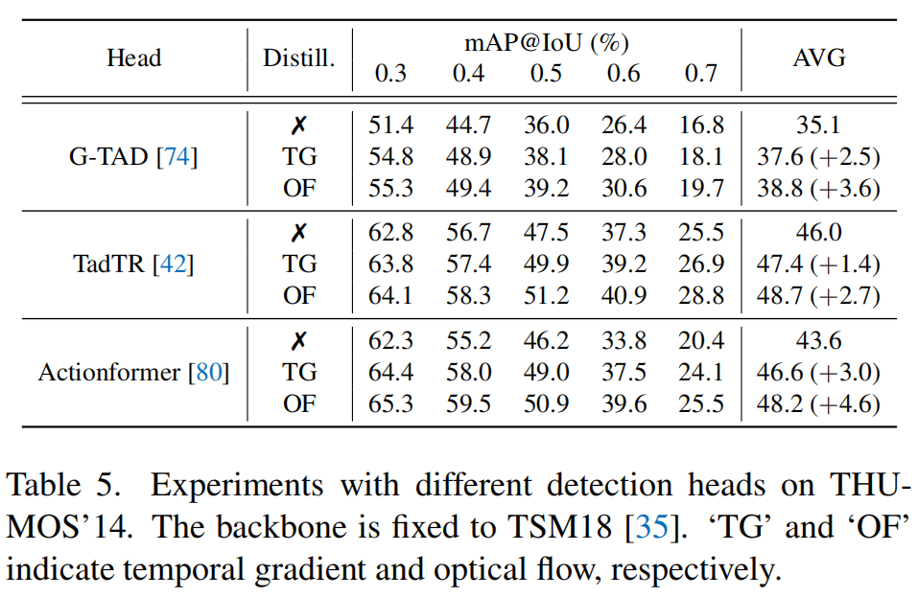
Experiments
a

Slide 11
Experiments
a
Tiny movements

Slide 12
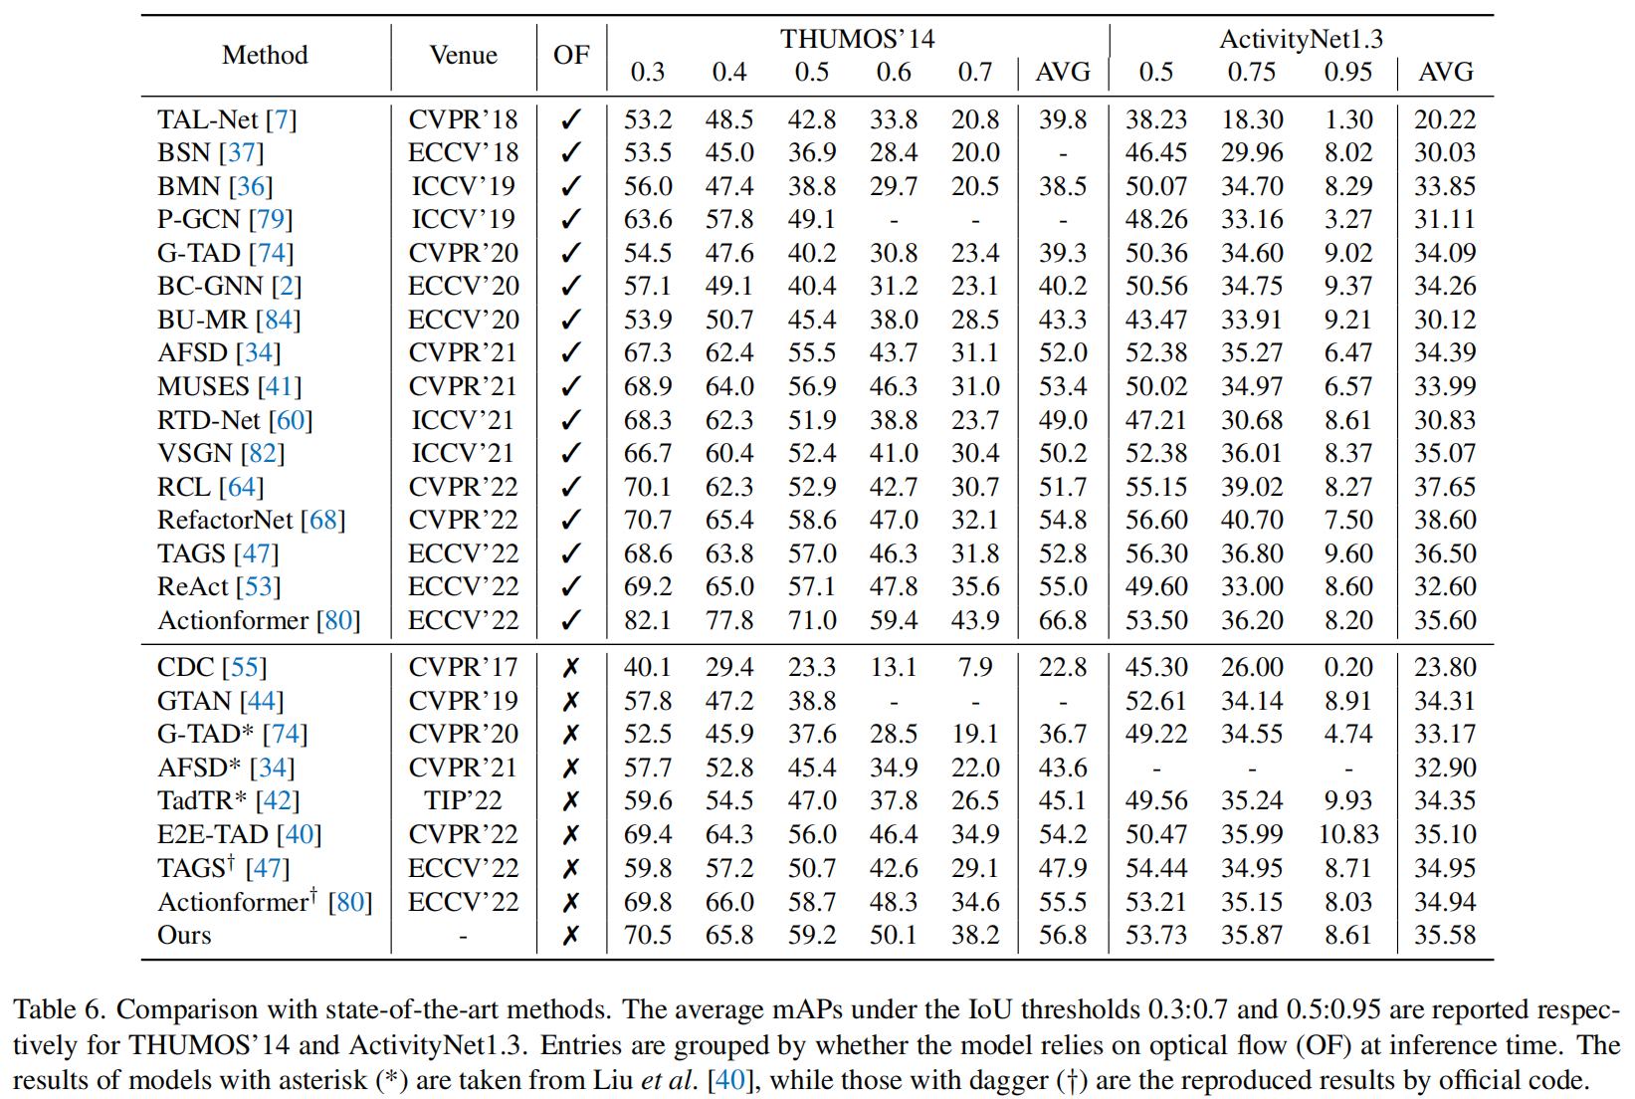
Experiments
a

Slide 13
Conclusion
+ 很好的模态缺失解决方法
+ 同样很好的模态融合方法
不想做模态融合的知识蒸馏论文不是好动作定位论文

Slide 14
Writing
Abstract
Temporal action detection aims to predict the time intervals and the classes of action instances in the video. Despite the promising performance, existing two-stream models exhibit slow inference speed due to their reliance on computationally expensive optical flow. In this paper, we introduce a decomposed cross-modal distillation framework to build a strong RGB-based detector by transferring knowledge of the motion modality. Specifically, instead of directdistillation, we propose to separately learn RGB and motionrepresentations, which are in turn combined to perform action localization. The dual-branch design and the asymmetric training objectives enable effective motion knowledge transfer while preserving RGB information intact. In addition, we introduce a local attentive fusion to better exploitthe multimodal complementarity. It is designed to preserve the local discriminability of the features that is important for action localization. Extensive experiments on the benchmarks verify the effectiveness of the proposed method in enhancing RGB-based action detectors. Notably, our framework is agnostic to backbones and detection heads, bringing consistent gains across different model combinations.
介绍动作定位任务目标

Slide 15
Writing
Abstract
Temporal action detection aims to predict the time intervals and the classes of action instances in the video. Despite the promising performance, existing two-stream models exhibit slow inference speed due to their reliance on computationally expensive optical flow. In this paper, we introduce a decomposed cross-modal distillation framework to build a strong RGB-based detector by transferring knowledge of the motion modality. Specifically, instead of directdistillation, we propose to separately learn RGB and motionrepresentations, which are in turn combined to perform action localization. The dual-branch design and the asymmetric training objectives enable effective motion knowledge transfer while preserving RGB information intact. In addition, we introduce a local attentive fusion to better exploitthe multimodal complementarity. It is designed to preserve the local discriminability of the features that is important for action localization. Extensive experiments on the benchmarks verify the effectiveness of the proposed method in enhancing RGB-based action detectors. Notably, our framework is agnostic to backbones and detection heads, bringing consistent gains across different model combinations.
提出目前框架存在问题：双流输入要求计算量太大！

Slide 16
Writing
Abstract
Temporal action detection aims to predict the time intervals and the classes of action instances in the video. Despite the promising performance, existing two-stream models exhibit slow inference speed due to their reliance on computationally expensive optical flow. In this paper, we introduce a decomposed cross-modal distillation framework to build a strong RGB-based detector by transferring knowledge of the motion modality. Specifically, instead of directdistillation, we propose to separately learn RGB and motionrepresentations, which are in turn combined to perform action localization. The dual-branch design and the asymmetric training objectives enable effective motion knowledge transfer while preserving RGB information intact. In addition, we introduce a local attentive fusion to better exploitthe multimodal complementarity. It is designed to preserve the local discriminability of the features that is important for action localization. Extensive experiments on the benchmarks verify the effectiveness of the proposed method in enhancing RGB-based action detectors. Notably, our framework is agnostic to backbones and detection heads, bringing consistent gains across different model combinations.
介绍解决办法：提出一个只依靠RGB输入的动作检测模型

Slide 17
Writing
Abstract
Temporal action detection aims to predict the time intervals and the classes of action instances in the video. Despite the promising performance, existing two-stream models exhibit slow inference speed due to their reliance on computationally expensive optical flow. In this paper, we introduce a decomposed cross-modal distillation framework to build a strong RGB-based detector by transferring knowledge of the motion modality. Specifically, instead of directdistillation, we propose to separately learn RGB and motionrepresentations, which are in turn combined to perform action localization. The dual-branch design and the asymmetric training objectives enable effective motion knowledge transfer while preserving RGB information intact. In addition, we introduce a local attentive fusion to better exploitthe multimodal complementarity. It is designed to preserve the local discriminability of the features that is important for action localization. Extensive experiments on the benchmarks verify the effectiveness of the proposed method in enhancing RGB-based action detectors. Notably, our framework is agnostic to backbones and detection heads, bringing consistent gains across different model combinations.
介绍详细实现细节：双分支、分支信息融合等等

Slide 18
Writing
Abstract
Temporal action detection aims to predict the time intervals and the classes of action instances in the video. Despite the promising performance, existing two-stream models exhibit slow inference speed due to their reliance on computationally expensive optical flow. In this paper, we introduce a decomposed cross-modal distillation framework to build a strong RGB-based detector by transferring knowledge of the motion modality. Specifically, instead of directdistillation, we propose to separately learn RGB and motionrepresentations, which are in turn combined to perform action localization. The dual-branch design and the asymmetric training objectives enable effective motion knowledge transfer while preserving RGB information intact. In addition, we introduce a local attentive fusion to better exploitthe multimodal complementarity. It is designed to preserve the local discriminability of the features that is important for action localization. Extensive experiments on the benchmarks verify the effectiveness of the proposed method in enhancing RGB-based action detectors. Notably, our framework is agnostic to backbones and detection heads, bringing consistent gains across different model combinations.
介绍实验结果：挺不错的

Slide 19
Writing
Abstract
Temporal action detection aims to predict the time intervals and the classes of action instances in the video. Despite the promising performance, existing two-stream models exhibit slow inference speed due to their reliance on computationally expensive optical flow. In this paper, we introduce a decomposed cross-modal distillation framework to build a strong RGB-based detector by transferring knowledge of the motion modality. Specifically, instead of directdistillation, we propose to separately learn RGB and motionrepresentations, which are in turn combined to perform action localization. The dual-branch design and the asymmetric training objectives enable effective motion knowledge transfer while preserving RGB information intact. In addition, we introduce a local attentive fusion to better exploitthe multimodal complementarity. It is designed to preserve the local discriminability of the features that is important for action localization. Extensive experiments on the benchmarks verify the effectiveness of the proposed method in enhancing RGB-based action detectors. Notably, our framework is agnostic to backbones and detection heads, bringing consistent gains across different model combinations.
指明方法泛用性：对骨干网络和检测头没有特殊要求

Slide 20
Writing
Introduction
With the popularization of mobile devices, a significant number of videos are generated, uploaded, and shared every single day through various online platforms such as YouTube and TikTok. Accordingly, there arises the importance of automatically analyzing untrimmed videos. As one of the major tasks, temporal action detection (or localization) [56] has attracted much attention, whose goal is to find the time intervals of action instances in the given video. In recent years, a lot of efforts have been devoted to improving the action detection performance [28–30, 36, 37, 74, 79, 84].
Most existing action detectors take as input two-stream data consisting of RGB frames and motion cues, e.g., optical flow [21, 66, 78]. Indeed, it is widely known that different modalities provide complementary information [6, 24, 58, 69]. To examine how much two-stream action detectors rely on the motion modality, we conduct an ablative study using a set of representative models. As shown in Table 1, regardless of the framework types, all the models experience sharp performance drops when the motion modality is absent, probably due to the static bias of video models [11, 27, 31, 32]. This indicates that explicit motion cues are essential for accurate action detection.
开头先介绍现在视频越来越多，动作定位越来越重要，相关工作进展的也不错

Slide 21
Writing
Introduction
With the popularization of mobile devices, a significant number of videos are generated, uploaded, and shared every single day through various online platforms such as YouTube and TikTok. Accordingly, there arises the importance of automatically analyzing untrimmed videos. As one of the major tasks, temporal action detection (or localization) [56] has attracted much attention, whose goal is to find the time intervals of action instances in the given video. In recent years, a lot of efforts have been devoted to improving the action detection performance [28–30, 36, 37, 74, 79, 84].
Most existing action detectors take as input two-stream data consisting of RGB frames and motion cues, e.g., optical flow [21, 66, 78]. Indeed, it is widely known that different modalities provide complementary information [6, 24, 58, 69]. To examine how much two-stream action detectors rely on the motion modality, we conduct an ablative study using a set of representative models. As shown in Table 1, regardless of the framework types, all the models experience sharp performance drops when the motion modality is absent, probably due to the static bias of video models [11, 27, 31, 32]. This indicates that explicit motion cues are essential for accurate action detection.
逐渐深入主题
说明目前大部分动作定位网络都用双流输入，并通过表格说明双流的重要性

Slide 22
Writing
Introduction
However, two-stream action detectors impose a cycle of dilemmas for real-world applications due to the heavy computational cost of motion modality. For instance, the most popular form of motion cues for action detection, TV-L1 optical flow [66], is not real-time, taking 1.8 minutes to process a 1-min 224 × 224 video of 30 fps on a single GPU [58]. Although cheaper motion clues such as temporal gradient [63, 70, 85] can be alternatives, two-stream models still exhibit inefficiency at inference by doubling the network forwarding process. Therefore, it would be desirable to build strong RGB-based action detectors that can bridge the performance gap with two-stream methods.
抛出问题所在
双流输入中的光流计算量太大了，并且举出实际例子说明即使是离线推理光流的计算也相当费时间

Slide 23
Writing
Introduction
However, two-stream action detectors impose a cycle of dilemmas for real-world applications due to the heavy computational cost of motion modality. For instance, the most popular form of motion cues for action detection, TV-L1 optical flow [66], is not real-time, taking 1.8 minutes to process a 1-min 224 × 224 video of 30 fps on a single GPU [58]. Although cheaper motion clues such as temporal gradient [63, 70, 85] can be alternatives, two-stream models still exhibit inefficiency at inference by doubling the network forwarding process. Therefore, it would be desirable to build strong RGB-based action detectors that can bridge the performance gap with two-stream methods.
继续强调问题严重性
即使光流可以被时间梯度替代，但计算量还是相对单RGB输入要大

Slide 24
Writing
Introduction
However, two-stream action detectors impose a cycle of dilemmas for real-world applications due to the heavy computational cost of motion modality. For instance, the most popular form of motion cues for action detection, TV-L1 optical flow [66], is not real-time, taking 1.8 minutes to process a 1-min 224 × 224 video of 30 fps on a single GPU [58]. Although cheaper motion clues such as temporal gradient [63, 70, 85] can be alternatives, two-stream models still exhibit inefficiency at inference by doubling the network forwarding process. Therefore, it would be desirable to build strong RGB-based action detectors that can bridge the performance gap with two-stream methods.
给出解决办法
知识蒸馏一个单RGB输入的模型出来

Slide 25
Writing
Introduction
To this end, we focus on cross-modal knowledge distillation [12,16], where the helpful knowledge of motion modality is transferred to an RGB-based action detector during training in order to improve its performance. In contrast to conventional knowledge distillation [19, 20, 46, 52] where the superior teacher guides the weak student, cross-modal distillation requires exploiting the complementarity of the teacher and student. However, existing cross-modal distillation approaches [12,13] fail to consider the difference and directly transfer the motion knowledge to the RGB model (Fig. 1a), as conventional distillation does. By design, the RGB and motion information are entangled with each other, making it difficult to balance between them. As a result, they often achieve limited gains without careful tuning.
具体介绍方法
提出一个交叉知识蒸馏模型

Slide 26
Writing
Introduction
To this end, we focus on cross-modal knowledge distillation [12,16], where the helpful knowledge of motion modality is transferred to an RGB-based action detector during training in order to improve its performance. In contrast to conventional knowledge distillation [19, 20, 46, 52] where the superior teacher guides the weak student, cross-modal distillation requires exploiting the complementarity of the teacher and student. However, existing cross-modal distillation approaches [12,13] fail to consider the difference and directly transfer the motion knowledge to the RGB model (Fig. 1a), as conventional distillation does. By design, the RGB and motion information are entangled with each other, making it difficult to balance between them. As a result, they often achieve limited gains without careful tuning.
说明为什么不用传统蒸馏模型
传统蒸馏让学生模型从RGB输入中同时学静态信息和动态信息，它能学吗，没这个能力知道吧

Slide 27
Writing
Introduction
To tackle the issue, we introduce a novel framework, named decomposed cross-modal distillation (Fig. 1b). In detail, our model adopts the split-and-merge paradigm, where the high-level features are decomposed into appearance and motion components within a dual-branch design. Then only the motion branch receives the distillation signal, while the other branch remains intact to learn appearance information. For explicit decomposition, we adopt the shared detection head and the asymmetric objective functions for the branches. Moreover, we design a novel attentive fusion to effectively combine the multimodal information provided by the two branches. In contrast to existing attention methods, the proposed fusion preserves local sensitivity which is important for accurate action detection. With these key components, we build a strong action detector that produces precise action predictions given only RGB frames.
介绍模型实现细节
双分支，一个分支蒸馏，一个分支正常监督

Slide 28
Writing
Introduction
To tackle the issue, we introduce a novel framework, named decomposed cross-modal distillation (Fig. 1b). In detail, our model adopts the split-and-merge paradigm, where the high-level features are decomposed into appearance and motion components within a dual-branch design. Then only the motion branch receives the distillation signal, while the other branch remains intact to learn appearance information. For explicit decomposition, we adopt the shared detection head and the asymmetric objective functions for the branches. Moreover, we design a novel attentive fusion to effectively combine the multimodal information provided by the two branches. In contrast to existing attention methods, the proposed fusion preserves local sensitivity which is important for accurate action detection. With these key components, we build a strong action detector that produces precise action predictions given only RGB frames.
介绍模型实现细节
为了防止模型偷懒，只改变检测头参数以应对两个分支的训练，共享两个分支检测头的参数

Slide 29
Writing
Introduction
To tackle the issue, we introduce a novel framework, named decomposed cross-modal distillation (Fig. 1b). In detail, our model adopts the split-and-merge paradigm, where the high-level features are decomposed into appearance and motion components within a dual-branch design. Then only the motion branch receives the distillation signal, while the other branch remains intact to learn appearance information. For explicit decomposition, we adopt the shared detection head and the asymmetric objective functions for the branches. Moreover, we design a novel attentive fusion to effectively combine the multimodal information provided by the two branches. In contrast to existing attention methods, the proposed fusion preserves local sensitivity which is important for accurate action detection. With these key components, we build a strong action detector that produces precise action predictions given only RGB frames.
介绍模型实现细节
局部加权的两分支信息融合方式

Slide 30
Writing
Introduction
We conduct extensive experiments on the popular benchmarks, THUMOS’14 [22] and ActivityNet1.3 [4]. Experimental results show that the proposed framework enables effective cross-modal distillation by separating the RGB and motion features. Consequently, our model largely improves the performance of RGB-based action detectors, exhibiting its superiority over conventional distillation. The resulting RGB-based action detectors effectively bridge the gap with two-stream models. Moreover, we validate our approach by utilizing another motion clue, i.e., temporal gradient, which has been underexplored for action detection.
To summarize, our contributions are three-fold: 1) We propose a decomposed cross-modal distillation framework, where motion knowledge is transferred in a separate way such that appearance information is not harmed. 2) We design a novel attentive fusion method that is able to exploit the complementarity of two modalities while sustaining the local discriminability of features. 3) Our method is generalizable to various backbones and detection heads, showing consistent improvements.
介绍实验结果
单输入模型的性能比肩双流输入

Slide 31
Writing
Introduction
We conduct extensive experiments on the popular benchmarks, THUMOS’14 [22] and ActivityNet1.3 [4]. Experimental results show that the proposed framework enables effective cross-modal distillation by separating the RGB and motion features. Consequently, our model largely improves the performance of RGB-based action detectors, exhibiting its superiority over conventional distillation. The resulting RGB-based action detectors effectively bridge the gap with two-stream models. Moreover, we validate our approach by utilizing another motion clue, i.e., temporal gradient, which has been underexplored for action detection.
To summarize, our contributions are three-fold: 1) We propose a decomposed cross-modal distillation framework, where motion knowledge is transferred in a separate way such that appearance information is not harmed. 2) We design a novel attentive fusion method that is able to exploit the complementarity of two modalities while sustaining the local discriminability of features. 3) Our method is generalizable to various backbones and detection heads, showing consistent improvements.
贡献总结
1. 提出分解式知识蒸馏框架
2. 提出两分支信息的局部加权融合方式
3. 方法对骨干网络和检测头没要求

