Slide 1
Difficulty-Aware Attention Network with
Confidence Learning for Medical Image Segmentation
AAAI2019 Poster
2020/4/24

Slide 2
Motivation
(1) Deep neural networks often only perform good on regular samples (i.e., easy-to-segment samples), since the datasets are dominated by easy and regular samples.
(2) For medical images, due to huge inter-subject variations or disease-specific effects on subjects, there exist several difficult-to-segment cases that are often overlooked by the previous works.

Slide 3
Main Contribution
(1) A fully convolutional adversarial network for confidence learning is proposed to provide voxel-wise and region-wise confidence information for the segmentation network.
(2) A difficulty-aware attention mechanism is proposed to properly handle hard samples or hard regions considering structural information, which may go beyond the shortcomings of focal loss.

Slide 4
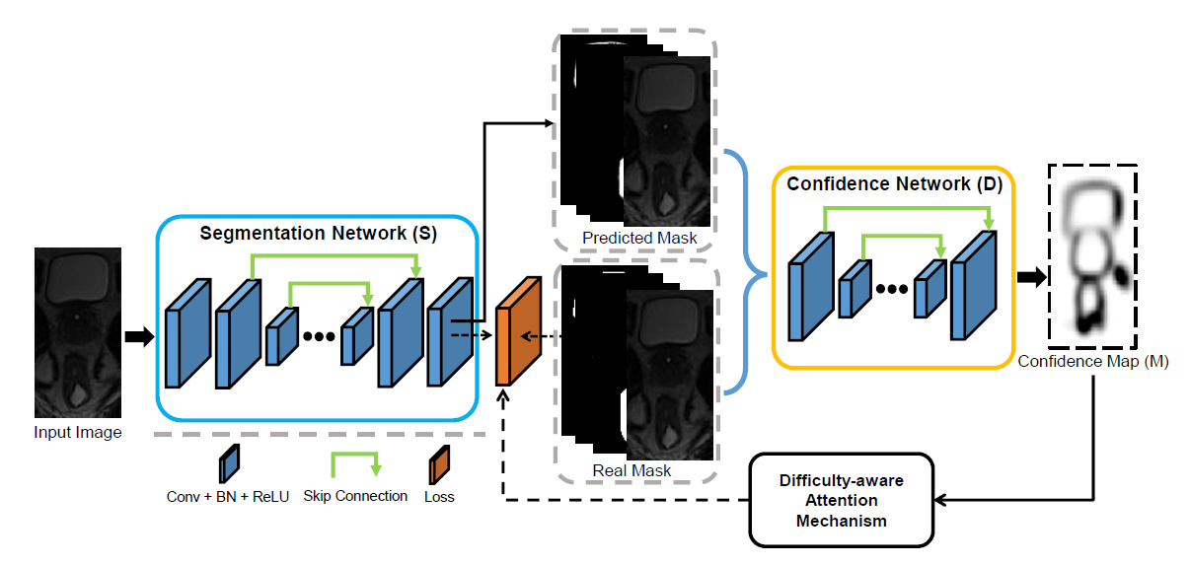
Network Architecture
Notes:
The goal of confidence network is inspired by the concept of adversarial learning, to learn how well the local regions are segmented (i.e., the output confidence map can provide the trustworthy and untrustworthy regions in the segmented label map).
Based on the confidence map, difficulty-aware attention mechanism to adaptively assign region-level and voxel-level importance
for training the network.

Slide 5
Hybrid loss for segmentation network
Notes:
P is generated by converting the label map Y into C binary label maps with one-hot encoding

Slide 6
The problems of focal loss
（1）Training may be unstable due to the dominance of a certain class.
（2）Easy and hard samples may also have similar focal weights due to the potential multi-class competition.
（3）focal loss only provides voxel-level attention and ignores region-level attention.
（4）Only predicted mask may not really indicate the hard regions without considering the original input image of the segmentation network.
Notes:
Besides the two loss functions, the authors want to tackle the hard example problems.
Although focal loss has been shown effective to alleviate the overwhelming effect of easy samples in many computer vision tasks, there’re some problems.

Slide 7
Difficulty-Aware Attention Mechanism
Notes:
Inspired by focal loss, the authors improve the loss function in region-level and voxel-level
To the r power
Dsc is the average Dice similarity coefficient of a specific category, so it means that for each class, the segmentation result will be feedback to the loss functions.
M is the confidence map

Slide 8
Adversarial loss of the segmentation network
Final loss for segmentation network
Notes:
The goal of the adversarial loss is to fool the confidence network, and let it fail to discriminate the predicted segmentation map from the groundtruth map

Slide 9
Loss for confidence network
Notes:
The authors utilize an adversarial loss to enable the confidence network to successfully discriminate the predicted mask and the real groundtruth mask

Slide 10
Experiments
Dataset:
（1）Pelvic Dataset
50 patients, MRI scans of prostate, bladder, rectum
Five-fold cross-validation, 35 training, 5 validation, 10 testing
（2）MR Brain Challenge Dataset
（3）Prostate Challenge Dataset

Slide 11
Evaluation Metrics
（1）Dice Similarity Coefficient (DSC)
（2）Average Surface Distance (ASD)

Slide 12
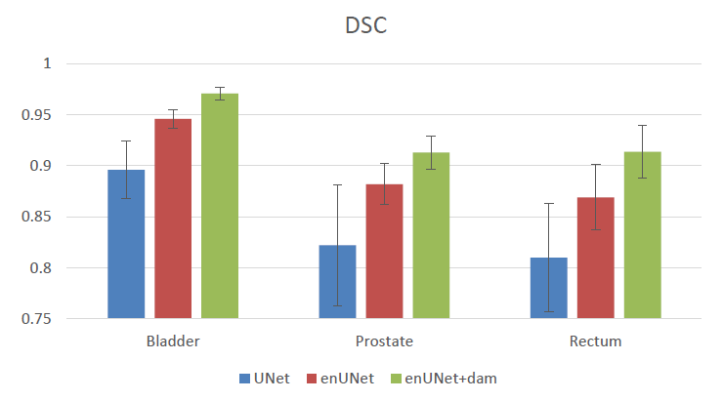
Ablation Study

Slide 13
Pelvic Dataset

Slide 14
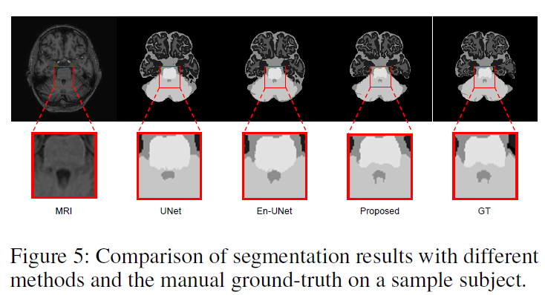
MR Brain Challenge Dataset
3.5% improvement of DSC

Slide 15
Prostate Challenge Dataset
Notes:
DSC, the average over the shortest distance between the boundary (surface) points of the volumes (ABD or ASD), the 95% Hausdorff distance (95HD), and the percentage of the absolute difference between the volumes (aRVD)

Slide 16
Conclusion
Confidence information is provided by the adversarial learning of the network.
Difficulty-aware attention mechanism is interesting and novel for the medical image processing task, and successfully focus on the hard region and voxel, which further improves the performance.

