Slide 1
CVPR2022

Slide 2
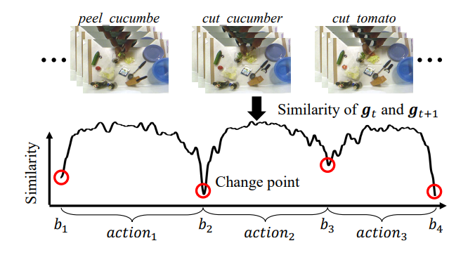
Motivation
For action segmentation, the ideal features should be consistent within an action and inconsistent across different actions. Therefore, we pinpoint temporal action boundary proposals based on the similarity between adjacent frames.

Slide 3
Motivation
For action segmentation, the ideal features should be consistent within an action and inconsistent across different actions. Therefore, we pinpoint temporal action boundary proposals based on the similarity between adjacent frames.
Due to the occlusion, changing viewpoint or lighting, the features within an action may fail to maintain strictly consistent as expected. Therefore, we first utilize a smoothing filter on original features to dilute the effect of noise.

Slide 4
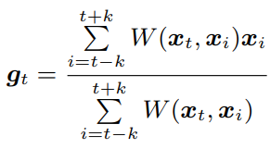
Method
Smoothing filters along the temporal dimension to mitigate the noise for action boundary detection
Calculating the cosine similarity between adjacent frames in the temporal dimension

Slide 5
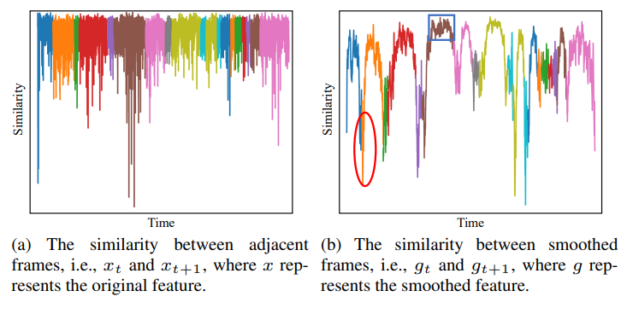
Method
Smoothing filters along the temporal dimension to mitigate the noise for action boundary detection

Slide 6
Method
Red Box: To account for these spurious responses near boundaries, we utilize the NMS algorithm to reduce them.
Blue Box: To deal with these spurious responses, we propose a bottom-up refinement to cluster these segments. Cluster M segments to K classes.

Slide 7
Method
Online Action Boundary Detection:
Smoothing features only using previous frames.
Centering NMS window at (t-L/2).
No cluster. Turning cluster into a threshold.

Slide 8
Experiment
Breakfast: The dataset contains 1,712 videos, of which the lengths vary from a few seconds to several minutes. The dataset contains 48 different actions for breakfast preparation where every video has 6.9 actions on average.
YouTube Instructional Videos: The dataset contains 150 videos and the average length is around 2 minutes. There are 5 activities in this dataset. The fraction of background is around 63.5%, which is the largest one in these four datasets.
Hollywood Extended: The dataset has 937 video sequences with around 800,000 frames in total. The videos contain 16 different classes, and each video has about 2.5 action instances. There are roughly 61% background frames.
50Salads: The dataset contains 4.5 hours of different people making salads and each video has about 10k frames on average.

Slide 9
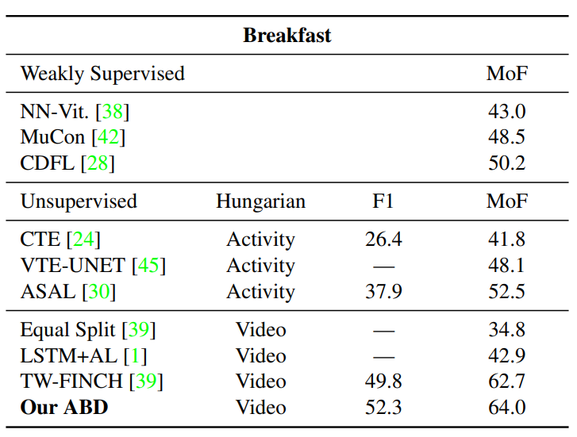
Experiment
37.7%/51.3%

Slide 10
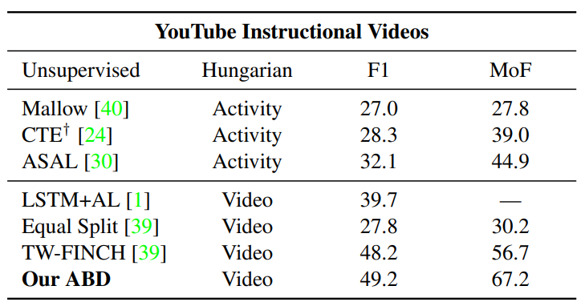
Experiment

Slide 11
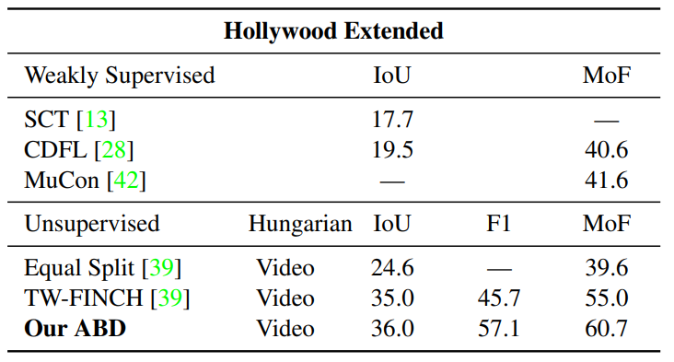
Experiment

Slide 12
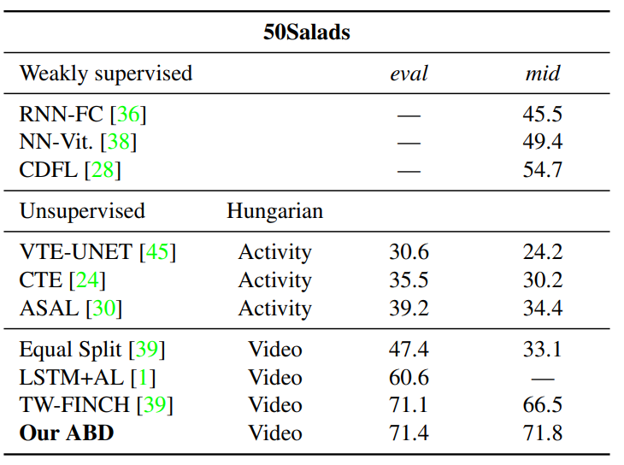
Experiment
64.2% 59.2%

Slide 13
Experiment

Slide 14
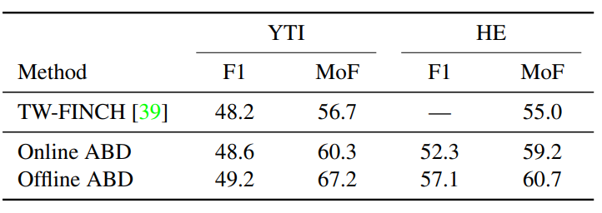
Experiment

Slide 15
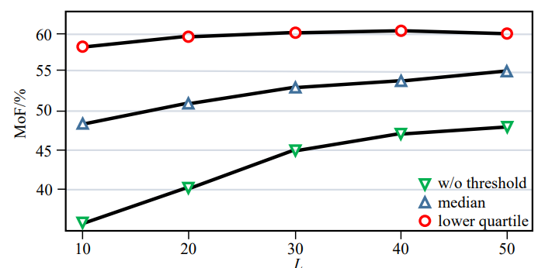
Experiment

Slide 16
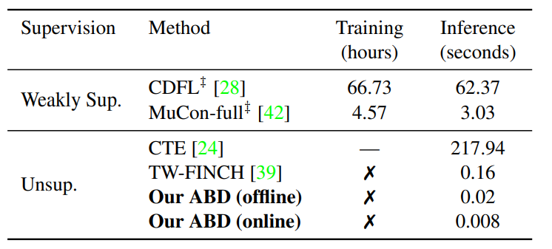
Experiment

Slide 17
Conclusion
Fast and efficient Baseline generation method;
Pseudo-label generation method.

